Slide 1
Victims Services
Quarterly Conversation
#23
April 11, 2024

Slide 2
VS Quarterly Conversations
Held beginning of each quarter
Mix of specific topics & discussion items
DCJS & VS announcements
Q&A
*NEW* “Tools-You-Can-Use”
*NEW* “Featured Resource”

Slide 3


Sexual Assault Awareness Month 2024
Building Connected Communities

Slide 4

National Child Abuse Prevention Month
Building A Hopeful Future Together

Slide 5

National Crime Victims’
Rights Week

Slide 6
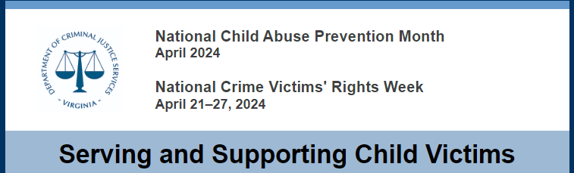
DCJS Victims Services Resources
https://conta.cc/4cEwPfi

Slide 7
Tools-You-Can-Use

Slide 8
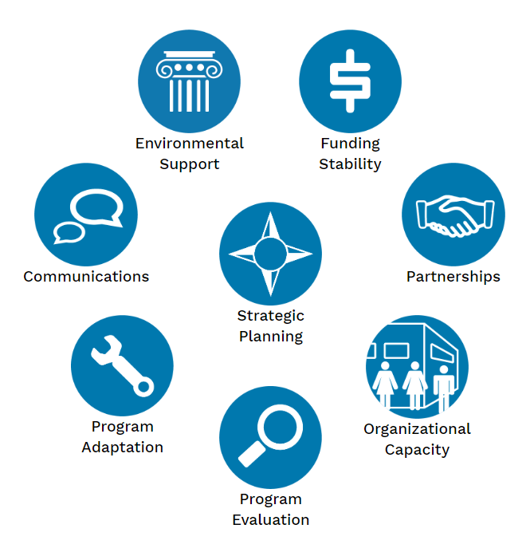
Program Sustainability Assessment Tool (PSAT)
A Sustainability Framework with eight domains that can help build capacity for maintaining a program.
https://sustaintool.org/psat/assess/

Slide 9
DCJS & Victims Services Team
Announcements

Slide 10
Victims Crisis Assistance & Response Team
(VCART)
Join the team! Our next Basic VCART training is being held in Radford on July 10-12, 2024.
Coming soon:
  VCART Family Assistance Center (FAC) Planning Regional Workshops for VWP, emergency managers, CSBs, and other key agencies.
  Advanced Crisis Response Team Training scheduled for September 9-11, 2024. More info to come...
To request a training on VCART for your staff, contact Dawn Bush at dawn.bush@dcjs.virginia.gov.
To learn more about VCART and/or becoming a member, contact Andrew Kinch at andrew.kinch@dcjs.virginia.gov.

Slide 11
SDV Program Professional Standards
The Professional Standards Committee met on 2/14/24 to continue the process of revising the Professional Standards. It is anticipated that the revised Manual will be finalized at the next meeting scheduled for 5/8/24.
The Professional Standard Team expects to hold information sessions regarding the revised Standards and the Guidelines for Processes and Procedures in July.
The Team is currently evaluating seven agencies for accreditation.

Slide 12
State Trafficking Response Team
Upcoming In-Person Training
Sexual Exploitation Treatment and Training Services (SETTS)
  April 22–26 in Richmond
Human Trafficking Victim Identification for Law Enforcement
  May 22 in Fredericksburg
  May 23 in Ashburn
Human Trafficking Investigations and Prosecutions
  April 29–30 in Williamsburg

Slide 13
TRI-SAVI Training
Trauma-Responsive Investigations and Sexual Assault Victim Interviews (TRI-SAVI)
June 25 – 28, 2024
Alexandria, VA
A 4-day intensive course for law enforcement officers, prosecutors, and victim advocates to enhance investigations and prosecutions of adult sexual assault.
https://www.dcjs.virginia.gov/training-events/trauma-responsive-investigations-and-sexual-assault-6

Slide 14
DCJS is Hiring!
Our DCJS Grants Management Team is hiring.
Please spread the word!
Grants Administration Manager
https://www.jobs.virginia.gov/jobs/grants-administration-manager-richmond-virginia-united-states

Slide 15

Questions?

Slide 16
Victims Services
Grant Management Reminders

Slide 17
Grant Management
Successful grant management begins and ends with a firm understanding of the grant requirements and the ability to demonstrate compliance with those requirements.

Slide 18
OGMS Reminders
Registration
Dashboard Alerts
  Add to your Safe Sender List: VAgrantsDCJS@mail.webgrantscloud.com
  Check Alert History
Grant Components
Technical Assistance: ogmssupport@dcjs.virginia.gov
Resources: OGMS Training & Resources | Virginia Department of Criminal Justice Services

Slide 19
OGMS Grant Components
General Information
Claims
Contract Amendments
Contract Document
Correspondence
Encumbrances
Status Reports
Other

Slide 20
Budget Modification Due Dates
This is the time to check your grant spend-down.
If necessary, budget amendments must be submitted 45 days or more before the end of the grant award period.
In-line budget revisions must be submitted no less than two weeks before the end of the award period.
Submit requests, in advance of the deadline, with sufficient lead time for review and approval.
For SFY 24 grant programs (ARPA, VSDVVF, VSGP, VWGP) the BA deadline is May 17, 2024.
Click here for the budget amendment desk tool which includes definitions, guidance, and sample language.

Slide 21
Suitability to Work with Minors
Special Condition Reminder
Determination of suitability required, in advance, for certain individuals who may interact with participating minors
The recipient (and any subrecipient at any tier) may not permit any covered individual to interact with any participating minor in the course of activities under the award, unless the recipient or subrecipient first has made a written determination of the suitability of that individual to interact with participating minors
The full text and details of this special condition are posted at:
https://ojp.gov/funding/Explore/Interact-Minors.htm
https://www.justice.gov/ovw/award-conditions
https://www.dcjs.virginia.gov/victims-services/grant-management-resources

Slide 22
Grant Management Resources
For instructional guides, sample forms, policies, documents and more, please visit the following page: Grant Management Resources | Virginia Department of Criminal Justice Services
For tips on effective and efficient grant management, view the following presentation: https://www.youtube.com/watch?v=oS1c7101XO8
For questions regarding your DCJS grant, contact your assigned grant monitor.

Slide 23
Grantee Orientation
DCJS Victims Services Grant Management Orientation
Occurs on the 2nd Friday of each month
Next Session:
Friday, April 12, 2024, 1:00 -2:30 P.M.
Register in advance:
https://us02web.zoom.us/webinar/register/WN_0GCu3fb5SZC2j0gCAWvZkQ

Slide 24
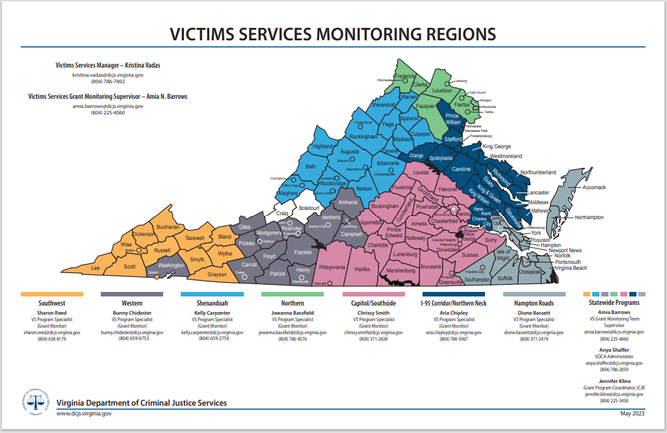

Slide 25
VSQC
Featured Resource
*This does not indicate an endorsement by DCJS or the DCJS Victims Services Team.

Slide 26

“Safe Stays” Program
https://www.reloshare.com/products/safe-stays
1-minute intro video
Notes:
There is still a lot that’s unknown!

Slide 27

“Safe Stays” Program
Notes:
There is still a lot that’s unknown!

Slide 28
Victims Services
Grant Program
Announcements

Slide 29
DCJS Victims Services Grant Programs as of January 1, 2024
Sexual Assault Services Program (SASP)
Victim Witness Grant Program (VWGP)
Victims Services Grant Program (VSGP)
VSTOP
Virginia Sexual & Domestic Violence Victim Fund (VSDVVF)
Improving Criminal Justice Responses (ICJR)
American Rescue Plan Act (ARPA) VSGP Restoration

Slide 30
VS Grant Program Totals
Funding Source | Grant Program | Grant Cycle | Number of Awards | Total Amount (including match)
VOCA, SGF | Victims Services Grant Program (VSGP) | FY24 | 96 | $25,074,192
VOCA, SGF, SSF | Victim Witness Grant Program (VWGP) | FY24 | 114 | $18,049,364
Federal | American Rescue Plan Act (ARPA) VSGP Restoration | FY24 | 37 | $2,023,671
VAWA | Improving Criminal Justice Responses (ICJR) | FY24 | 4 | $277,339
VAWA | Sexual Assault Services Program (SASP) | CY24 | 31 | $990,597
VAWA | Sexual Assault Services Program (SASP) (one-time special funding opportunity) | FY24 | 14 | $276,028
VAWA | VSTOP | CY24 | 85 | $4,597,608
SGF, SSF | Virginia Sexual & Domestic Violence Victim Fund (VSDVVF) (Disc. & Prosecution) | FY24 | 43 | $1,785,333
SGF, SSF | VSDVVF (Sexual Assault Nurse Examiners) | FY24 | 9 | $665,833
SGF | Virginia Victim Assistance Network | FY24 | 1 | $400,000
 | TOTALS |  | 434 | $54,139,965
Notes:
There is still a lot that’s unknown!

Slide 31
Victims of Crime Act
(VOCA)
FFY 2024 VOCA allocations to states approved. As anticipated, Virginia's award is much lower than in previous years.
Federal Crime Victims Fund balances remain concerningly low, but a large deposit is anticipated this fiscal year.
The Department of Justice Office of the Inspector General may continue to select individual subrecipients to audit (three have been selected so far).
Notes:
There is still a lot that’s unknown!

Slide 32
Victim Services Grant Program (VSGP)
SFY 2025 Competitive Grants
  Competitive applications were due on 3/1/24.
  The amount of funding available is significantly decreased, from approximately $9 million in SFY24 (current) to $2.9 million for SFY25.
  Priority/focus on underserved populations.
  Received 77 applications totaling approximately $10.8 million in requests.
  Anticipate CJSB making award decisions on 5/9/24.
Notes:
As we’ve said before -- what this means is that many who applied, including those who currently receive competitive awards, will likely not receive an award for FY25.

Slide 33
Victim Witness Grant Program (VWGP)
SFY 2025 continuation funding for current VWGP subgrantees only.
The anticipated award amount for each eligible agency has been predetermined, based on state budget information available at the time of publishing of the guidelines.
Each eligible agency will receive a total amount that equals their SFY 2024 VWGP award. The allocation of federal, state, and or special funds varies. See the Maximum Award list in OGMS Funding Opportunity 528927and DCJS Website.

Slide 34
Victim Witness Grant Program (VWGP)
SFY 2025 applications due Monday, May 6, 2024 at 5:00 pm.
Should additional funds become known prior to award, DCJS will notify applicants of the revised award amounts that will be submitted to the Criminal Justice Services Board for approval. Grant recipients will be required to submit revised budgets if award amounts change.

Slide 35
Victim Witness Grant Program (VWGP)
SFY 2024
  3rd Quarter Financial and Status Reports due 4/15/24.
Spending
  State funds memo from Grants Management
  Be mindful of year end close out – 45 days after the end of the grant year.

Slide 36
VWGP: VSDCS
Avoid selecting "Other" as a Charged Offense/Victimization Type. Align charged offenses selected in VSDCS with existing offenses. Victimization Types in VSDCS cannot be modified by the user.

Slide 37
VWGP: VSDCS
Only enter data for services your program actually provides with the use of VWGP funds awarded by DCJS.
Example:
  If you provide a victim with a referral to housing or shelter and help a victim access that housing, BUT grant funds are not paying for that shelter, it should be counted as a referral.
  If you provide a victim with a referral to shelter and use grant funds* to pay for that shelter (i.e. paying for hotel stays), that should be counted under Housing/Shelter service category.
  *some programs are funded to assist victims with emergency funds.

Slide 38
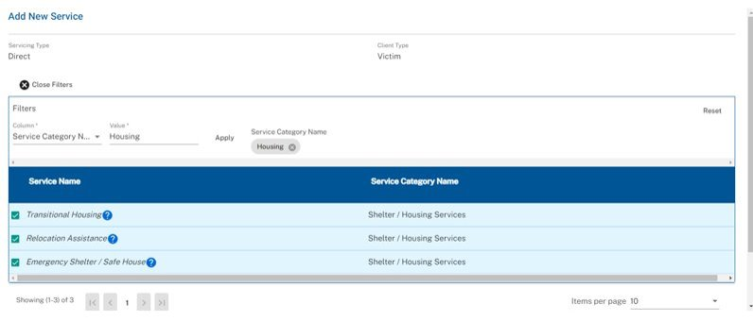
Only select the below services when you are funded to do so. Any referrals to Transitional Housing, Relocation Assistance, and Emergency Shelter/Safe House should be in the Information & Referral Services category.

Slide 39
VSDCS Enhancements
7/15/2024 scheduled updates:
Progress Report layout update (correct page breaks between like sections).
Notification Updates: Due date field added to notification for denied progress reports.
Terminology popup updates to mirror federal language.
Removal of the other crimes against persons category.
Letter Modification (spacing for letterhead, standard date, addresses, and phone number formatting).

Slide 40
Please continue to refer VSDCS technical assistance requests and enhancement requests to VictimsServicesTA@dcjs.virginia.gov

Slide 41
American Rescue Plan Act (ARPA)
VSGP Restoration
Extended grants end 6/30/24.
Quarterly financial report and claims due 4/15/24.
Make sure a detail of expenditures has been submitted for all claims, especially if you drew down funds in advance.

Slide 42
American Rescue Plan Act (ARPA)
VSGP Restoration
New ARPA solicitation released and is due 4/12/24. In accordance with state budget language, only sexual and domestic violence agencies are eligible.
The solicitation includes an option to budget for allowable expenses retroactively to 1/1/24.
DCJS must obligate all remaining ARPA funds by end of the year.

Slide 43
Sexual Assault Services Program (SASP)
State Fiscal Year 2024 SASP Special Funding Opportunity
  Financial Report for 3rd Quarter is due 4/15/24.
  Final 6 Month Status Report is due 7/15/24.
Calendar Year 2024 SASP
  Financial Report for 1st Quarter is due 4/15/24.
  All projects must be implemented now.

Slide 44
Victims Services Grant Program (VSGP)
SFY 2024
  3rd Quarter Financial and Status Reports due 4/15/24.
    This includes PMT data submission.
    Email Anya.Shaffer@dcjs.virginia.gov and copy your grant monitor with any PMT issues.
    If you are unable to submit the reports on time, submit a reporting extension in the Contract Amendments component. Contact your grant monitor for questions/assistance.
Spending
  State funds memo from Grants Management
  Be mindful of year end close out – 45 days after the end of the grant year.

Slide 45
Victims Services Grant Program (VSGP)
SFY 2025
  The competitive and noncompetitive portions of VSGP have been split into two different solicitations for SFY25.
  The competitive portion applications were due 3/1/24: https://www.dcjs.virginia.gov/grants/programs/sfy-2025-competitive-voca-vsgp
    The amount of funding available is significantly decreased
    Focus on underserved populations
    Anticipate CJSB making award decisions on 5/9/24.
  The noncompetitive solicitation for sexual and domestic violence programs has been released and is due 4/12/24.

Slide 46
Virginia Sexual and Domestic Violence Victim Fund (VSDVVF) Grant Program
SFY 2024:
  Award Period: July 1, 2023 – June 30, 2024
  Please ensure compliance with all encumbrances by the due date indicated.
  Quarterly status reports due in OGMS by 4/15/24
    Only report on VSDVVF funded activities
    Please use the reporting form for your respective program type: Prosecution or Discretionary fillable PDF
SFY 2025:
  Applications were due in OGMS on 4/1/24
  Open to current FY 24 Prosecution, Discretionary, and Forensic Examiners
  Please adhere to all requests for negotiations by the due date indicated
  Final funding decisions will be made in May 2024 by the CJSB

Slide 47
VSDVVF Forensic/SA Nurse Examiner
SFY 2023-2024
  Award Period: January 1, 2023 – June 30, 2024
  Quarterly status reports due in OGMS by 4/15/24
    Only report on VSDVVF funded activities
    Complete the Status Report component in OGMS
SFY 2025
  Applications were due in OGMS on 4/1/24
  Open to current FY 24 Prosecution, Discretionary, and Forensic Examiners
  Please adhere to all requests for negotiations by the due date indicated
  Final funding decisions will be made in May 2024 by the CJSB
For grant program resources visit:
https://www.dcjs.virginia.gov/grants/programs/virginia-sexual-and-domestic-violence-victim-fund-grant

Slide 48
VSTOP
CY 2023
  If you receive requests for Cumulative Report revisions, please respond by the due date indicated in the request
  Please submit all claims and programmatic requirements to close out your award as soon as possible
CY 2024-2025
  Award Period: 1/1/2024 – 12/31/2025 (24 months)
  SOGAs were uploaded in OGMS. Please follow instructions within your SOGA to formally accept your award.
  Ensure compliance with all encumbrances by the due date indicated.
  For grant program resources visit:
  https://www.dcjs.virginia.gov/victims-services/grants/violence-against-women-v-stop

Slide 49
Questions?

