Slide 1

On The Road To Excellence
DCJS Victims Services Grant Programs
An Overview

Slide 2

We want to hear from you
What feelings come to mind when you think of grant management?

Slide 3

Victims Services Grant Programs

Slide 4

Current Victims Services Grants
Sexual Assault Services Program (SASP)
Victim/Witness Grant Program (VWGP)
Virginia Sexual & Domestic Violence Victim Fund (VSDVVF)
Virginia Services, Training, Officers, Prosecution
(V-STOP)
VOCA Victim Services Grant Program (VSGP)

Slide 5
Sexual Assault Services Program (SASP)
The Sexual Assault Services Formula Grant Program was created by the Violence Against Women and DOJ Reauthorization Act of 2005.
It is the first federal funding stream solely dedicated to the provision of direct intervention and related assistance for victims of sexual assault.
Funding through SASP supports rape crisis centers and other nonprofit, nongovernmental organizations or tribal programs that provide core services, direct intervention, and related assistance to victims of sexual assault.

Slide 6
Sexual Assault Services Program (SASP)
The Office on Violence Against Women has identified the following priority areas for funding:
Supporting rape crisis centers in providing direct intervention and related assistance
Supporting dual programs that provide sexual assault and domestic violence services to enhance their provision of direct intervention and related assistance tailored for victims of sexual assault
Retaining core services for victims of sexual assault
Increasing support for underserved populations, particularly communities of color, in a culturally-appropriate manner, with a special emphasis on addressing the African-American, tribal, and Lesbian, Gay, Bisexual, and Transgender (LGBT) communities, as well as individuals with disabilities and Deaf individuals

Slide 7
Sexual Assault Services Program (SASP)
Rape crisis centers and other nonprofit, nongovernmental organizations or tribal programs that provide core services, direct intervention, and related assistance to victims of sexual assault are eligible.
SASP operates on a calendar year cycle (January – December), and requires one annual progress report due in GMIS on/by the last working day of January for activity occurring during the previous calendar year.
  SASP CY2019-Due January 21, 2020
  SASP CY2020-Due January 15, 2021
For more information on this grant program, contact the SASP Administrator, Andi Martin, andi.martin@dcjs.virginia.gov

Slide 8
Victim/Witness Grant Program (VWGP)
In 1984, the General Assembly created the victim/witness grant program and designated DCJS as the administering agency. The Victims of Crime Act (VOCA), passed by Congress in 1984, established a crime victims fund and authorized the Director of the Office for Victims of Crime to make annual VOCA victim assistance and compensation grants to states.
Currently, DCJS is using federal VOCA funds, as well as state Special Funds, and General Funds to support Victim/Witness Programs.

Slide 9
Victim/Witness Grant Program (VWGP)
Purpose:
To provide financial support to local victim/witness programs and statewide victim assistance programs designed to provide direct services, information,
and assistance required by Virginia’s
Crime Victim and Witness Rights Act.

Slide 10
Victim/Witness Grant Program (VWGP)
Local Victim/Witness programs are crime victim advocacy programs with a statutory mandate (Va. Code §19.2-11.01) to serve all types of crime victims and ensure that they:
have opportunities to make the courts aware of the full impact of crime;
are treated with dignity, respect, and sensitivity and that their privacy is protected;
are informed of their rights;
receive authorized services; and
are heard at all critical stages of the criminal justice process.

Slide 11
Victim/Witness Grant Program (VWGP)
Services provided include, but are not limited to:
Explaining victims’ rights;
Explaining and helping victims apply for compensation through the Criminal Injuries Compensation Fund (CICF);
Explaining the criminal justice process;
Assisting victims in preparing victim impact statements;
Assisting victims in obtaining protective orders;
Notifying victims of case status, court dates, and prisoner status;
Accompanying victims to court and criminal justice related meetings;
Providing crisis intervention; and
Providing case disposition information.

Slide 12
Victim/Witness Grant Program (VWGP)
The Victim/Witness Grant Program is open to local units of government and certain state agencies.
Victim/Witness programs in Virginia are primarily located in the offices of Commonwealth’s Attorneys and Sheriffs and have the mandate, expertise and position to make the criminal justice system more responsive to victims’ interests at critical stages of the criminal justice process.
There are 110 local grant funded Victim/Witness programs and 3 statewide victim assistance programs.

Slide 13
Victim/Witness Grant Program (VWGP)
VWGP operates on a state fiscal year cycle (July – June), and requires quarterly progress reports in GMIS on/by the 15th of the month following the end of the quarter.
VWGP programs use the Client Information Management System (CIMS) to generate quarterly program performance reports.
For more information on this grant program, please contact the VWGP Coordinator, Patricia Foster, patricia.foster@dcjs.virginia.gov.

Slide 14
Virginia Sexual & Domestic Violence Victim Fund (VSDVVF)
In 2004, the Virginia General Assembly passed legislation creating the Virginia Domestic Violence Victim Fund (VDVVF).
In 2006, the Virginia General Assembly passed additional legislation changing the name of the fund from the Virginia Domestic Violence Victim Fund to the Virginia Sexual & Domestic Violence Victim Fund (VSDVVF). This change was made so that the name of the fund would more accurately reflect its purpose and clarify that resources should be focused on addressing both domestic and sexual violence.

Slide 15
Virginia Sexual & Domestic Violence Victim Fund (VSDVVF)
The Department of Criminal Justice Services (DCJS) was designated as the administering agency for this fund. State special funds support the Virginia Sexual & Domestic Violence Victim Fund.
The amount available for awards is dependent on deposits into the Virginia Sexual & Domestic Violence Victim Fund.

Slide 16
Virginia Sexual & Domestic Violence Victim Fund (VSDVVF)
The purpose of the VSDVVF is to provide funding to assist in protecting and providing necessary services to victims of and children affected by sexual violence, domestic violence, stalking, and family abuse.
Virginia Sexual & Domestic Violence Victim Fund grants are available to state agencies, local units of government, and non-profit programs that provide services to victims of and/or children affected by sexual violence, domestic violence, stalking and family abuse.

Slide 17
Virginia Sexual & Domestic Violence Victim Fund (VSDVVF)
Eligible applicants include:
law enforcement agencies,
victims services programs,
programs that provide civil legal assistance,
public college and university campus programs, and
private, non-profit hospitals.

Slide 18
Virginia Sexual & Domestic Violence Victim Fund (VSDVVF)
VSDVVF operates on a state fiscal year cycle (July – June), and requires quarterly progress reports in GMIS on/by the 15th of the month following the end of the quarter.
For more information on this grant program, contact Tricia Everetts, Grant & Training Program Coordinator, tricia.everetts@dcjs.virginia.gov

Slide 19
Virginia Services, Training, Officers, Prosecution (V-STOP)
In 1994, the United States Congress passed the Violence Against Women Act (VAWA) as part of the Violent Crime Control and Law Enforcement Act. VAWA includes the Services, Training, Officers, Prosecution (STOP) grant program.
DCJS is the administering agency for the STOP Violence Against Women grant in Virginia, known as V-STOP. V-STOP offers grant funds to successful applicants for activities which increase the apprehension, prosecution, and adjudication of persons committing violent crimes against women.

Slide 20
Virginia Services, Training, Officers, Prosecution (V-STOP)
Purpose Areas:
Training law enforcement, court personnel, and prosecutors to more effectively respond to violent crimes against women including sexual assault, domestic violence, dating violence, and stalking;
Developing, training, or expanding units of law enforcement specifically targeting violent crimes against women, developing and implementing more effective police, court, and prosecution policies, protocols, orders, and services
Improving data collection and communication systems, etc.

Slide 21
Virginia Services, Training, Officers, Prosecution (V-STOP)
Priority areas:
  Reduce violent crime against women and promote victim safety
  Increase response to victims of human trafficking
  Enhance coordinated community response
  Increase victim access to substance abuse services
  Increase efforts to combat stalking

Slide 22
Virginia Services, Training, Officers, Prosecution (V-STOP)
This grant program is open to local units of government, state agencies, and nonprofit/nongovernmental victims services agencies which fall into one of the following applicant categories:
  law enforcement,
  prosecution, or
  victims services.

Slide 23
Virginia Services, Training, Officers, Prosecution (V-STOP)
V-STOP operates on a calendar year cycle (January – December), and requires bi-annual progress reports and narratives in GMIS on/by the 15th day of the month following the end of the 2nd and 4th quarters, as well as one annual cumulative progress report due in GMIS on/by the last working day of January for the previous calendar year.
For more information on this grant program, contact Julia Fuller-Wilson, VAWA Program Administrator, Julia.fuller-Wilson@dcjs.virginia.gov.

Slide 24
VOCA Victims Services Grant Program (VSGP)
This grant program is supported by federal Victims of Crime Act (VOCA) funds, through the Department of Justice, Office of Justice Programs, Office for Victims of Crime (OVC).
Funding under this grant program is available in three different categories:
  Services for Victims of Crime
  One-Time Initiatives
  Sexual and Intimate Partner Violence Core Services

Slide 25
VOCA Victims Services Grant Program (VSGP)
The federal Crime Victim Fund, established in 1984, is one of the major funding sources for victim services throughout the United States.
Revenues are deposited into the Fund annually from criminal fines, forfeited appearance bonds, penalties, special forfeitures, special assessments, and gifts, donations, and bequests by private parties.
Fund dollars do not come from taxpayers.

Slide 26
VOCA Victims Services Grant Program (VSGP)
The VOCA Victims Services Grant Program supports local, regional, and statewide programs that provide direct services to victims of crime. Public and private non-profit entities, including state and local governments and community-based organizations, are eligible to apply. Priority will be given to organizations that have a long-standing and proven track record of service to their communities. Funding will not be provided for start-up organizations.

Slide 27
VOCA Victims Services Grant Program (VSGP)
VOCA specifies that an organization must provide services to crime victims and be operated by a public agency or nonprofit organization in order to be eligible to receive VOCA funding.
Eligible organizations include victim services organizations whose sole mission is to provide services to crime victims. These organizations include:
  sexual and domestic violence agencies,
  child abuse programs,
  centers for missing children,
  mental health services, and
  other community-based victim coalitions and support organizations, including those who serve survivors of homicide victims.

Slide 28
VOCA Victims Services Grant Program (VSGP)
In addition to victim services organizations, whose sole purpose is to serve crime victims, there are many other public and nonprofit organizations that have components which offer services to crime victims.
These organizations are eligible to receive VOCA funds, if the funds are used to expand or enhance the delivery of crime victim services. These organizations include, but are not limited to, the following:
  Faith-based and neighborhood programs,
  Crime victim compensation programs, and
  Public or nonprofit hospitals and emergency medical facilities

Slide 29
VOCA Victims Services Grant Program (VSGP)
VSGP operates on a state fiscal year cycle (July – June), and requires quarterly reports in GMIS on/by the 15th of the month following the end of the quarter describing activities supported with these funds.
The federal Office for Victims of Crime (OVC) requires all VOCA funded projects to report annual award and quarterly performance activities in the Performance Measurement Tool (PMT) online system. Grantees are required to submit data in PMT, as well as additional narrative reports and data in GMIS.
For more information on this grant program, contact the VSGP Program Coordinator, Andi Martin, andi.martin@dcjs.virginia.gov. For more information on VOCA, contact the VOCA Administrator, Anya Shaffer, anya.shaffer@dcjs.virginia.gov.

Slide 30
Grant Land
Life Cycle of a Subaward
Life Cycle of a DCJS Subaward

Slide 31
Life Cycle of a DCJS Subaward
Traditionally, DCJS releases solicitations twice annually.
  Once in the spring for the coming state fiscal year
  Again in the fall for federal, calendar year programs.
During grant review, DCJS collects and reviews all applications and makes award recommendations to the Criminal Justice Services Board (CJSB) Grants Subcommittee.
Upon approval, funding is awarded to the recommended projects and announcements are made via web.

Slide 32
Life Cycle of a DCJS Subaward
DCJS disseminates Grant Award Packages which contain the terms and conditions of the award.
Subgrantees:
Sign the award acceptance
Respond to any special award conditions
Upon budget approval, implement the funded project according to plan.

Slide 33
Life Cycle of a DCJS Subaward
Throughout the grant period, the subgrantee submits quarterly financial and programmatic reports to track and report project expenditures and program activities.
DCJS is responsible for:
Assuring compliance of all federal awards in accordance with federal regulations and program guidelines
Conducting on-site and office-based monitoring to track programmatic and financial adherence to the award guidelines.

Slide 34
Life Cycle of a DCJS Subaward
Throughout the grant period, subgrantees can submit requests to modify the budget based on project needs.
Grant Monitors are available to review progress reports and provide technical assistance and training and ensure successful implementation of the awarded project.
The Grants Compliance Supervisor reviews and approves all request for funds.

Slide 35
Life Cycle of a DCJS Subaward
1. Application Review and Approval
2. DCJS CJSB Approval
3. Issuing and Acceptance of Awards
5. Closeout of Subawards
4. Programmatic and Financial Management of Subawards

Slide 36
Pre-Solicitation Process
Victims Services grants are mostly comprised of Federal funding from the Department of Justice, Office on Violence Against Women and Office on Victims of Crime.

Slide 37
Pre-Solicitation Process
The timeline from federal application to award is as follows:
  Federal government announces new grant
  DCJS’ Grants Manager fills out an application online to apply
  Federal government sends an award package to the agency
  Grants Manager reviews award and provides input
  DCJS Director reviews award including special conditions
  DJCS Director signs and sends back to the federal government
  DCJS program coordinator creates solicitation/grant announcement
  DCJS director reviews and recommends changes
  Solicitation/grant announcement package is posted online

Slide 38
Pre-Award Process
Grant applications are submitted by subgrantees to DCJS
Facesheets and Itemized budgets are submitted to Grants Administration
Grant Monitor reviews, recommends, and enters any special conditions
Competitive applications are reviewed by teams of internal and external reviewers
Grants Administration generates funding recommendations for the Criminal Justice Services Board (CJSB) Grants Committee, who provides recommendations for the full CJSB meeting
CJSB reviews and approves/denies each application based on the grant subcommittee recommendations
Award announcements are posted to the DCJS Website

Slide 39
Post-Award Process
Subgrantee emails Statement of Grant Award (SOGA) to DCJS within 60 days
Subgrantee submits Special Conditions to Grant Monitor
Grant Monitor reviews Special Conditions to approve or deny
Once the SOGA has been accepted and special conditions are met, the subgrantee will be able to submit financial reports, request funds, etc.
Subgrantee enters Request for Funds, Progress Reports, Financial Reports and Budget Amendments for review in GMIS
Monitor reviews progress reports and budget amendments
Grants Compliance Supervisor processes all requests for funds
Fiscal Grant Monitor performs are duties for grant closeout and contacts the subgrantee if additional items or actions are needed

Slide 40
Financial Management Overview
Review the Award Package and Approved Budget:
  Once the award has been accepted and the budget has been approved, subgrantees can implement the project
  Financial reports, requests for funds, budget modifications are submitted through the Grants Management Online Information System (GMIS)

Slide 41
Financial Management Overview
Review the Program Guidelines and Approved Grant Activities:
  Subgrantees provide services as outlined in the grant application and in accordance with all federal regulations and program guidelines
  Subgrantees report quarterly on service outputs and outcomes on the required DCJS forms
  Progress reports are submitted through the Grants Management Online System (GMIS) as well as the Performance Management Tool (PMT)

Slide 42
Financial Management Overview
Grant Monitoring
  Grant monitors work with the subgrantee to ensure successful implementation of the project
  Monitors complete desk reviews in preparation for site visits for all the sub grantees’ grant programs
  Monitors conduct on-site monitoring according to the agency’s risk-based monitoring policy
  Monitors provide onsite technical assistance to sub grantees on program management and reporting
  Monitors also assist programs in problem solving to assure compliance with program and budget requirements

Slide 43
Sexual Assault Services
Program (SASP)
This grant program operates on a calendar year - January – December
1 Year Cycle
One annual report due – January 21st for CY19
Budget Amendments – 45 days before the end of the grant period

Slide 44
Victim Witness Grant
Program (VWGP)
This grant program operates on a State Fiscal Year – July 1st - June 30th
3 Year Grant Cycle
Progress reports – 4 times a year – due on the 15th day after the end of each quarter
Financial reports – 4 times a year –due on the 15th day after the end of each quarter
Budget Amendments - 45 days before the end of the grant period (May 15th)

Slide 45
Victims Services Grant Program (VSGP)
This grant program operates on a State Fiscal Year – July 1st - June 30th
2 Year Grant Cycle
Progress reports – 4 times a year – due on the 15th day after the end of each quarter
Financial reports – 4 times a year –due on the 15th day after the end of each quarter
Budget Amendments - 45 days before the end of the grant period (May 15th)

Slide 46
Virginia – Services, Training, Officers, Prosecution (V-STOP)
This grant program operates on a Calendar year - January – December Grant Year
3 Year Grant Cycle
Two biannual reports – due on the 15th after the close of the 2nd and 4th quarters (6/30 and 12/31)
One annual report – due 1/31
Budget amendments due 45 days prior to end of the grant period

Slide 47
Virginia Sexual & Domestic Violence Victim Fund (VSDVVF)
This grant program operates on a State Fiscal Year – July 1st - June 30th
3 Year Grant Cycle
Progress reports – 4 times a year – due on the 15th day after the end of each quarter
Financial reports – 4 times a year –due on the 15th day after the end of each quarter
Budget Amendments - 45 days before the end of the grant period (May 15th)

Slide 48
Budget Amendments
Two per grant period
Monitors have 2 weeks to approve or request revisions
A final review is conducted by Grants Administration and can take up to twenty-one days for approval
Upon approval, the subgrantee will receive an email from Grants Administraton
Subgrantees can also check the status of the request in GMIS

Slide 49

Activity
ttps://jeopardylabs.com/play/grant-land
Time to play for fame, fortune, or at least bragging rights
Notes:
Ask for any questions. Split into two teams and play grant land jeopardy.

Slide 50

Special Conditions
Driving School
Notes:
Introduce the topics and learning objectives for this road stop.

Slide 51
Time to test those Special Condition Driving Skills. It is time for ………
Activity
The Amazing Race-Special Conditions Edition
Notes:
Did you hear the rumor about the peanut butter? I don’t want to spread it.

Slide 52
Fiscal Year
Award Process
Statements of Grant Award Package will be mailed by
Grants Management of the Division of Finance and Administration
Notes:
The SOGA must be signed by the Project Administrator. Discuss General Special Conditions address acceptance of this grant by the local government applicant constitutes its agreement that is assumes full responsibility for the management of and accounting for grant funds; assuring that personnel paid with grant funds are hired, supervised and evaluated in accord with the local government’s established employment and personnel policies; and assuring that all terms, conditions and assurances.

Slide 53
General Conditions
The general award terms and conditions provided in the award package are applicable to all subrecipients.
Each award also has “program specific” award conditions that are included with each award made under the relevant grant program.
The conditions are designed to ensure that subrecipients comply with the program’s statutory scope and programmatic requirements.
Notes:
For specific programmatic requirements, subrecipients should refer to the Grant Program Guidelines and/or contact the Grant Monitor for technical assistance.

Slide 54
Acknowledgment
Read your award package thoroughly
  Sign the Statement of Grant Award/Acceptance
  Some Special conditions are generic, not requiring any immediate action
  Some special conditions require action.
  Submit all required Special Conditions by the specified deadline
Manage/track your grant online
  Obtain a GMIS Online username and password
  Manage your budget and submit requests for funds
  Submit financial and programmatic reports
  (due on the 15th following the close of each quarter)
  Track the status of all requests in GMIS

Slide 55
Award Acceptance
Acceptance of the grant award by the subgrantee constitutes its agreement that it assumes full responsibility for the management of all aspects of the grant and the activities funded by the grant, including the following:
  Assuring proper fiscal management of and accounting for grant funds;
  Assuring that personnel paid with grant funds are hired, supervised and evaluated in accordance with established employment and personnel policies; and
  Assuring that all terms, conditions and assurances--those submitted with the grant application, and those issued with this award--are complied with.
Notes:
Failure to comply with any one or more of the award requirements -- whether a condition set out in full in the award package, a condition incorporated by reference, or a certification or assurance related to conduct during the award period -- may result in the Office of Justice Programs (OJP) or the Department of Criminal Justice Services (DCJS) taking appropriate action with respect to the subgrantee and the award.
OJP and DCJS may withhold award funds, disallow costs, or suspend or terminate the award. The Department of Justice ("DOJ"), including OJP, also may take other legal action as appropriate.
If in agreement with the terms and conditions, the project administrator must sign and date the agreement and then submit it to Grants Administration grantmgmt@dcjs.virginia.gov. Maintain the original signed documents for presentation in the event of an on-site monitoring visit.

Slide 56
Award Acceptance
By signing the Statement of Grant Award/Acceptance, the subgrantee agrees to:
  Use the grant funds to carry out the activities described in the grant application, as modified by the terms and conditions attached to this award or by subsequent amendments approved by DCJS;
  Adhere to the approved budget contained in this award and amendments made to it in accord with these terms and conditions; and,
  Comply with all terms, conditions and assurances either attached to this award or submitted with the grant application.

Slide 57
Fiscal Year Award Amounts
In accordance with federal guidelines, only those costs directly related to and essential to providing direct services to crime victims can be supported with grant funds.
Notes:
REMINDER: Grants are made to the Locality – State Fiscal Year – July 1 – June 30th.
Due to VOCA increase – VW Programs increased, funds increased (4 times the amount allocated in FY16); staffing increased from 96 to estimated 292 . The number of crime victims served by VOCA supported projects increased from 20,488 victims in FY15 to 61,533 in FY17.
VW Programs are supported by federal VOCA Funds, VW State Funds (A portion of the sum collected for fixed court fees), and
State General Funds:
General Fund support for Victim/Witness Programs continues to remains important because General Funds:
Provide a portion of the required 20% match to federal VOCA funds.
Enable a sustainable expenditure level from the Victim/Witness Special Fund
Enable maintenance of a reasonable Victim Witness Special Fund operating balance, as a hedge against any decline in federal VOCA funds.
Grant Funds allocated for FY18 total $17.8 million.
Budget Flexibility:
Within these broad restrictions, however, grantees have discretion to determine how grant funds can most effectively be utilized.
For example, this guidance does not prescribe nor prohibit changes in staff salaries in FY2018, so long as such changes are reasonable, appropriate, consistent with local personnel and compensation plans, and justified

Slide 58
Updated Requirements
#2. The Uniform Administrative Requirements, Cost Principles, and Audit Requirements in 2 C.F.R. Part 200
#3. Compliance with DOJ Financial Guide
#5. Requirements related to “de minimus” indirect cost rate
Notes:
2. Uniform Guidance: To strengthen federal grant management, OMB issued Uniform Guidance on Administrative Requirements, Cost Principlies, and Audit Requirements for federal awards. This guidance is effective for all subgrantees and informs the financial regulations and standards noted in the award conditions.
For more information and resources on the Part 200 Uniform Requirements as they relate to OJP awards and subawards ("subgrants"), see the OJP website at https://ojp.gov/funding/Part200UniformRequirements.htm.
In the event that an award-related question arises from documents or other materials prepared or distributed by OJP that may appear to conflict with, or differ in some way from, the provisions of the Part 200 Uniform Requirements, the subgrantee is to contact DCJS promptly for clarification.
3. DOJ Financial Guide-In addition to being governed by federal grant regulations, subgrantees are required to comply with the financial and administrative requirements contained in the Department of Justice (DOJ) Financial Guide.
References to the DOJ Grants Financial Guide are to the DOJ Grants Financial Guide as posted on the OJP website (currently, the "DOJ Grants Financial Guide" available at https://ojp.gov/financialguide/DOJ/index.htm ) including any updated version that may be posted during the period of performance.
5. Indirect Cost Rate: A subgrantee that is eligible to use the "de minimis" indirect cost rate and that elects to use the "de minimis" indirect cost rate, must advise DCJS in writing of both its eligibility and its election, and must comply with all associated requirements in the Part 200 Uniform Requirements. The "de minimis" rate may be applied only to modified total direct costs (MTDC) as defined by the Part 200 Uniform Requirements.

Slide 59
Updated Requirements
#6. Reporting potentially duplicative funding
#7. System for Award Management (SAM) registration
#8. Reporting breaches in confidentiality
#11. Prohibited conduct related to the trafficking of others
#13. Collecting and maintaining performance data
Notes:
6. Duplicative Funding: If the subgrantee currently has other active awards of federal funds, or if the subgrantee receives any other award of federal funds during the period of performance for this award, the subgrantee promptly must determine whether funds from any of those other federal awards have been, are being, or are to be used (in whole or in part) for one or more of the identical cost items for which funds are provided under this award. If so, the subgrantee must promptly notify DCJS in writing of the potential duplication, and, if so requested by DCJS, must seek a budget-modification or change-of-project-scope to eliminate any inappropriate duplication of funding.
7. The subgrantee must comply with applicable requirements regarding the System for Award Management (SAM), currently accessible at https://www.sam.gov/SAM/. This includes applicable requirements regarding registration with SAM, as well as maintaining the currency of information in SAM.
The subgrantee must maintain a valid DUNS number (a unique nine-digit number used for identifying and keeping track of entities receiving federal funds). Subgrantees must be registered in SAM to receive an award and must maintain an active registration for the entire period of the award.
Confidentiality breaches: The subgrantee must have written procedures in place to respond in the event of an actual or imminent "breach“. The subgrantee's breach procedures must include a requirement to report actual or imminent breach of PII to DCJS no later than 24 hours after an occurrence of an actual breach, or the detection of an imminent breach.
11. The details of the subgrantee's obligations related to prohibited conduct related to trafficking in persons are posted on the OJP web site at https://ojp.gov/funding/Explore/ProhibitedConduct-Trafficking.htm (Award condition: Prohibited conduct by subgrantees related to trafficking in persons (including reporting requirements and OJP authority to terminate award)), and are incorporated by reference here.
13. The subgrantee must collect and maintain data that measure the performance and effectiveness of work under this award. The data must be provided to DCJS as specified by DCJS in the program solicitation or other applicable written guidance. Performance awards are due on the 15th of the month following the close of the quarter (October 15th, January 15th, April 15th, July 15th)
19. In general, as a matter of federal law, federal funds awarded by OJP may not be used by the subgrantee, either directly or indirectly, to support or oppose the enactment, repeal, modification, or adoption of any law, regulation, or policy, at any level of government. Additionally, Another federal law generally prohibits federal funds awarded by OJP from being used by the subgrantee, to pay any person to influence (or attempt to influence) a federal agency, a Member of Congress, or Congress (or an official or employee of any of them).

Slide 60
Civil Rights Compliance
#16-18 The subgrantee must comply with all applicable requirements of 28 C.F.R. Part 42, 54, and 38 specifically including any applicable requirements that relate to an equal employment opportunity program, nondiscrimination on the basis of sex in certain "education programs."
As a condition for receiving funding from OJP, recipients must comply with applicable federal civil rights laws, including Title VI of the Civil Rights Act of 1964, Section 504 of the Rehabilitation Act of 1973, Title IX of the Education Amendments of 1972, the Age Discrimination Act of 1975, and the Department of Justice (DOJ) regulation for the Equal Treatment of Faith-Based Organizations.
Notes:
16. Compliance with DOJ regulations pertaining to civil rights and nondiscrimination –28 C.F.R. Part 42
The subgrantee must comply with all applicable requirements of 28 C.F.R. Part 42, specifically including any applicable requirements in Subpart E of 28 C.F.R. Part 42 that relate to an equal employment opportunity program.
17. Compliance with DOJ regulations pertaining to civil rights and nondiscrimination –
28 C.F.R. Part 54
The subgrantee must comply with all applicable requirements of 28 C.F.R. Part 54, which relates to nondiscrimination on the basis of sex in certain "education programs."
18. Compliance with DOJ regulations pertaining to civil rights and nondiscrimination –28 C.F.R. Part 38
Among other things, 28 C.F.R. Part 38 includes rules that prohibit specific forms of discrimination on the basis of religion, a religious belief, a refusal to hold a religious belief, or refusal to attend or participate in a religious practice. Part 38 also sets out rules and requirements that pertain to subgrantee organizations that engage in or conduct explicitly religious activities, as well as rules and requirements that pertain to subgrantees that are faith-based or religious organizations.

Slide 61
Conflict of Interest
For subgrantees, special conditions require a written conflict of interest policy, and certification that any potential conflicts of interest will be disclosed to DCJS. (2 C.F.R. Part 200, Subpart E § 200.112)
For nonprofit agencies, the IRS 990 Form also asks for a written policy on conflicts of interest, as well as about processes to manage and determine conflicts of interest
A Conflict of Interest policy should require disclosure of a potential conflict and prohibit voting on matters in which there is a conflict
In addition to having conversations about conflict of interest in board meetings, an annual questionnaire may help identify existing and new conflicts

Slide 62
Conflict of Interest
Conflicts of interest can be financial, or non-financial
  May be “conflict of loyalty,” for example: serving on two board of organizations in the same field; being employed by a funding agency while serving on a board; being a parent of a child receiving services.
  Conflicts of loyalty, or of interest, do not necessarily prohibit serving on a board, but should be acknowledged in the decision-making process.

Slide 63
Requirements
#19. Restrictions on lobbying
#24. Encouragement of policies to ban text messaging while driving
# 25. Access to Grant Records
#26. VOCA Requirements
#27. Demographic Data
Notes:
19. In general, as a matter of federal law, federal funds awarded by OJP may not be used by the subgrantee, either directly or indirectly, to support or oppose the enactment, repeal, modification, or adoption of any law, regulation, or policy, at any level of government. Additionally, Another federal law generally prohibits federal funds awarded by OJP from being used by the subgrantee, to pay any person to influence (or attempt to influence) a federal agency, a Member of Congress, or Congress (or an official or employee of any of them).
24. Text While Driving Ban: DOJ encourages subgrantees to adopt and enforce policies banning employees from text messaging while driving any vehicle during the course of performing work funded by this award, and to establish workplace safety policies and conduct education, awareness, and other outreach to decrease crashes caused by distracted drivers.
25. The subgrantee must authorize DCJS, Office for Victims of Crime (OVC) and/or the Office of the Chief Financial Officer (OCFO), and its representatives, access to and the right to examine all records, books, paper, or documents related to the VOCA grant.

Slide 64
Requirements
#27. Demographic Data
#28. Discrimination Findings
#30. Performance Measurement Reporting
#31. Documentation Requirements
#32. Additional Monitoring Requirements
#33. Record Retention and Access
Notes:
27. Demographic Data
The subgrantee will collect and maintain information on race, sex, national origin, age, and disability of victims receiving assistance, where such information is voluntarily furnished by the victim.
28. Discrimination Findings
The subgrantee assures that in the event that a Federal or State court or Federal or State administrative agency makes a finding of discrimination after a due process hearing on the ground of race, religion, national origin, sex, or disability against a recipient of victim assistance formula funds under this award, the subgrantee will forward a copy of the findings to the Office for Civil Rights of OJP.
30. Performance Measurement Reporting
The subgrantee agrees to submit quarterly performance reports on the performance metrics identified by DCJS and OVC and in a manner required by DCJS and OVC. This information on the activities supported by the award funding will assist in assessing the effects that VOCA Victim Assistance funds have had on services to crime victims within the jurisdiction.
31. Documentation Requirements
The subgrantee agrees promptly to provide, upon request, financial or programmatic-related documentation related to this award, including documentation of expenditures and achievements.
32. Additional Monitoring Requirements
The subgrantee understands that it may be subject to additional financial and programmatic on-site monitoring, which may be on short notice, and agrees that it will cooperate with any such monitoring.
33. Record Retention and Access
Records pertinent to the award must be retained for a period of three (3) years from the date of submission of the final expenditure report. Subgrantee must provide access, including performance measurement information, in addition to the financial records, supporting documents, statistical records, and other pertinent records indicated at 2 C.F.R. 200.333.

Slide 65
Requirements
34. Non-Supplanting Requirement
Funds made available through this award will not be used to replace state or local funds that would, in the absence of this grant, be made available for the same purposes. Guidance on the non-supplanting requirement is available here:
https://ojp.gov/archives/financial_guides/financialguide11/PreawardRequirements/chapter5page6.htm

Slide 66
Requirements
#37. Civil Rights Training Requirement
#38. Equal Employment Opportunity Plan (EEOP)
#39. Performance and Obligation Periods
#41. Project Initiation
#42. Budget Amendments
Notes:
37. Civil Rights Training Requirement
The subgrantee agrees to meet the civil rights training requirements through viewing the online training modules offered through the Office on Civil Rights at https://ojp.gov/about/ocr/assistance.htm or online training offered by DCJS. The subgrantee must review these training modules at least once per grant cycle and must view the civil rights overview, standard assurances modules, and the module on the obligations to provide services to limited English proficient (LEP) individuals.
38. Equal Employment Opportunity Plan (EEOP)
As a recipient of Department of Justice funding, the subgrantee agrees to comply with the requirements regarding Equal Employment Opportunity Plans (EEOP). In certain cases, subgrant recipients must develop an EEOP. Your organization is required to submit a Certification Report and/or the Utilization Report section of your plan to the Office of Civil Rights. Further guidance can be found at https://ojp.gov/about/ocr/eeop.htm . The Certification form required by OJP can be found at http://www.ojp.usdoj.gov/about/ocr/pdfs/cert.pdf .
39. Performance and Obligation Periods
Grant funds, including state and local match, may be expended and/or obligated during the grant award period of performance. Subgrantees may only charge to the award allowable costs incurred during this grant award period. All properly incurred obligations must be liquidated no later than 45 days after the end of the award period. No new obligations may be made during the liquidation period. The subgrantee agrees to submit a final financial report and return all received and unexpended grant funds to DCJS within 45 days of the end of the grant award period.
41. Project Initiation
Within 60 days of the starting date of the grant, the subgrantee must initiate the project funded. If not, the subgrantee must report to DCJS, in writing, the steps taken to initiate the project, the reasons for the delay, and the expected starting date. If the project is not operational within 90 days of the start date, the subgrantee must obtain approval in writing from DCJS for a new implementation date or DCJS may cancel and terminate the project and redistribute the funds.
42. Budget Amendments
No amendment to the approved budget may be made without the prior approval of DCJS. No more than two (2) budget amendments will be permitted during the grant period. Budget amendments must be requested using the online Grants Management Information System (GMIS), accompanied with a narrative. The deadline for all VOCA funded and/or state fiscal year grant programs is 45 days prior to the end of the grant year (May 15). For OVW funded grant programs (VSTOP & SASP) the deadline is 60 days before the end of the grant year (Oct. 31)

Slide 67
Requirements (Cont.)
#43. Financial Audits
#45. Conflict of Interest
#46. Financial Management Systems
#47. Project Income
#48. Computer Equipment
#49. E-mail and Internet
#50. Change in Personnel
Notes:
43. Financial Audits
The subgrantee agrees to forward a copy to DCJS of the subgrantee’s scheduled financial statement audit for the fiscal year that covers the grant award period. If the subgrantee is a local government or non-profit organization and expends $750,000 or more in federal awards (from all sources) during its fiscal year, the subgrantee is required to submit the appropriate single or program specific audit in accordance with the provisions outlined in 2CFR Part 200 Subpart F.
45. Conflict of Interest
All subgrantees must have a written conflict of interest policy. The subgrantee certifies that it will disclose in writing any potential conflict of interest to DCJS in accordance with applicable federal awarding agency policy as required in 2 C.F.R. Part 200, Subpart E § 200.112.
46. Financial Management Systems
All subgrantees are required to establish and maintain adequate accounting systems and financial records and to accurately account for funds awarded to them. They must have a financial management system in place that is able to record and report on the receipt, obligation, and expenditure of grant funds. Subgrantees must properly track the use of award funds and maintain adequate supporting documentation including maintaining proper documentation for all paid grant and match staff and volunteer time reported. Further information is available in the DOJ Financial Guide at https://ojp.gov/financialguide/doj/pdfs/DOJ_FinancialGuide.pdf .
47. Project Income
Any funds generated as a direct result of DCJS grant-funded projects are deemed project income. Project income must be reported on the Subgrantee Financial Report for Project Income provided by DCJS. Instructions for the Project Income form can be downloaded at: http://www.dcjs.virginia.gov/forms/grants/subgrantProjectIncomeInstructions.doc. The Project Income form can also be downloaded from the DCJS website at: http://www.dcjs.virginia.gov/forms/grants/subgrantProjectIncome.xls. Examples of project income might include service fees; client fees; usage or rental fees; sales of materials; and income received from sale of seized and forfeited assets (cash, personal or real property included).
48. Computer Equipment
All new Computer Processing Units (CPU’s) purchased with grant funds must be protected by anti-virus software, which must be updated, as necessary.
49. E-mail and Internet
Email and internet access funded through this grant must be for official program use only.
50. Change in Personnel
The subgrantee agrees to submit the DCJS Program Change/Update form when there is a personnel change in the program. Available on the DCJS website at: https://www.dcjs.virginia.gov/victims-services/forms.

Slide 68
Important Information for Managing Your Award

Slide 69
Read the Guidelines
Subgrantees have 60 days from the award date to accept the award.
The signed acceptance should be submitted to Grants Administration via email: grantsmgmt@dcjs.virginia.gov.
If you are unable to accept the award within this time, you should notify DCJS immediately.
Failure to accept the award within 60 days may result in the awarding agency deobligating funds.
Within 60 days, the subgrantee should initiate the project. If the project has not been implemented by that time, the subgrantee should notify DCJS immediately and outline the reasons for the delay in implementation as well as the anticipated start date.

Slide 70
Program Update Form
As stated in the award conditions, all subgrantees agree to submit to DCJS, the Program Update Form when there is a personnel change in the program.
The form is available on the DCJS website: https://www.dcjs.virginia.gov/victims-services/forms

Slide 71
IMPORTANT: Notify DCJS!
Staff turnover may or not be frequent at your grant-funded program, but no matter how important the position, create the habit of informing your grant monitor of those changes as soon as possible.
Who we need to be informed of:
    Project Director, Project Administrator, Finance Officer (Found on Face Sheets)
    Grant-funded staff (listed in Itemized Budget and Budget Narrative)
The authorized grant officials are listed on grant application documents (face sheet)

Slide 72
IMPORTANT: Notify DCJS!
Why these individuals are important to DCJS
  Project Director: Responsible for Day-to-Day grant operations
  Project Administrator: Responsible for the organization’s use of grant funds
  Finance Officer: Responsible for authorizing the program funding use as budgeted and the reporting of that use
  Grant-funded staff: Responsible for performing grant-funded services as outlined in grant application

Slide 73
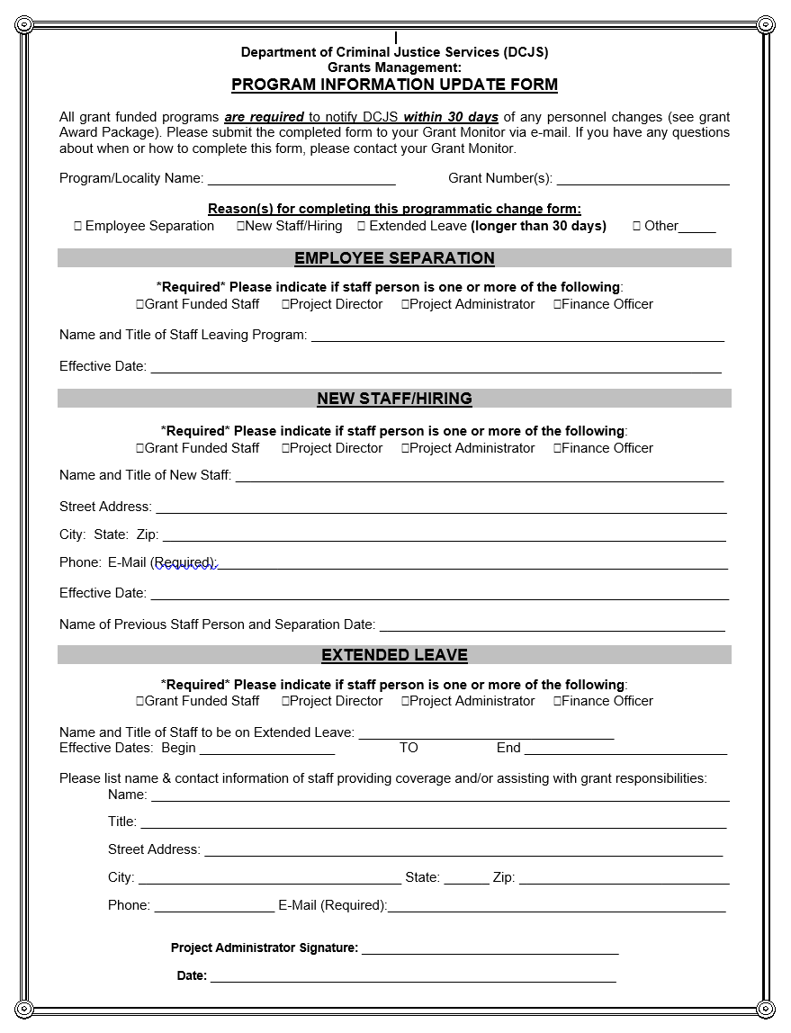
Filling Out Program Update Form
This form can be found on the DCJS website at www.dcjs.virginia.gov/grants/forms

Slide 74
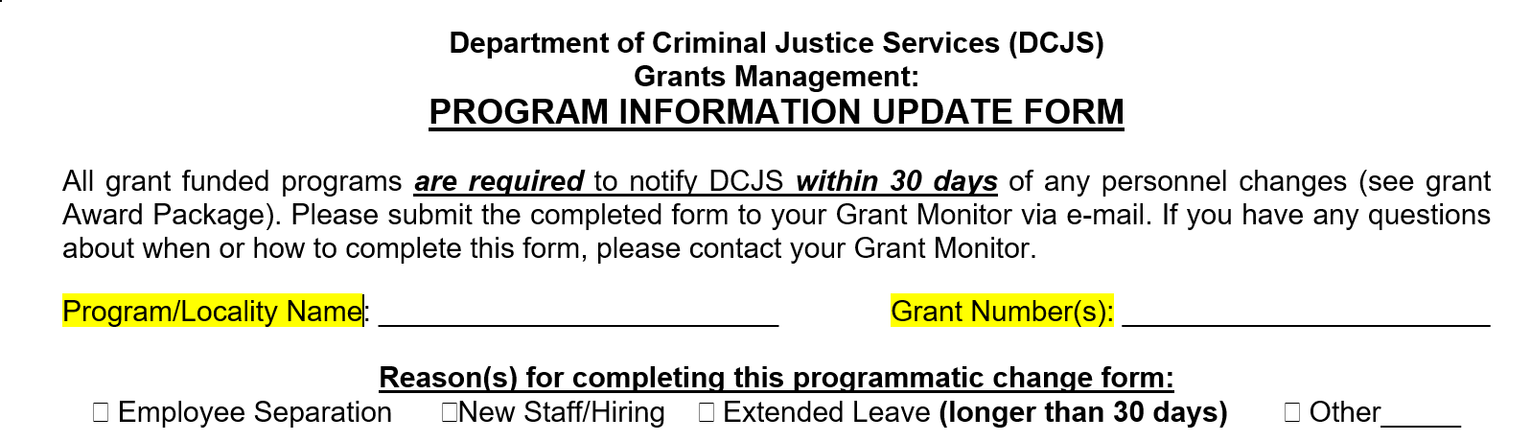
Part 1: Complete top of the form
Add organization name, relevant grant number(s) and check box for reason(s) for completing the form

Slide 75
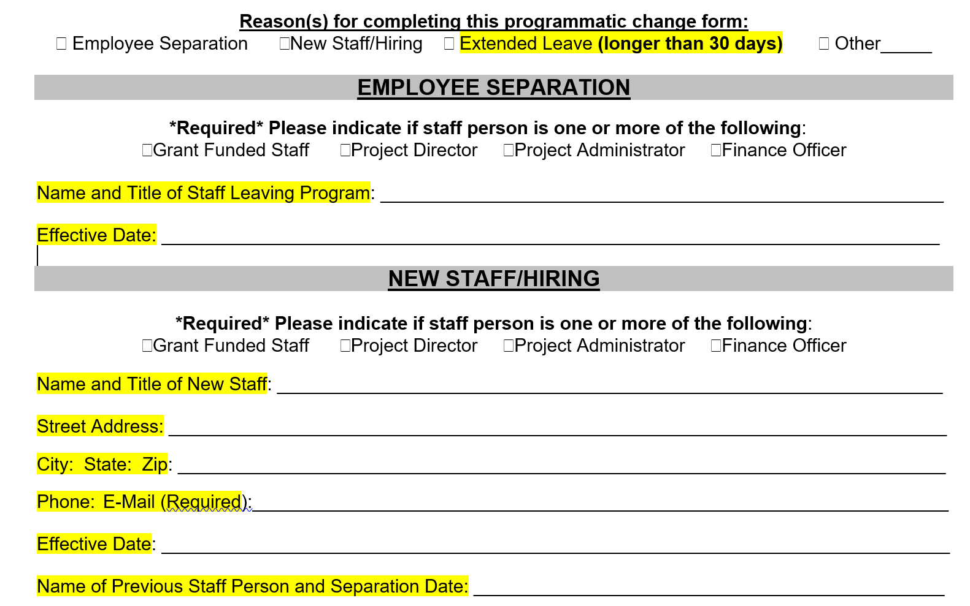
Part 2:
Complete “Employee Separation” for staff departures or “New Staff/Hiring” for new or replacement of staff

Slide 76
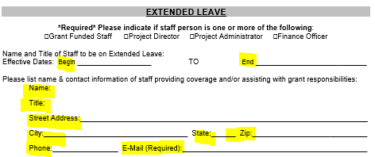
Part 3: Complete “Extended Leave” for staff on any type of administrative leave but set to return
Like previous sections, check box for the relevant staff member and fill in all information of the highlighted contact information lines. This section is utilized for individuals scheduled to be out of the office for a month or greater. Required to include contact information for temporary replacement.

Slide 77
Part 4:
The current Project Administrator must sign for changes in the Project Director, Project Administrator or Finance Officer
As each of these contacts need to be up to date for all primary grant-related correspondence and reporting, it is important for the Project Administrator to sign in acknowledgment that they are aware of transition in these positions. Grant-funded staff change forms do not have to be signed by the Project Administrator

Slide 78
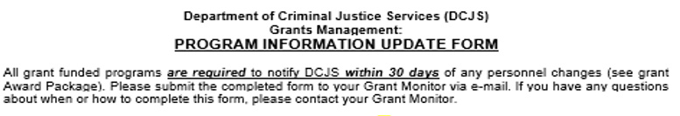
Please notify DCJS ASAP!
As a reminder, here is the top of the document….

Slide 79
Reporting Requirements
By accepting the grant award, you are agreeing to submit online quarterly financial and progress reports for this grant throughout the grant period, as well as final reports to close the grant.
No eligible current recipient of funding will be considered for continuation funding if, as of the continuation application due date, any of the required financial and progress reports for the current grant are more than 30 days overdue.
For good cause, submitted in writing by the grant recipient, DCJS may waive this provision.

Slide 80
Disbursement of Funds
Disbursement of funds will occur on a cost reimbursement basis for actual funds expended. Actual expenditures should be quarterly and invoiced pursuant to approved line item budget categories in the grant award package.
Notes:
Grant funds, including matching funds, may only be expended and/or obligated during the grant period. All obligations must be fulfilled no later than 90 days after the end of the grant period. Requests for reimbursement shall be submitted through DCJS GMIS.

Slide 81
Failure to Abide by the Terms of the Award
If the subgrantee has failed to comply with the terms and conditions of the award, DCJS may take one or more enforcement actions which include disallowing costs, withholding of funds or future awards, or wholly or partially suspending the grant pending corrective action.
Support may be withheld if the subgrantee failed to meet the terms and conditions of previous awards (as noted in the award conditions); failed to show satisfactory progress achieving the objectives of the project; failed to comply with program guidelines (i.e. VOCA Rule).
Generally, DCJS will suspend (rather than immediately terminate) a grant and allow the subgrantee an opportunity to take appropriate corrective action before a final decision on funding has been made.

Slide 82
Technical Assistance
The resources provided in this presentation are to help you successfully comply with the terms and conditions of your award.
For questions regarding programmatic compliance, please contact your assigned grant monitor.
Be sure to reference the current grant number and include supporting details when you call/email.
All requests will be answered within 48 business hours.

Slide 83
Civil Rights Compliance
Understanding Your Rights
and Responsibilities

Slide 84
Sub-Grantee Compliance
Every sub-grantee of DCJS funding must comply with the same federal and state laws and regulations as DCJS.

Slide 85
Notice of Applicable Civil Rights Laws and Regulations
Title VI of the Civil Rights Act of 1964, which prohibits discrimination on the basis of race, color or national origin in OJP and COPS funded programs or activities. (42 U.S.C. § 2000d and 28 C.F.R. §42.101 et seq.)
The Omnibus Crime Control and Safe Streets Act of 1968, as amended, which prohibits discrimination on the basis of race, color, national origin, religion, or sex, in OJP, OVW, and COPS funded programs or activities. (42 U.S.C. § 3789d and 28 C.F.R. §42.201 et seq.) A chart of grant programs generally covered by this nondiscrimination provision is located here.
Section 504 of the Rehabilitation Act, which prohibits discrimination on the basis of disability in OJP and COPS funded programs or activities. (29 U.S.C. § 794 and 28 C.F.R. § 42.501 et seq.)

Slide 86
Notice of Applicable Civil Rights Laws and Regulations
Title II of the Americans with Disabilities Act of 1990, as it relates to discrimination on the basis of disability in OJP or COPS funded programs or activities. (42 U.S.C. § 12132 and 28 C.F.R. Pt. 35).
The Age Discrimination Act of 1975 as it relates to services discrimination on the basis of age in OJP or COPS funded programs or activities. (42 U.S.C. § 6102 and 28 C.F.R. § 42.700 et seq.)
Title IX of the Education Amendments of 1972, as it relates to discrimination on the basis of sex in OJP and COPS funded training or educational programs. (20 U.S.C. § 1681 and 28 C.F.R. pt 54).

Slide 87
Notice of Applicable Civil Rights Laws and Regulations
Services to Limited English-Proficient Persons (LEP) as it relates to national origin discrimination on the basis of limited English proficiency. (http://www.lep.gov/).
Equal Treatment for Faith-Based and Community Organizations is the Equal Treatment Regulation as it relates to ensuring equal treatment for Faith-Based Organizations and nondiscrimination of beneficiaries on the basis of religious belief. (28 C.F.R. § 38 and Executive Order 13279).

Slide 88
Violence Against Women Act (VAWA) 2013
October 1, 2013 effective date
Covers employment practices
“actual or perceived”
Applies to all recipients, including funded faith based organizations, state administering agencies, and law enforcement agencies

Slide 89
Civil Rights Compliance under VAWA 2013
No person in the United States shall, on the basis of actual or perceived race, color, religion, national origin, sex, gender identity (as defined in paragraph 249(c)(4) of title 18, United States Code),sexual orientation, or disability, be excluded from participation in, be denied the benefits of, or be subjected to discrimination under any program or activity funded in whole or in part with funds made available under [VAWA], and any other program or activity funded in whole or in part with funds appropriated for grants, cooperative agreements, and other assistance administered by the Office on Violence Against Women.

Slide 90
Sex Segregation or Sex-Specific Services
If sex segregation or sex-specific programming is necessary to the essential operation of a program, nothing in this paragraph shall prevent any such program or activity from consideration of an individual’s sex. In such circumstances, grantees may meet the requirements of this paragraph by providing comparable services to individuals who cannot be provided with the sex-segregated or sex-specific programming.

Slide 91
Sex Segregation or
Sex-Specific Services
Sex-Segregated Programming
When males and females receive services in separate settings
Sex-Specific Programming
When a recipient designs programming differently for males and females
Beneficiaries choose the appropriate program based upon gender identity

Slide 92
Sex Segregation or
Sex-Specific Services
“Necessary for the Essential Operation of the Programming”
Fact-specific inquiry; consider:
Nature of the service
Consequences to beneficiaries of making sex-segregated or sex-specific
Literature on Efficacy
Impact on transgender clients
Reasons may not be trivial, based solely on convenience, or rooted in stereotypes

Slide 93
Comparable Services
Comparable Services: designed to confer a substantially equal benefit
Consider the following:
Nature, quality, and duration of the service
Relative benefits of different therapeutic modalities
Geographic location

Slide 94
Gender Identity
What is Gender Identity?
“Actual or perceived gender-related characteristics” (from Matthew Shepard- James Bird Hate Crimes Prevention Act)
A person’s internal view of the individual’s gender
May or may not correspond to sex assigned at birth
Transgender, male, and female are examples of gender identities

Slide 95
Gender Identity
Serving Transgender Clients
Assign clients to service which corresponds to the gender with which the client identifies
Consider transgender victim’s health and safety in making housing assignments
Transgender client’s own views regarding personal safety deserves serious consideration
Do not isolate or segregate
Do not make burdensome demands for identity documents
Do not inquire into surgery or other medical interventions

Slide 96
Civil Rights Training Requirement
To meet the civil rights training requirements, sub-grantees must view the online training modules offered through the Office on Civil Rights at https://ojp.gov/about/ocr/assistance.htm or online training offered by DCJS.
The sub-grantee must review these training modules at least once per grant cycle and must view the civil rights overview, standard assurances modules, and the module on the obligations to provide services to limited English proficient (LEP) individuals.

Slide 97
Civil Rights Training Requirement
The Project Director must view the training on Civil Rights available on the DCJS website (Victims Services page) or at https://ojp.gov/about/ocr/ocr-training-videos/video-ocr-training.htm.
The Project Director must accept responsibility for ensuring that project staff understands their responsibilities as outlined in the presentations.
If any questions arise about the material presented and sub-grantee responsibilities, they should contact their grant monitor.

Slide 98
Civil Rights Training Requirement
Every sub-grantee program/organization must complete the Certification of Compliance with Regulations Office For Civil Rights Form
The original form should be returned to grantsmgmt@dcjs.virginia.gov within 45 days of the grant award beginning date.

Slide 99
Civil Rights Compliance for Sub-Grantee Programs
All sub-grantee programs (regardless of the type of entity or the amount awarded) are subject to prohibitions against discrimination in any program or activity, and must take reasonable steps to provide meaningful access for persons with limited English proficiency.
Every sub-grantee program will maintain data (and submit when required) to ensure that: services are delivered in an equitable manner to all segments of the service population; employment practices comply with Equal Opportunity Requirements, 28 CFR 42.207 and 42.301 et seq.; projects and activities provide meaningful access for people with limited English proficiency as required by Title VI of the Civil Rights Act, (See also, 2000 Executive Order #13166).

Slide 100
Civil Rights Compliance for Sub-Grantee Programs
The person in this agency or unit of government who is responsible for reporting civil rights findings of discrimination will submit these findings, if any, to the DCJS within 45 days of the finding, and/or if the finding occurred prior to the grant award beginning date, within 45 days of the grant award beginning date.
Sub-grantee programs must certify that the program/organization will prepare and submit an EEOP and Certification at https://ojp.gov/about/ocr/eeop.htm, within 60 days of the award.
The EEOP shall be submitted in accordance with 28 CFR §42, subpart E, to Office for Civil Rights, Office of Justice Programs, U.S. Department of Justice that will include a section specifically analyzing the grantee (implementing) agency.

Slide 101
Complaint Procedures
A person who believes he/she has been harassed or been subject to discriminatory treatment by a DOJ-funded sub-recipient because of race, color, national origin, sex, age, religion, or disability, or has been retaliated against for engaging in protected activity, is urged to file a complaint through the Civil Rights Officer.
Civil Rights Officer
Department of Criminal Justice Services
1100 Bank Street
Richmond, VA 23219

Slide 102
Complaint Procedures
Generally, formal complaints must be filed with the Civil Rights Officer within 180 calendar days of the alleged act of discrimination. If the complaint is not filed on time, the complainant should provide the reason for the delay and request a waiver of this filing requirement. DCJS will decide whether to grant the waiver. The complaint must be filed in writing either by regular mail or in an email.
The DCJS Civil Rights Officer will refer all complaints to an external agency, such as the Office of Justice Program (OJP), Office for Civil Rights, (OCR) for investigation and resolution. DCJS will notify the external agency in writing of any referral within 30 calendar days of receipt of the complaint. The complainant will also be notified of the referral in writing.

Slide 103
Complaint Procedures
A DCJS sub-grantee receiving DOJ funds shall advise the Civil Rights Officer of any employment or services discrimination complaint filed against it within 10 business days of receiving the complaint.

Slide 104
Complaint Procedures
As an alternative or in addition to filing a complaint with DCJS, an individual may wish to file a complaint directly with an external agency for investigation, such as a local or state human rights commission.
The Commonwealth of Virginia has the following agency that reviews complaints alleging conduct which violates any Virginia or federal statute or regulation governing discrimination on the basis of race, color, religion, national origin, sex, pregnancy, childbirth or related medical conditions, age, or disability:
Human Rights Council
1220 Bank Street
Jefferson Building, 3rd Floor
Richmond, VA 23218

Slide 105
Complaint Procedures
Federal laws prohibit recipients of Justice Department funding from discriminating against individuals or groups, either in employment or in the delivery of services or benefits, on the basis of race, color, national origin, religion, sex, age, or disability. Below is the contact information for the office in the Department of Justice that investigates complaints:
Office of Civil Rights
Office of Justice Programs
US Department of Justice
810 7th Street NW
Washington, DC 20531

Slide 106
Questions?
Sub-grantee programs should contact their grant monitor with questions regarding civil rights compliance.

Slide 107

CONFIDENTIALITY. It’s kind of Important.

Slide 108
What is confidentiality?
The Office for Victims of Crime (OVC) defines confidentiality as:
“The laws, rules, and regulations that prohibit certain professionals from disclosing information that can be used to identify the individuals they serve.”

Slide 109
Confidentiality
Limits the disclosure of information without the victim’s consent.
Requires victim service providers to disclose any limits to confidentiality to the victim.
Practice “Need to know” standard when obtaining information.
A victim’s decision to disclose information must be voluntary and free from pressure.
Confidentiality standards provide a broad range of protection for victims with regards to medical information, immigration status, personal identifying information (PII), and other documents/information.
All information about the victim, stated or inferred, belongs to the victim.
Identifying information, options discussed, written notes and materials, and the fact that a victim has sought or received services are confidential.

Slide 110

Reaction to a breach in Confidentiality?

Slide 111
Promoting Confidentiality in Practice
An agency should have a standard confidentiality policy that is displayed in all areas where victims are served as well as signed and available in each individual’s file. It is the responsibility of the Victims’ Services professional to get informed consent regarding release of information.
Informed consent “means that the victim has been fully informed of the potential benefits and risks of releasing confidential information and the victim fully and freely consents to do so. The victim’s authorization to release information should be made in writing.”
“A victim’s decision to disclose information must be voluntary and free from pressure.”

Slide 112
Policy Should Include:
Confidential policy statement
Exceptions to policy
Confidentiality for support groups
A victim can withdraw the authorization to release information at any time
Procedures for:
  Notifying victims of policy
  Ensuring compliance with policy
  Collecting, storing, and disposing of records
  Ensuring victims have been given informed consent
  Internal communications and supervision
  Responding to subpoenas

Slide 113
Victim Records
Victim Records should be addressed within the Agency Confidentiality policy
Victim Records should be maintained in a secure and safe location with defined access standards
Victim Record File should NOT include:
  Verbatim statements by the victim
  Medical information
  Internal communication about the victim
  Diaries or personal notes provided by the victim

Slide 114


Slide 115
Exceptions to Confidentiality
Signed release of information
State mandated reporter
Duty to warn
Local Government Victim/Witness Personnel
Unique situations with children and adolescents

Slide 116
VA. CODE ANN. § 63.2-104.1 (2016), states:
Programs and individuals providing services to victims of sexual or domestic violence may share:
Non-personally identifying data in the aggregate regarding services to their clients and non-personally identifying demographic information in order to comply with Federal, State, tribal, or territorial reporting, evaluation, or data collection requirements;
Court generated information and law-enforcement generated information contained in secure, governmental registries for protection order enforcement purposes; and
Information necessary for law enforcement and prosecution purposes.

Slide 117
Comply with the Law:
A victims’ services professional may reveal confidential information in order to comply with mandatory reporting statutes (e.g., child abuse), law enforcement or administrative agency investigations, business operations, and other such lawful purposes.
Keep in mind that HIPAA (Health Insurance Portability and Accountability Act) contains a law enforcement exception that may affect some medical records.
Victims’ services professional may release confidential information upon the receipt of an order by a court of competent jurisdiction.

Slide 118
I lied. Confidentiality is REALLY IMPORTANT
Failure to maintain confidentiality may result in termination of your employment, or other corrective action. This policy is intended to protect you as well as your agency because in extreme cases, violations of this policy also may result in personal liability.
Although the agency is liable for your acts within the scope of your duty, giving information to an unauthorized person could result in the agency's refusal to support you in the event of legal action. Violation of the state statutes regarding confidentiality of records is punishable upon conviction by fines or by imprisonment or by both.

Slide 119
Checkpoints for your agency
Staff Agreements
Posted Policy
Release Form
Do you have an agreement that details the requirements for staff members and volunteers?
Is this agreement updated and signed annually?
Are you checking in with staff to see if there have been any issues involving confidentiality?
How are staff disciplined for breaches in confidentiality?
Have you discussed Progress Reports and the Freedom of Information Act (FOIA)?
Does your agency have a standard confidentiality policy?
Is it posted in your office or listed on your brochures?
How are you communicating the policy to victims?
Do you have a release of information form?
Are you maintaining a copy in each victim’s file?
Is it time limited? Release forms should have an end date as to when records can be requested and victims must be informed that they can revoke it at any time.

Slide 120
Sample Policy
All client information obtained while working as a staff member, intern, or volunteer of the (Locality)___ Victim/Witness Program will be held in the strictest confidence from any outside person or agency.
Any information pertinent to a criminal case investigation or prosecution may be discussed within the ____(Host Agency)_____ and with other appropriate criminal justice personnel who are assisting with the investigation or prosecution of that case. All other information, not related to a criminal case, communicated by the client shall remain confidential between that client and the ___(Locality)___ Victim/Witness Program representative.
When preparing reports, responding to surveys or requests from the media, or providing educational presentations, only non-identifying information will be disseminated.
All records containing confidential information will be maintained securely in locked files accessible only to representatives of the _____(Locality)_____ Victim/Witness Program.
The only exceptions to confidentiality include:
1) client requests in writing that the program release information,
2) client makes a report of child or elder abuse,
3) client threatens to hurt self or others, and/or
4) court orders disclosure via subpoena.
Every client will be informed of the conditions of this confidentiality policy during the first Program contact with that client.
I, the undersigned, do hereby agree to abide by the Confidentiality Policy. I fully understand that any violation of this requirement may result in immediate termination. I further understand that this confidentiality requirement will continue after my employment, internship, or role as a volunteer in this office is completed.
Signed_________________________________ Date___________
Supervisor______________________________ Date___________

Slide 121
Sample Confidentiality Policy
Employees, interns, and volunteers of the _______________________ Victim/Witness Program shall preserve, in confidence, all client information subject to the limited exceptions set forth below.
1. Written client waiver (general or limited) of confidentiality.
2. The law or court order requires disclosure.
3. Client statements of child or elder abuse.
4. Client statements regarding an intention to commit a crime.
5. Client information pertinent to any criminal investigation or
prosecution may be disseminated to agencies responsible for that
case.
I, the undersigned, agree to abide by the Confidentiality Policy and ensure that each of my clients is advised of the conditions of this policy. I understand that any willful or continued violation of this policy may result in immediate termination. I further understand that my obligations pursuant to this policy will continue in perpetuity following my employment, internship, or volunteer service with the ___________________ Victim/Witness Program.
Signed ______________________________________ Date _____________
Supervisor ___________________________________ Date _____________

Slide 122
“A tree is known by its fruit; a man by his deeds. A good deed is never lost; he who sows courtesy reaps friendship, and he who plants kindness gathers love.”
Confidentiality Resources:
National Network to End Domestic Violence Confidentiality Toolkit
OVC-TTAC Maintaining Confidentiality
National Organization for Victim Assistance- “Ethics and Confidentiality Training”- Clair Ponder Selib, MSW, CA
Notes:
Did you hear the rumor about the peanut butter? I don’t want to spread it.

Slide 123


Slide 124
Victims Services Grant Programs Allowable vs. Unallowable Costs and Program Activities

Slide 125
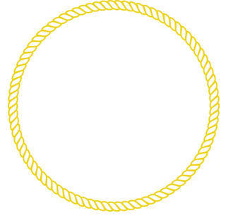
Goal of this Workshop
Federal Victims of Crime Act (VOCA) Funds Victim Witness & Victims Services Grant Programs
Identify allowable and unallowable costs and activities for Victims Services Program Grants
Federal Violence Against Women Act (VAWA) Funds-VA Services, Training, Officers, Prosecution (VSTOP) Grant Programs
Federal Violence Against Women Act (VAWA) Funds-Sexual Assault Services Program (SASP) Grant Programs
Virginia Sexual Domestic Violence Victim Fund (VSDVVF)-State General Funds

Slide 126
Victims Services Grant Programs
VOCA (VSGP, V/W, Child Treatment, CASA, CACs, School-based, Hospital-based violence intervention)
VAWA-VSTOP
VAWA-SASP
Virginia VSDVVF
Grant Type=Federal Funding
Intent=Provides funding for direct services for victims of crime
Match=Required
Grant Type=Federal Funding, Office on Violence Against Women (OVW)
Intent=Assists projects that develop and strengthen effective responses to sexual assault, domestic violence, dating violence, and stalking
Match=Required
Grant Type=Federal
Intent=Dedicated to the provision of direct intervention and related assistance for victims of sexual assault
Match=NONE
Grant Type=State Funds
Intent=To provide funding to assist in protecting and providing necessary services to victims of and children affected by sexual violence, domestic violence, stalking, and family abuse.
Match=NONE

Slide 127
Victims of Crime Act (VOCA)
The purpose of VOCA funding is to expand and/or enhance direct services for victims of crime.
Crime victim or victim of crime means a person who has suffered physical, sexual, financial, or emotional harm as a result of the commission of a crime.
Notes:
There are a wide variety of direct services that are allowable under VOCA. Direct services are efforts that: (1) Respond to the emotional, psychological, or physical needs of crime victims; (2) Assist victims to stabilize their lives after victimization; (3) Assist victims to understand and participate in the criminal justice system; or (4) Restore a measure of security and safety for the victim.
VOCA funds may also be used for administrative costs that are supportive of direct service provision.

Slide 128
Priority Areas
There are three priority categories of crime victims that state administering agencies must allocate a minimum of 10% of each year’s VOCA grant to underserved victims of crime:
  Sexual Assault
  Domestic Violence
  Child Abuse
  Previously underserved
Notes:
There are a wide variety of direct services that are allowable under VOCA. Direct services are efforts that: (1) Respond to the emotional, psychological, or physical needs of crime victims; (2) Assist victims to stabilize their lives after victimization; (3) Assist victims to understand and participate in the criminal justice system; or (4) Restore a measure of security and safety for the victim.
VOCA funds may also be used for administrative costs that are supportive of direct service provision.

Slide 129
Victims of Crime Act (VOCA)
Direct services or services to victims of crime means those services that:
  Respond to the emotional, psychological, or physical needs of crime victims;
  Assist victims to stabilize their lives after victimization;
  Assist victims to understand and participate in the criminal justice system; or
  Restore a measure of security and safety for the victim.
Notes:
There are a wide variety of direct services that are allowable under VOCA. Direct services are efforts that: (1) Respond to the emotional, psychological, or physical needs of crime victims; (2) Assist victims to stabilize their lives after victimization; (3) Assist victims to understand and participate in the criminal justice system; or (4) Restore a measure of security and safety for the victim.
VOCA funds may also be used for administrative costs that are supportive of direct service provision.

Slide 130
Allowable Direct Services
Direct services for which VOCA funds may be used include, but are not limited to, the following: Immediate emotional, psychological, and physical health and safety. Services that respond to immediate needs (other than medical care, except as allowed under paragraph (a)(9) of this section) of crime victims, including, but not limited to:
  Crisis intervention services;
  Accompanying victims to hospitals for medical examinations;
  Hotline counseling;
  Safety planning;
  Emergency food, shelter, clothing, and transportation;
  Short-term (up to 45 days) in-home care and supervision services for children and adults who remain in their own homes when the offender/caregiver is removed;

Slide 131
Allowable Direct Services
  Short-term (up to 45 days) nursing-home, adult foster care, or group-home placement for adults for whom no other safe, short-term residence is available;
  Window, door, or lock replacement or repair, and other repairs necessary to ensure a victim's safety;

Slide 132
Allowable Admin Costs
Administrative costs for which VOCA funds may be used by sub-recipients include, but are not limited to, the following:
  Personnel costs
  Skills training for staff
  Training-related travel
  Organizational expenses
  Equipment and furniture
  Operating costs
  VOCA administrative time
  Purchase or leave of vehicles (upon approval from the State Administering Agency)
  Maintenance, repair, or replacement of essential items
  Project evaluation

Slide 133
Allowable Costs
Focused on direct services for victims of crime
Costs must be:
  Allowable
  Reasonable
  Necessary
  Allocable
  VOCA Rule: https://www.govinfo.gov/content/pkg/FR-2016-07-08/pdf/2016-16085.pdf
Notes:
There are a wide variety of direct services that are allowable under VOCA. Direct services are efforts that: (1) Respond to the emotional, psychological, or physical needs of crime victims; (2) Assist victims to stabilize their lives after victimization; (3) Assist victims to understand and participate in the criminal justice system; or (4) Restore a measure of security and safety for the victim.
VOCA funds may also be used for administrative costs that are supportive of direct service provision.

Slide 134
Allowability
Allowable costs are approved under Federal, state, and local regulations, necessary and reasonable for the operation and performance of the award and allocable or assignable to the awarded project
Costs deemed excessive or unreasonable are when its nature and amounts exceeds that which would be incurred by a prudent person
Notes:
There are a wide variety of direct services that are allowable under VOCA. Direct services are efforts that: (1) Respond to the emotional, psychological, or physical needs of crime victims; (2) Assist victims to stabilize their lives after victimization; (3) Assist victims to understand and participate in the criminal justice system; or (4) Restore a measure of security and safety for the victim.
VOCA funds may also be used for administrative costs that are supportive of direct service provision.

Slide 135
VOCA Unallowables
Lobbying
Research and Studies
Active Investigation and the Prosecution of Criminal Activities
Fundraising
Capital Expenses (including construction)
Compensation for Victims of Crime
Medical Care
Salaries and Expenses of Management
Notes:
ANYA
The last three items are unallowable except where specifically allowed elsewhere in the VOCA Rule.

Slide 136
VOCA Allowable Costs Examples (non-exhaustive)
VOCA funds may pay for HIV/preventive medicines on an emergency basis (i.e., when the state compensation program, the victim’s health insurance plan, Medicaid, or another healthcare funding source is not reasonably expected to be available quickly enough to meet the emergency needs of a victim)
Funds may be used for a victim and/or a service provider to be reimbursed for transportation expenses for travel beyond the typical court proceedings as long as the underlying service necessitating the transportation is an allowable expense under the VOCA rule.
Funds may support required minor building adaptations that are necessary to meet DOJ’s standards for implementing the Americans with Disabilities Act.

Slide 137
VOCA Allowable Costs Examples (non-exhaustive)
Capacity evaluations, which are particularly relevant for older victims of crime, are an allowable use of VOCA victim assistance funding. Capacity evaluations facilitate the provision of victim services and help inform service providers and investigators about how to interact with the victims.
Funds may be used for in-house mental health counseling so long as the treatment is directly related to the victimization.
Funds may be used for traditional and alternative forms of therapy/support. State administering agencies have the discretion to determine which alternative forms of therapy may be covered.

Slide 138
Virginia Services, Training, Officers, Prosecution (VSTOP)

Slide 139
VSTOP Funding
VSTOP funds are awarded to states to develop and strengthen the criminal justice system's response to violence against women and to support and enhance services for victims.
Personnel, training, technical assistance, evaluation, data collection and equipment that promote the apprehension, prosecution and adjudication of persons committing violent crimes against women.
Grant funds may be used only for expenses that directly relate to carrying out the activities described in the twenty-one purpose areas of VSTOP.

Slide 140
VSTOP Allowable Costs
21 Purpose Areas
Developing, training, or expanding units of law enforcement officers, judges, other court personnel, and prosecutors specifically targeting violent crimes against women, including the crimes of sexual assault, dating violence, stalking, and domestic violence. (units)
Developing, installing, or expanding data collection and communication systems, including computerized systems, linking police, prosecutors, and courts or for the purpose of identifying, classifying, and tracking arrests, protection orders, violations of protection orders, prosecutions, and convictions for violent crimes against women, including the crimes of sexual assault, dating violence, stalking, and domestic violence. (data)

Slide 141
VSTOP Allowable Costs
21 Purpose Areas
Developing, enlarging, or strengthening victim service and legal assistance programs, including sexual assault, domestic violence, and dating violence programs, developing or improving delivery of victim services to underserved populations, providing specialized domestic violence court advocates in courts where a significant number of protection orders are granted, and increasing reporting and reducing attrition rates for cases involving violent crimes against women, including crimes of sexual assault, domestic violence, stalking, and dating violence. Legal assistance can now be provided on such matters as separation, divorce, and custody. (victims)

Slide 142
VSTOP Allowable Costs
21 Purpose Areas
Training law enforcement officers, judges, other court personnel, and prosecutors to more effectively identify and respond to violent crimes against women, including the crimes of sexual assault, domestic violence, stalking, and dating violence. Training can now include information related to non-immigrant status (specifically T and U visas). (training)
Developing and implementing more effective police, court, and prosecution policies, protocols, orders, and services specifically devoted to preventing, identifying, and responding to violent crimes against women, including the crimes of sexual assault, dating violence, stalking, and domestic violence. Protocols and policies that address the appropriate treatment of victims is now included. (protocol)

Slide 143
VSTOP Allowable Costs
21 Purpose Areas
Developing, enlarging, or strengthening programs addressing stalking. (stalking)
Developing, enlarging, or strengthening programs addressing the needs and circumstances of Indian tribes in dealing with violent crimes against women, including the crimes of sexual assault, dating violence, stalking, and domestic violence. (tribes)
Supporting formal and informal statewide, multidisciplinary efforts, to the extent not supported by state funds, to coordinate the response of state law enforcement agencies, prosecutors, courts, victim services agencies, and other state agencies and departments, to violent crimes against women, including the crimes of sexual assault, domestic violence, stalking, and dating violence. (statewide)

Slide 144
VSTOP Allowable Costs
21 Purpose Areas
Training of sexual assault forensic medical personnel examiners in the collection and preservation of evidence, analysis, prevention, and providing expert testimony and treatment of trauma related to sexual assault. (forensic)
Developing, enlarging, or strengthening programs to assist law enforcement, prosecutors, courts, and others to address the needs and circumstances of older and disabled women who are victims of domestic violence, dating violence, stalking, and sexual assault, including recognizing, investigating, and prosecuting instances of such violence or assault and targeting outreach and support, counseling, and other victim services to such older and disabled individuals. (disabled)

Slide 145
VSTOP Allowable Costs
21 Purpose Areas
Providing assistance to victims of domestic violence, dating violence, stalking, and sexual assault in immigration matters. (immigration)
Maintaining core victim services and criminal justice initiatives, while supporting complementary new initiatives and emergency services for victims and their families.(victim services)
Supporting the placement of special victim assistants (to be known as "Jessica Gonzales Victim Assistants") in local law enforcement agencies to serve as liaisons between victims of domestic violence, dating violence, sexual assault, and stalking and personnel in local law enforcement agencies in order to

Slide 146
VSTOP Allowable Costs
21 Purpose Areas
(Continued)
improve the enforcement of protection orders. Jessica Gonzales Victim Assistants shall have expertise in domestic violence, dating violence, sexual assault, or stalking and may undertake the following activities
  Developing, in collaboration with prosecutors, courts, and victim service providers, standardized response policies and evidence-based indicators for local law enforcement agencies, including triage protocols to ensure that dangerous or potentially lethal cases are identified and prioritized;
  Notifying persons seeking enforcement of protection orders as to what responses will be provided by the relevant law enforcement agency;

Slide 147
VSTOP Allowable Costs
21 Purpose Areas
  (Continued)
  Referring persons seeking enforcement of protection orders to supplementary services (such as emergency shelter programs, hotlines, or legal assistance services); and
  Taking other appropriate action to assist or secure the safety of the person seeking enforcement of a protection order; and

Slide 148
VSTOP Allowable Costs
21 Purpose Areas
To provide funding to law enforcement agencies, nonprofit nongovernmental victim services providers, and State, tribal, territorial, and local governments, (which funding stream shall be known as the Crystal Judson Domestic Violence Protocol Program) to promote:
The development and implementation of training for local victim domestic violence service providers, and to fund victim services personnel, to be known as "Crystal Judson Victim Advocates," to provide supportive services and advocacy for victims of domestic violence committed by law enforcement personnel:
The implementation of protocols within law enforcement agencies to ensure consistent and effective responses to the commission of domestic violence by personnel within such

Slide 149
VSTOP Allowable Costs
21 Purpose Areas
(Continued)
agencies (such as the model policy promulgated by the International Association of Chiefs of Police ['Domestic Violence by Police Officers: A Policy of the IACP, Police Response to Violence Against Women Project' July 2003];
The development of such protocols in collaboration with State, tribal, territorial and local victim services providers and domestic violence coalitions.

Slide 150
VSTOP Allowable Costs
21 Purpose Areas
Develop or promote state, local, or tribal legislation, policies, that enhance best practices for responding to domestic violence, sexual assault, stalking, or dating violence.
Developing, implementing, and strengthening Sexual Assault Response Teams (SART) or Coordinated Community Response Teams (CCRT) for addressing and responding to sexual violence
Develop and strengthen policies, protocols, best practices, and training for law enforcement agencies and prosecutors relating to the investigation and prosecution of sexual assault, domestic violence, dating violence, and stalking cases and the appropriate treatment of victims.

Slide 151
VSTOP Allowable Costs
21 Purpose Areas
Develop, enlarge, or strengthen programs addressing sexual assault against men, women, and youth in correctional and detention settings.
Identify and conduct inventories of backlogs of sexual assault evidence collection kits and developing protocols and policies for responding to and addressing such backlogs, including protocols and policies for notifying and involving victims
Develop, enlarge, or strengthen programs and projects to provide services and responses targeting male and female victims of domestic violence, dating violence, sexual assault, or stalking, whose ability to access traditional services and responses is affected by their sexual orientation or gender identity.

Slide 152
VSTOP Allowable Costs
21 Purpose Areas
Develop, enhance, or strengthen prevention and educational programming to address domestic violence, dating violence, sexual assault, or stalking. (No more than 5% of the total award can be used towards prevention efforts).

Slide 153
VSTOP Allowable Cost Examples, non-exhaustive
Personnel costs directly associated with staffing the project,
specialized training for staff members involved in the project,
Costs of equipment necessary for the project.
Legal assistance programs to provide representation for victims in their attempts to obtain civil protective orders, separation, divorce, and child custody.

Slide 154
VSTOP Allowable Cost Examples, non-exhaustive
Services to children in limited circumstances: STOP funds should be used for projects that serve or focus on adult and youth (age 11-24) women and girls who are victims of domestic violence, dating violence, sexual assault, or stalking.
STOP funds may be used to address child sexual abuse when the victim is now an adult, provided that the abuse occurred or continued when the victim was age 11 or older.

Slide 155
VSTOP Allowable Cost Examples, non-exhaustive
STOP funds may be used to pay for health care providers’ time conducting forensic examinations
STOP funds may not be used for general substance abuse counseling, but they may be used for victim service providers who wish to focus on providing services to victims with substance abuse issues.
STOP grants can support supervised visitation and exchange by and between parents in cases involving domestic violence, dating violence, sexual assault, and stalking.
STOP funds may be used to partially purchase equipment that will be used for the STOP project as well as other purposes if the expenses are prorated according to the percentage of time that the equipment is used for STOP purposes.

Slide 156
VSTOP Allowable Cost Examples, non-exhaustive
STOP funds may be used to purchase food in some instances.
The provision of food and beverages at training events or conferences is governed by the most recent version of the DOJ Financial Guide.
Food provision within the context of victim services (e.g., providing food in shelters) is permissible if the food is necessary or integral to providing services to women to enhance their safety.

Slide 157
VSTOP Allowable Cost Examples, non-exhaustive
STOP funding may be used to purchase groceries as part of victim services that subgrantees provide to victims.
Grantees and subgrantees need to have a process in place to ensure that all items purchased are allowable, reasonable, and necessary under applicable state and federal statutes and regulations and used for program purposes.
Pursuant to federal regulations, the purchase of any alcohol, tobacco, or related products is strictly prohibited with the use of grant funds.

Slide 158
VSTOP Allowable Cost Examples, non-exhaustive, cont.
Services to men:
Although the focus of this funding stream is on violence against women, STOP subgrantees must provide services to a male victim in need who is similarly situated to female victims the subgrantee ordinarily serves and who requests services.

Slide 159
VSTOP Allowable Cost Examples, non-exhaustive
Services to incarcerated victims of domestic violence, dating violence, sexual assault, or stalking.
The services provided, however, may only address the domestic violence, dating violence, sexual assault, or stalking victimization experienced by the incarcerated individual, including both such crimes experienced while incarcerated and crimes experienced at other points in their youth and adult lives.

Slide 160
VSTOP Allowable Cost Examples, non-exhaustive
Legal services, such as housing, family law, public benefits, and other similar matters.
Reasonable transportation costs that would enhance a woman’s safety such as transporting a victim safely out-of-state.
Batterers’ intervention programs may be supported provided that the programs use court monitoring to hold offenders accountable for their behavior.

Slide 161
VSTOP Allowable Cost Examples, non-exhaustive
Violence prevention programs, such as media campaigns to educate the general public about violence against women; however, no more than 5 percent of the state’s total STOP award for the year may be used for this purpose.
STOP funds can be used to pay the first month’s rent. Deposits are also allowable if the subgrantee has an agreement in place with the landlord that the full/remaining deposit will be returned to the subgrantee and not the victim at the end of the lease.

Slide 162
VSTOP Unallowable Cost Examples, non-exhaustive
Grant funds may not be used for renovations, construction, land acquisition, lobbying, fund-raising, or formation of corporations.
STOP funds cannot be used to fund any criminal defense work, including defending women who assault, kill, or otherwise injure their abuser.
Services to incarcerated individuals that are rehabilitative services related to the crime committed by the incarcerated individual.

Slide 163
VSTOP Unallowable Cost Examples, non-exhaustive
STOP funds may not be used to pay for moving household goods to a new location or acquiring furniture or housing in a new location.
STOP funds can be used to pay the first month’s rent. Deposits are also allowable if the subgrantee has an agreement in place with the landlord that the full/remaining deposit will be returned to the subgrantee and not the victim at the end of the lease.
VSTOP funds cannot be used for couples counseling or any intervention that requires participation by a victim or that is not designed to hold offenders accountable for their violent behavior cannot be supported with STOP dollars.

Slide 164
VSTOP Unallowable Cost Examples, non-exhaustive
STOP funds cannot be used to purchase vehicles. Please note that this is a change from a 1998 memorandum that authorized the purchase of vehicles under certain circumstances.
STOP funds cannot be used to pay for immigration fees for battered immigrant women.
STOP funds cannot be used to support the purchase of standard issued law enforcement items, such as, uniforms, safety vests, shields, weapons, bullets, and armory.
VSTOP funds can only be used to purchase law enforcement equipment that is specifically for the purpose of responding to or investigating domestic violence, dating violence, sexual assault, or stalking, such as cameras to record injuries.

Slide 165
SASP Allowables
Focused on direct services for victims sexual assault
Costs must be:
  Allowable
  Reasonable
  Necessary
  Allocable
Notes:
There are a wide variety of direct services that are allowable under VOCA. Direct services are efforts that: (1) Respond to the emotional, psychological, or physical needs of crime victims; (2) Assist victims to stabilize their lives after victimization; (3) Assist victims to understand and participate in the criminal justice system; or (4) Restore a measure of security and safety for the victim.
VOCA funds may also be used for administrative costs that are supportive of direct service provision.

Slide 166
Examples of SASP Allowable Costs, non-exhaustive
24-hour hotline services providing crisis intervention services and referral
Accompaniment and advocacy through medical, criminal justice, and social support systems, including medical facilities, police, and court proceedings
Crisis intervention, short-term individual and group support services, and comprehensive service coordination and supervision to assist sexual assault victims and family or household members

Slide 167
Examples of SASP Allowable Costs, non-exhaustive
Community-based, culturally specific services and support mechanisms, including outreach activities for underserved communities
Development and distribution of materials on issues related to the services described above

Slide 168
Examples of SASP Allowable Costs, non-exhaustive
SASP funds may be used to support projects that focus on direct services for children who are victims of sexual assault.
Services rendered to child victims do not have to be provided in connection with serving an adult parent, and there is no age restriction on providing services to child victims.
In addition, SASP Formula funds may be used to provide services to children of victims of sexual assault.

Slide 169
Examples of SASP Allowable Costs, non-exhaustive
SASP funds may not be used for education and prevention.
However funds may be used for outreach to inform persons about the services provided by a specific program.
  For example, a program could use pamphlets, brochures, or community presentations to announce the services available under the grant.

Slide 170
Examples of SASP Unallowable Costs, non-exhaustive
Procedures or policies that exclude victims from receiving safe shelter, advocacy services, counseling, and other assistance based on their actual or perceived age, immigration status, race, religion, sexual orientation, gender identity, mental health condition, physical health condition, criminal record, work in the sex industry, or the age and/or gender of their children
Procedures or policies that compromise the confidentiality of information and privacy of persons receiving services
Policies that deny individuals access to services based on their relationship to the perpetrator

Slide 171
Examples of SASP Unallowable Costs, non-exhaustive
Materials that are not tailored to the dynamics of sexual assault or the culturally specific population to be served
Policies or engaging in practices that impose restrictive conditions to be met by the victim in order to receive services (e.g., mandatory counseling, seeking an order for protection)
Policies that require the victim to report the sexual assault to law enforcement

Slide 172
Examples of SASP Unallowable Costs, non-exhaustive
Research projects
Activities focused on prevention efforts and public education (e.g., bystander intervention, social norms campaigns, presentations on healthy relationships)
Criminal justice-related projects, including law enforcement, prosecution, courts, and forensic interviews
Sexual Assault Forensic Medical Examiner programs
Sexual Assault Response Team Coordination
Providing training to allied professionals and the community (e.g., law enforcement, child protection services, prosecution, other community based organizations)

Slide 173
Examples of SASP Unallowable Costs, non-exhaustive
Domestic violence services unrelated to sexual violence
Lobbying
Fundraising
Purchase of real property
Construction
Physical modifications to buildings, including minor renovations (such as painting or carpeting)

Slide 174
Examples of SASP Unallowable Costs, non-exhaustive
Food and Beverage/Costs for Refreshments and Meals are generally not allowable. OVW may approve the use of grant funds to provide a working meal at a meeting, conference, training, or other event, if one of the following applies:
  The location of the event is not in close proximity to food establishments, despite efforts to secure a location near reasonably priced and accessible commercial food establishments.
  Not serving food will significantly lengthen the day or necessitate extending the meeting to achieve meeting outcomes.
  A special presentation at a conference requires a plenary address where there is no other time for food to be obtained.
  Other extenuating circumstances necessitate the provision of food.

Slide 175
Examples of SASP Unallowable Costs, non-exhaustive
Justification for an exception listed above must be submitted to OVW, and grantees may only use funds to purchase food and/or beverages if OVW approves the specific expenditures in advance.

Slide 176
Virginia Sexual & Domestic Violence Victim Fund (VSDVVF)
The purpose of the VSDVVF is to provide funding to assist in protecting and providing necessary services to victims of and children affected by sexual violence, domestic violence, stalking, and family abuse.
The Department shall adopt guidelines, the purpose of which shall be to make funds available to
  local attorneys for the Commonwealth for funding the cost of additional attorneys or to further dedicate existing resources to prosecute felonies and misdemeanors involving domestic violence, sexual violence, sexual abuse, stalking and family abuse, and
  law-enforcement authorities or appropriate programs, including civil legal assistance, to assist in protecting and providing necessary services to victims of and children affected by domestic violence, sexual abuse, stalking and family abuse.

Slide 177
Activity
For each grant type listed below, please decide if the expense is allowable or not allowable.
VSGP: Translation Services, Lobbying, Research, Emergency Food, Counseling, Construction
SASP: Short-term group services to assist sexual assault vi educatioctims, bystander community education programs, outreach to underserved communities, training for law enforcement, carpeting organization’s lobby
VAWA: Moving household goods to a new location, personnel costs, substance abuse counseling, voucher program for housing.

Slide 178



Corral Those Costs!
Correct
Try Again
VSGP Translation Services
Allowable
Not Allowable

Slide 179


Corral Those Costs!
Correct
Try Again
VSGP -Lobbying
Allowable
Not allowable

Slide 180
Corral Those Costs!
Correct
Try Again
VSGP -Research
Allowable
Not allowable

Slide 181
Corral Those Costs!
Correct
Try Again
VSGP- Emergency Food
Allowable
Not Allowable

Slide 182
Corral Those Costs!
Correct
Try Again
VSGP- Counseling Services
Allowable
Not Allowable

Slide 183
Corral Those Costs!
Correct
Try Again
VSGP –Construction
Allowable
Not allowable

Slide 184
Corral Those Costs!
Correct
Try Again
SASP-Short-term group services
Allowable
Not Allowable

Slide 185
Corral Those Costs!
Correct
Try Again
SASP-Bystander Education Program
Allowable
Not allowable

Slide 186
Corral Those Costs!
Correct
Try Again
SASP-New Carpet for Lobby
Allowable
Not allowable

Slide 187
Corral Those Costs!
Correct
Try Again
SASP-Outreach to Underserved Communities
Allowable
Not Allowable

Slide 188
Corral Those Costs!
Correct
Try Again
VAWA-Moving Household Goods to New Location
Allowable
Not allowable

Slide 189
Corral Those Costs!
Correct
Try Again
VAWA-Personnel Costs
Allowable
Not Allowable

Slide 190
Corral Those Costs!
Correct
Try Again
VAWA-Substance Abuse Counseling
Allowable
Not Allowable

Slide 191
Corral Those Costs!
Correct
Try Again
VAWA-Voucher Housing Program
Allowable
Not allowable

Slide 192


Slide 193
Victims Services Programmatic Reporting Requirements

Slide 194
Reporting Requirements
DCJS requires that subgrantees comply with, and fully participate in the financial and programmatic reporting for all grant programs.
Once your agency has been notified of the award, you should begin tracking financial expenditures and program activities to fulfill DCJS programmatic reporting requirements per your special conditions.
DCJS grant monitors provide training and technical assistance to assist subgrantees in accurate data collection and reporting.
Technical assistance can be offered via phone, web-based learning, and/or on-site.

Slide 195
Purpose
Programmatic reporting is an important component to effective and efficient grants management.
Reports help collect vital information to track program performance, enhance service delivery, document accomplishments and compliance with the terms of awards.
Submitting performance data helps DCJS monitor the use of federal funds, assess subgrantee progress, and identify areas for growth.
Collecting, analyzing and reporting your agency’s data is not only a federal requirement, but is also crucial in making the case for continued and increased funding for victim assistance programs in the Commonwealth.

Slide 196
Standard Components
Project identifying information (name, point of contact, current grant number, reporting period, etc.)
Accomplishments from past activity period and goals for upcoming activity period
Outcomes or “products” from the activity such as the development of policies and/or distribution of materials
Effort of all personnel and major contributions including coordinated community response efforts
Description of services provided and impact of the project on victims through detailed case studies
Changes to the project (i.e. delay in plans, changes in approach or project scope)
Challenges to implementation, identify community needs/gaps in service delivery, trends in crime rates/victimization

Slide 197
Narrative Reports
The narrative summarizes what was accomplished during the reporting period, including a description of progress made toward achieving the goals of the project.
The narrative also helps track the project’s objectives and provides an important measure of accountability for the grantee.

Slide 198
Grantee Reporting Instructions

Slide 199
VS Grant Programs
All reports are required to be submitted through the Grants Management Online Information System (GMIS)
To obtain access to GMIS contact your Finance Officer
New Finance Officers can request login credentials by contacting: grantsweb@dcjs.virginia.gov

Slide 200
VSDVVF Reporting
VSDVVF operates on a state fiscal year cycle (July – June), and require quarterly narrative reports in GMIS on/by the 15th of the month following the end of the quarter.
To access the report form and reporting instructions, please visit the Victims Services website

Slide 201
VSDVVF Reporting Forms
A narrative is required each quarter to capture program activities, trends, challenges, needs, etc.

Slide 202
SASP Reporting
SASP operates on a calendar year cycle (January – December), and requires one annual progress report due in GMIS on/by the last working day of January for activity occurring during the previous calendar year.
  SASP CY2019-Due January 21, 2020
  SASP CY2020-Due January 15, 2021
To access the report form and instructions, please visit the DCJS Victims Services website

Slide 203
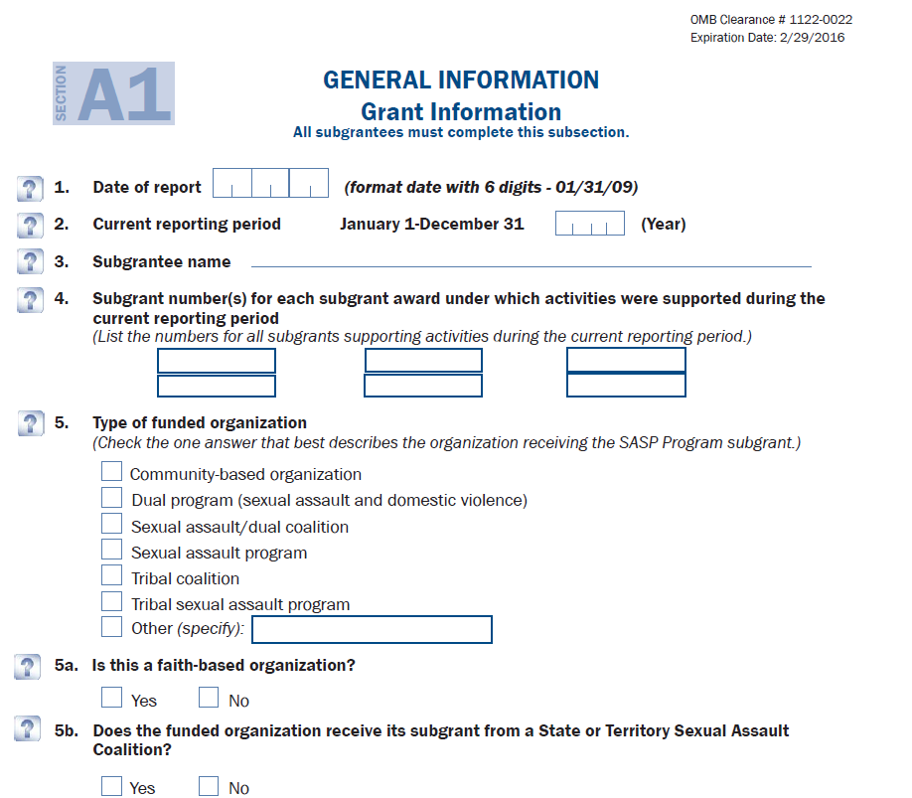
SASP Report Form

Slide 204
Things to remember…
Always VALIDATE your report
If you have questions when completing the report, refer to:
Helpful hints for subgrantees document
Instructions for Annual Progress Report document
If you still have questions, reach out to your grant monitor

Slide 205
VSTOP Reporting
V-STOP operates on a calendar year cycle (January – December), and requires bi-annual progress reports and narratives in GMIS on/by the 15th of the month following the end of the 2nd and 4th quarters, as well as one annual cumulative progress report due in GMIS on/by the last working day of January for the previous calendar year.
To access the report form and instructions, please visit the DCJS Victims Services website

Slide 206
VSTOP Reporting
Required bi-annually to include narrative
Annual cumulative report also required- no narrative required
Only complete the sections that correspond with the funded staff or project
Submit all forms in GMIS

Slide 207
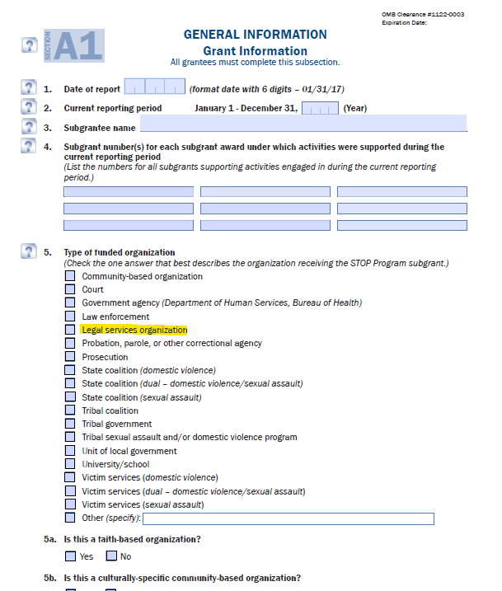
Annual Progress Report Form

Slide 208
Things to remember…
Always VALIDATE your report
If you have questions when completing the report, refer to:
Helpful hints for subgrantees document
Instructions for Annual Progress Report document
If you still have questions, reach out to your grant monitor

Slide 209
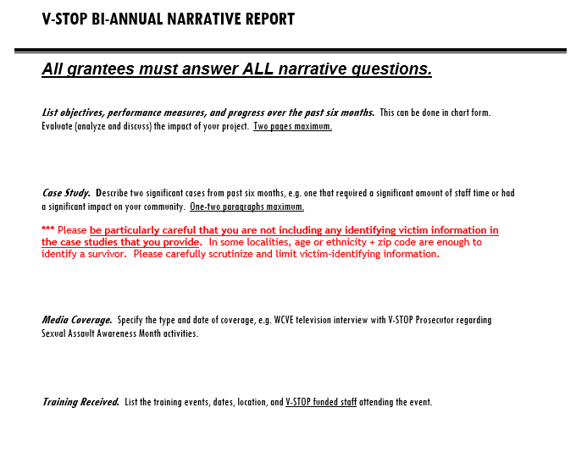
VSTOP Narrative Form

Slide 210
Victim Witness Reporting
Victim Witness operates on a state fiscal year cycle (July – June), and requires quarterly reports in GMIS on/by the 15th of the month following the end of the quarter describing activities supported with these funds.
Victim Witness grantees utilize the Client Information Management System (CIMS) to collect and report all grant funded activity
For technical assistance with CIMS, contact lisa.self@dcjs.virginia.gov
For assistance with completing the report, contact your grant monitor.

Slide 211
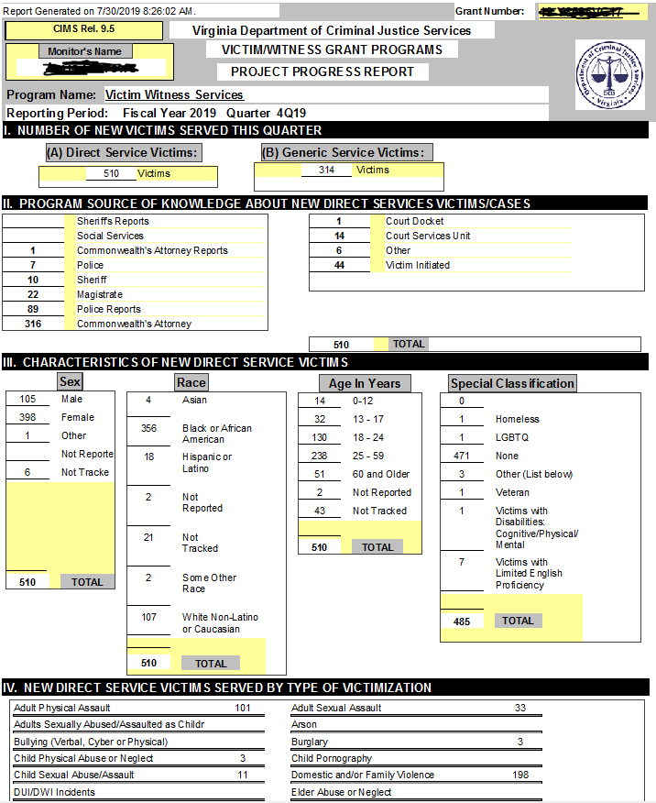
V/W Progress Report

Slide 212
Victims Services Grant Program Reporting
VSGP operates on a state fiscal year cycle (July – June), and requires quarterly reports in GMIS on/by the 15th of the month following the end of the quarter describing activities supported with these funds.
To access the report form and reporting instructions, please visit the Victims Services website

Slide 213
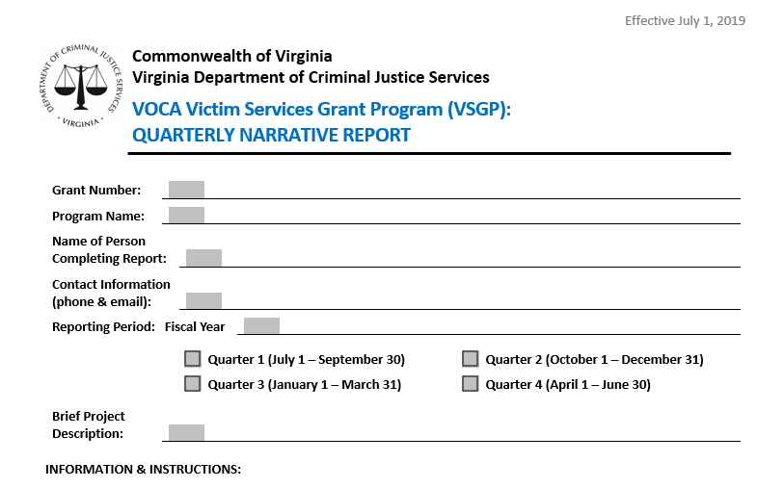
VSGP Narrative Form

Slide 214
Overdue Reports for Continuation Applicants
For projects with no activity, the subgrantee is still required to submit a report indicating there was no activity and/or expenses incurred for that quarter.
Repeated or continued delinquent reporting may result in withholding of grant funds and ineligibility of future funding.
Grantees should consult with their grant monitor to request a report extension. No more than (2) extensions are allowed per grant period.

Slide 215
Quarterly Review Process
The purpose of quarterly reviews is to identify issues that may affect timely project implementation and/or delivery of services for victims.
Grant monitors review all reports for accuracy and reconcile programmatic statistics against the number of victims served, goals and objectives submitted in the grant application.

Slide 216
Common Errors
Report is not completed according to the grant program progress report instructions (e.g., the minimum required two case studies are not provided in the narrative section)
Incomplete report submitted (i.e., targets are missing from the service objectives section or responses are missing from the narrative section)
Insufficient information provided (e.g., narrative response fails to answer or fully address the question according to the grant program progress report instructions)

Slide 217
Common Errors
Report includes information regarding activities which are not supported by the grant (e.g., unallowable or inappropriate accordingly to the grant program guidelines and conditions)
Report does not cover the appropriate reporting period
Report submitted in GMIS for an incorrect grant number
Report submitted on an outdated or incorrect form/file format

Slide 218
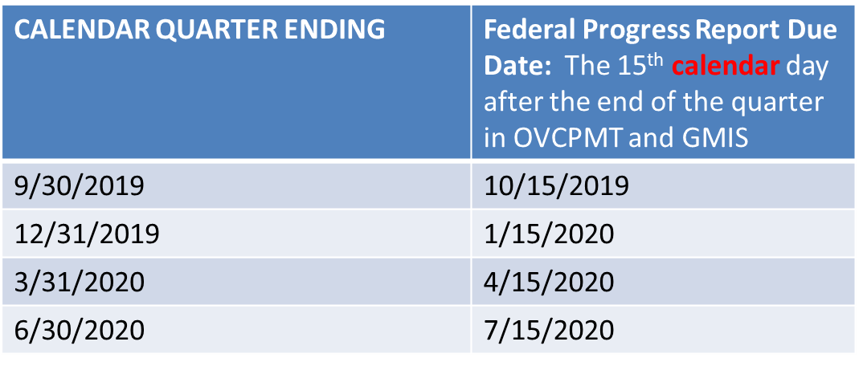
Reporting Deadlines

Slide 219
Technical Assistance
Always verify your data prior to uploading reports in GMIS!
For more information about accurately reporting your outcome performance statistics, consult with your DCJS Grant Monitor.

Slide 220
Victim Services Grant Program (VSGP)
Office of Justice Programs
Office for Victims of Crime
Performance Measurement
Tool (PMT)

Slide 221
Overview
The OVCPMT is a Web-based reporting system where grantees administering Victims of Crime Act (VOCA) Formula funded programs can electronically submit quantitative and qualitative program performance data.
Notes:
Performance measures are developed to collect meaningful data so that grantees can show the progress they have made toward meeting OVC program goals and objectives. Reports are submitted quarterly following the federal fiscal year and narrative data annually. After completing data entry in the PMT for all four quarters, grantees must create an annual report in the PMT and upload it as an attachment to their state’s annual progress reports in the Grants Management System (GMS).

Slide 222
PMT System
Use of the system is required for all Office for Victims of Crime (OVC), Victims of Crime Act (VOCA) funding recipients (subgrantees)

Slide 223
OVC PMT
Navigating the System
Find at: https://ojpsso.ojp.gov/
Use of Google Chrome is recommended and encouraged.
Notes:
Use of other browsers have been known to diminish functionality. The above link takes you to the login screen. Using the Chrome Browser you can enter ovcpmt.ojp.gov to arrive at the same link.

Slide 224
OVC PMT
Navigating the System
Accessing the OVC PMT System:
DCJS staff will set up your initial grant information in OVC PMT
The person listed as the Project Director in your grant application will be listed as the Point of Contact (POC) in OVC PMT
Notes:
OVCPMT only allows one point of contact. Each point of contact can add users to the OVCPMT system. The users will receive correspondence(s) direct to their email address from OVCPMT.

Slide 225
OVC PMT
Navigating the System
Accessing the OVC PMT System:
The POC will receive an email invitation from PMT to establish their account – you may have already
Contact tyler.hinton@dcjs.virginia.gov if your Project Director does not receive this email.
Notes:
804-225-3453 or if your POC changes during the reporting period and there is an immediate need to modify the POC prior to the Program Change Form being processed for your agency. See you Grant Monitor or DCJS website for the Program Change Form.

Slide 226
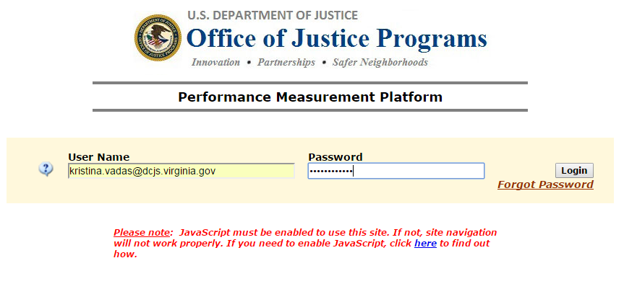
OVC PMT
Navigating the System
Enter User Name and Password
Click “Login”

Slide 227
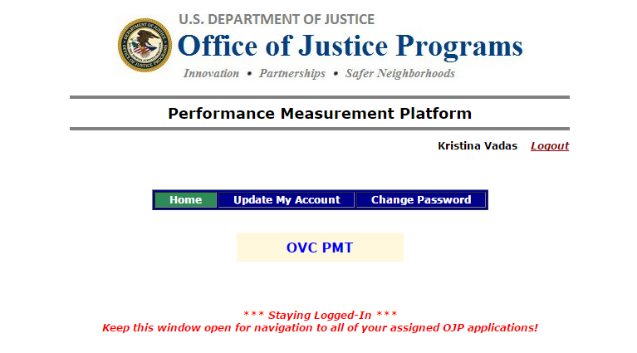
OVC PMT
Navigating the System
You can make updates to your account from this home screen
Notes:
OVCPMT will email the Point of Contacts directly with information and updates that impact performance reporting.

Slide 228
OVC PMT
Navigating the System
Select “OVC PMT” for data entry

Slide 229
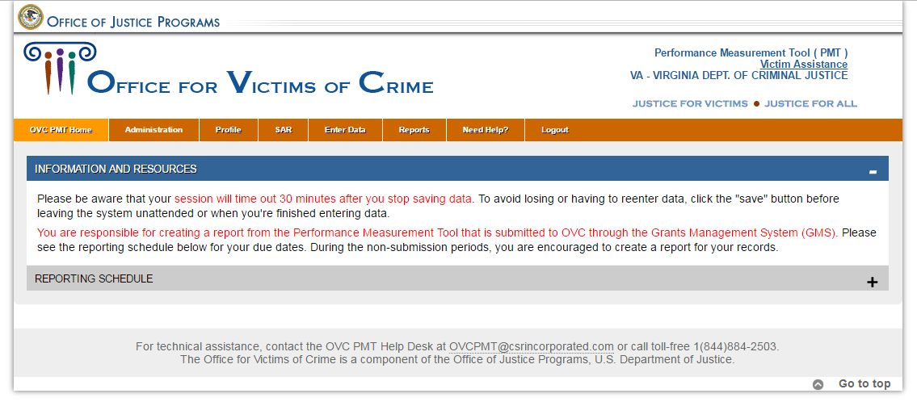
OVC PMT
Navigating the System
New tab opens
Screen will look similar to this:

Slide 230
OVC PMT
Navigating the System
The system will “time out” in approximately 30 minutes.
Be sure to save the data you enter frequently so it is not lost if it times out.
Notes:
The system will timeout 30 minutes after your last SAVE.

Slide 231
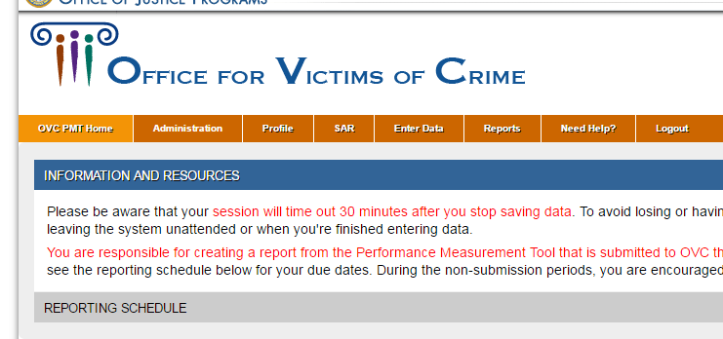
OVC PMT
Navigating the System
You can add additional users
Hover cursor over “Administration” and select “User Management”

Slide 232
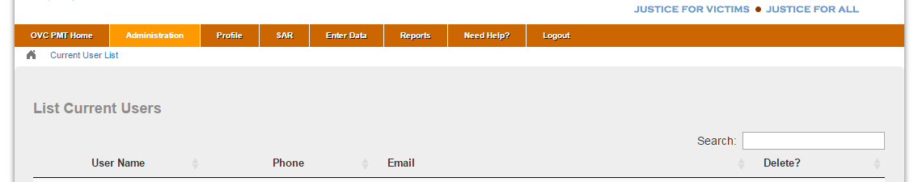
OVC PMT
Navigating the System
Select “Add a new user” at bottom
Notes:
Each subgrantee can add users.

Slide 233
OVC PMT
Navigating the System
Click “Need Help?” tab for resources
Notes:
This tab will show you the most recent approved reporting forms, PPT, and training materials to assist you in navigating the OVCPMT. (See the next slide).

Slide 234
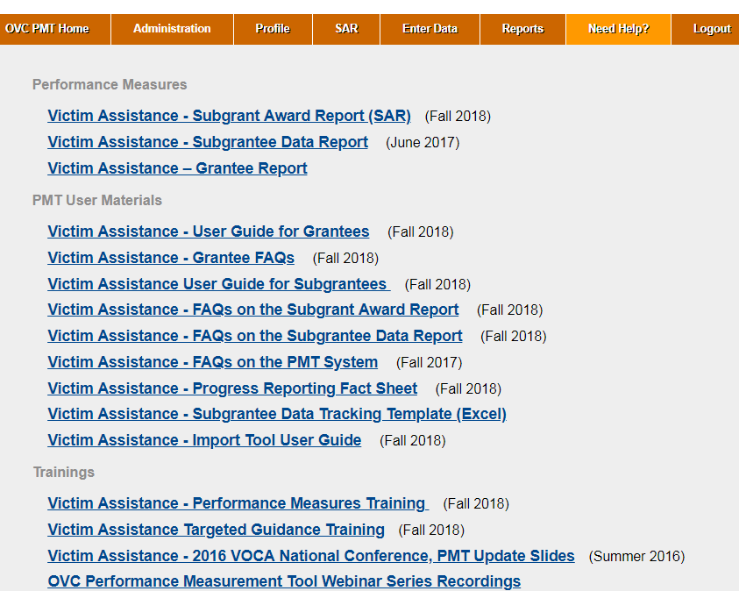
OVC PMT
Navigating the System
You will see this screen:
Notes:
PDF versions of the SAR & Performance Measures Report (listing data entry items) are available here.

Slide 235
OVC PMT
SAR & Data Entry
There are two primary components of your grant record in
the PMT:
Subgrant Award Report (SAR)
Quarterly Performance Data Entry
Notes:
Grantee (DCJS) enters questions 1-6, and Subgrantees enter questions 7-11.

Slide 236
OVC PMT
1. SAR
Subgrant Award Report (SAR):
Completed once at the beginning of the project.
Contains overall information about your grant award
Typically due by the end of the first quarter

Slide 237
OVC PMT
2. Data Entry
Quarterly Data Entry:
Completed at the end of each quarter of the fiscal year
Will be entered under the current SAR/grant fiscal year
SAR must be completed and approved prior to entering quarterly data for Quarter 1

Slide 238
OVC PMT
Entering Quarterly Data
REMINDER:
Report only on services and activities that are
funded through your grant (including state cash match).

Slide 239
OVC PMT
Entering Data
Include services and activities of volunteers and/or student interns that support the grant-funded project.

Slide 240
OVC PMT
Navigating the System
Click on “Enter Data” tab

Slide 241
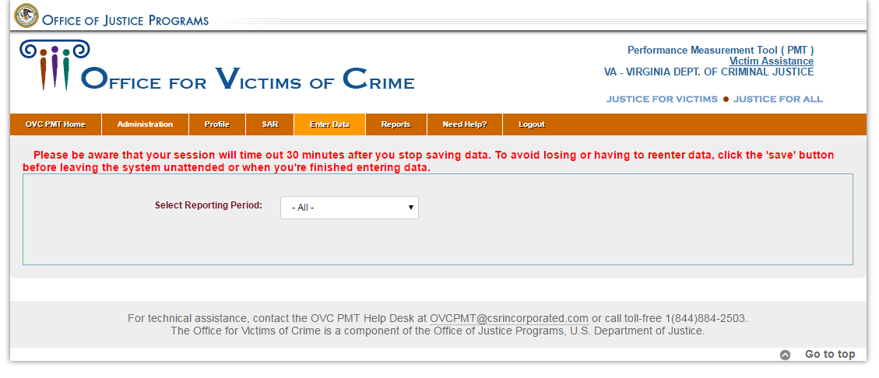
OVC PMT
Navigating the System
Select reporting period from dropdown menu

Slide 242
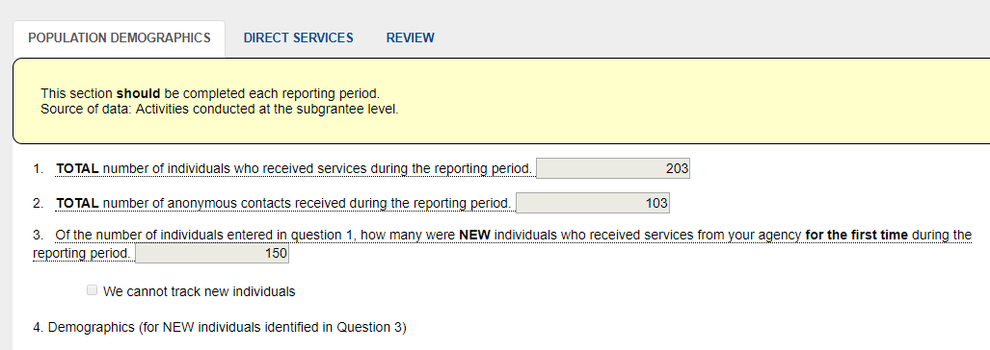
OVC PMT
Navigating the System
Data entry page with three tabs

Slide 243
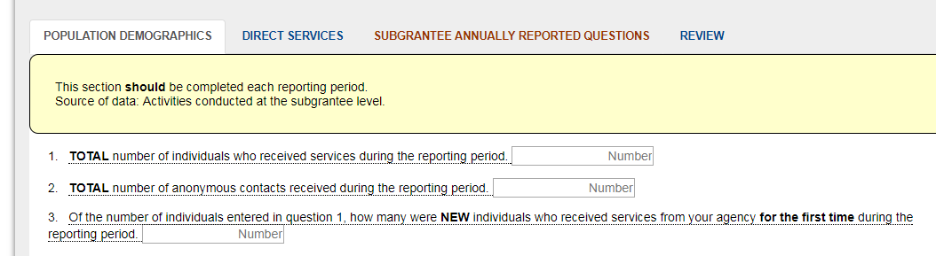
OVC PMT
Entering Data
There will be four tabs when you report in October.

Slide 244
OVC PMT
Entering Data
Subgrantee Annually Reported Questions
This tab will be displayed in October for the July-September quarter because September is the end of the Federal Fiscal Year

Slide 245
OVC PMT
Entering Data
Subgrantee Annually Reported Questions
Please respond to these questions as directed for the July-September 2019 reporting period
You may list “not applicable” or “not yet tracked” if you are unable to answer certain questions

Slide 246
OVC PMT
Entering Data
Report only on services and activities that are funded through this grant program. (including state cash match).
Hover cursor over any underlined words or phrases for additional instructions and/or definitions.

Slide 247
OVC PMT
Entering Quarterly Data
** New Process **
This is a process change, not a change to data collection
Use routine process: Excel spreadsheet, or other data tracking method to generate your quarterly stats
Enter them directly into OVC PMT.
Notes:
The need for the .replace file and .snp is now obsolete. You will upload the PDF generated by the OVCPMT to GMIS to satisfy reporting requirements.

Slide 248
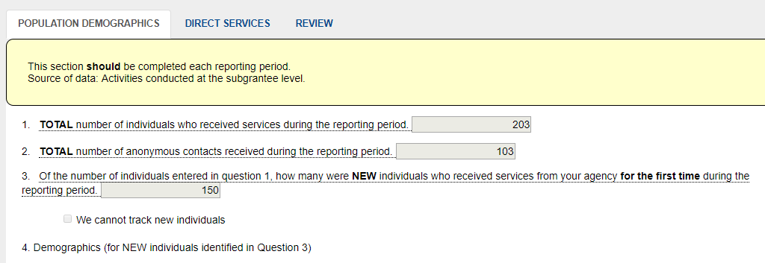
OVC PMT
Entering Data:
Population Demographics Tab

Slide 249
OVC PMT
Entering Data:
Population Demographics Tab
Question 1
Total number of individuals who received services during the reporting period. Count all individuals served by your organization with the use of VOCA plus match funds during the reporting period.
This number should be an unduplicated count of people served during a single reporting period,
Regardless of the number of services they received or victimization types with which they presented.
DO NOT include anonymous contacts
OVC would like an unduplicated count
If your organization only had anonymous contacts, enter zero (0).
Notes:
Count each individual once regardless of number of services or number of victimization types

Slide 250
OVC PMT
Entering Data:
Population Demographics Tab
Question 2
Total number of anonymous contacts received during the reporting period (quarter)
These are typically through a hotline or online chat service where the individuality of each contact cannot be established.
Notes:
If your organization did not have any anonymous contacts enter zero (0).

Slide 251
OVC PMT
Entering Data:
Population Demographics Tab
Question 3
Of the number of individuals entered in question 1, how many were NEW individuals who received services from your agency for the first time during the reporting period
Report the number of NEW individuals
For the first reporting period of your sub award, all individuals should be counted as new.
Notes:
For October report: count all as NEW for continuation sub recipients.

Slide 252
OVC PMT
Entering Data:
Population Demographics Tab
Question 4
Demographic information is as self-reported by the individual
Be sure to carefully review the “Not Reported” and “Not Tracked” definitions; the value of “0” should represent a true value of zero
Notes:
If your organization cannot track new individuals, please check the box indicating such in question #4.

Slide 253
OVC PMT
Entering Data:
Population Demographics Tab
Question 4A
A. Race/Ethnicity
  Hover cursor over each for definition
  Someone identifying bi- or multi-racial should be listed under “Multiple Races”
  Must equal the number reported in Question 3
Notes:
Demographics are for new individuals identified in Question 3.

Slide 254
OVC PMT
Entering Data:
Population Demographics Tab
Question 4B
B. Gender Identity
  As self-reported by the individual
  Provide a brief description if “Other” is selected
  Must equal the number reported in Question 3

Slide 255
OVC PMT
Entering Data:
Population Demographics Tab
Question 4C
C. Age
  Report each individuals’ age at the time of the victimization for which they are seeking services
  If a victim reports multiple victimizations at different ages, report the victim’s age at time of the earliest reported victimization
  Must equal the number reported in Question 3

Slide 256
OVC PMT
Entering Data:
Population Demographics Tab
Question 5. A., B., and C.
Indicate the types of victimizations for all individuals counted in Question 1 and 2
The value of “0” should represent a true value of zero

Slide 257
OVC PMT
Entering Data:
Population Demographics Tab
Question 5A
A. Victimization Type
  Hover cursor over each for definition
  An individual may be counted under more than one victimization type
  Do not count an individual more than once within the same victimization type

Slide 258
OVC PMT
Entering Data:
Population Demographics Tab
Question 5B
B. Multiple Victimization Types
  List the number of individuals (from Questions 1 & 2) that presented with more than one type of victimization
  In other words, how many individuals were counted under more than one victimization type in “A”?

Slide 259
OVC PMT
Entering Data:
Population Demographics Tab
Question 5C
C. Special Classifications
  As self-reported by the individual
  Individuals may not report any of the listed special classifications
  Individuals may be counted under more than one special classification
  “Other” includes any additional classification that you track

Slide 260
OVC PMT
Entering Data
Reminder:
Be sure to save frequently!
Notes:
The system times out after 30 minutes.

Slide 261
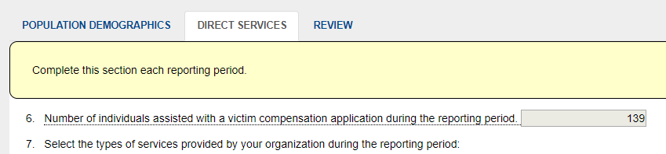
OVC PMT
Entering Data:
Direct Services Tab

Slide 262
OVC PMT
Entering Data:
Direct Services Tab
Question 6
Enter the number of individuals assisted with a victim compensation application during the quarter
(Virginia Victim Fund (formerly CICF) application)
Must have provided more assistance than simply handing out the application form
Notes:
Must be selected to continue with completing the PMT. The subgrantee must certify that they will assist potential recipients in seeking crime victim compensation benefits through various methods (availability of local victim service agencies (VWP) referrals or brochures and VVF brochures or outreach materials available in the office or with advocates).

Slide 263
OVC PMT
Entering Data:
Direct Services Tab
Questions 7. A., B., C., D., and E.
This is where services are documented
Five broad categories
Each category has additional subcategories of services
Reminder to report only grant-funded services
Notes:
See Appendix A and B for definitions common to the report questions.

Slide 264
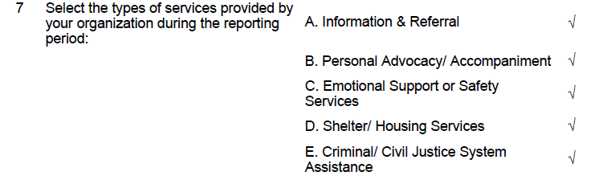
OVC PMT
Entering Data:
Direct Services Tab
Question 7:
First select the broad categories of services provided by your agency:
Notes:
all programs should be checking Information and Referral (Box A) if they work at all with victims.

Slide 265
OVC PMT
Entering Data:
Direct Services Tab
Question 8.
Once checked, additional options will drop down below in Question 8

Slide 266
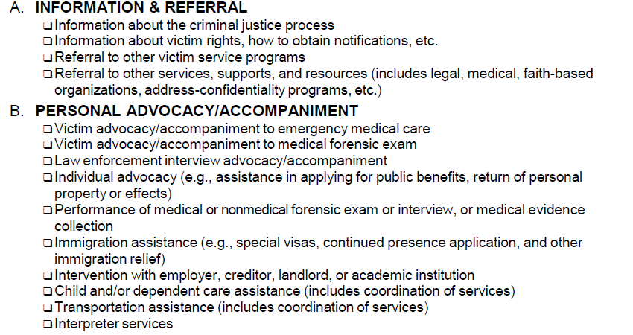
OVC PMT
Entering Data:
Direct Services Tab
Example:

Slide 267
OVC PMT
Entering Data:
Direct Services Tab
Question 8.
For each broad category that you checked, enter the number of individuals who received services in the category,
Enter the number of times that service was provided
Some clients may receive multiple services, the total number of times that services were provided within a category may be greater than the number of individuals who received those services.

Slide 268
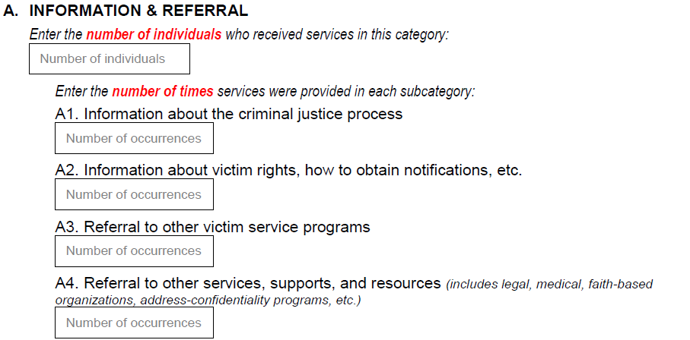
OVC PMT
Entering Data:
Direct Services Tab
Example:
For each subcategory within the broad categories that you checked, enter the number of times each service was provided during the reporting period

Slide 269
OVC PMT
Entering Data:
Direct Services Tab
Question 8
Zero is a valid response if you do not offer the subcategory service
Clients may be counted more than once in a subcategory

Slide 270
OVC PMT
Entering Data:
Direct Services Tab
Question 8
Be sure to count each service in only one subcategory; in other words, for each service you provide, pick the one subcategory that best describes it.

Slide 271
OVC PMT
Entering Data:
Direct Services Tab
Question 8
Some of the services have additional explanations and/or definitions; hover over these to view them
Services in categories A, B, C:
  Generally self-explanatory
  May not be applicable to all projects

Slide 272
OVC PMT
Entering Data:
Direct Services Tab
Question 8:
Services in category D (Shelter/Housing Services):
  May not be applicable to all projects
  D1 (Emergency shelter or safe house) & D2 (Transitional housing): A “unit” of service can be number of bed nights in shelter / transitional

Slide 273
OVC PMT
Entering Data:
Direct Services Tab
Question 8:
Services in category E (Criminal/Civil Justice System Assistance):
  E4, E5, E7: Can be an advocate, paralegal, attorney, or other person providing this type of assistance
  E6, E11: Very broad; use only if a service you provide truly doesn’t fit anywhere else
Notes:
Services designated with “Other” should used only if the service(s) do not fit anywhere else.

Slide 274
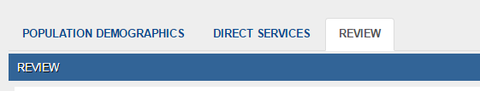
OVC PMT
Entering Data: Review Tab
Will alert you to any errors or missing information in the data you entered
Notes:
It will state “REQUIRED” next to incomplete questions – usually in red or blue font; won’t let you save until corrections are made
Quarterly Narrative Questions from OVC are #10-#15. Andi Martin provided the quarterly progress narrative report form to all subgrantees on July 29th.

Slide 275
OVC PMT
DCJS Review
DCJS staff will review the data you entered
Staff may contact you additional clarification or corrections
Once verified by DCJS, your data will be submitted to OVC

Slide 276
OVC PMT
Quarterly Submissions
As a reminder:
Enter OVC PMT data on/by the 15th of the month following the end of the quarter.
FINANCIAL REPORTS are due within 15 days after the end of each calendar quarter and must be approved by your locality’s Financial Officer. Reports are required even if no expenditures occurred during the quarter. If the due date falls on a weekend or non-business day, the report is due on the next business day. For financial questions, contact Bill Dodd at (804) 371-0638 or via email at Bill.Dodd@dcjs.virginia.gov or Mark Fero at (804) 225-2782 or via email at Mark.Fero@dcjs.virginia.gov
Submit copy of PMT data AND Quarterly Narrative Report in GMIS on/by 15th day following the end of the quarter. *
Notes:
Sub grantees are encouraged to submit progress and financial reports ahead of the deadline.

Slide 277
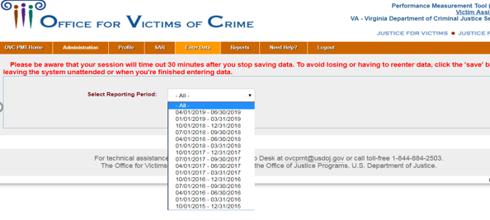
OVC PMT
Navigating the System
Reports
Notes:
Note: Future reporting periods are not available until OVCPMT opens it.

Slide 278
OVC PMT
Navigating the System
Can generate a PDF or Excel document that you can save
Notes:
This option to save PDF or Excel format is found on the Reports Tab.

Slide 279
OVC PMT
Quarterly Submissions
GMIS will allow up to four documents to be uploaded in a reporting period field.
A copy of the narrative report must be uploaded to GMIS only.
GMIS will accept files that end in: .pdf .rtf .snp .txt .zip .doc .xls
Note: Financial reports are also due in GMIS on/by the 15th calendar day following the end of the quarter.
Notes:
You may want to upload additional information in GMIS that supports the progress of your project. Ex. Newspaper articles, social media snips, etc.

Slide 280
Reporting Deadlines:
    Note: Financial reports are also due in GMIS on/by the 15th calendar day following the end of the quarter.
CALENDAR QUARTER ENDING | Federal Progress Report Due Date: The 15th calendar day after the end of the quarter in OVCPMT and GMIS
9/30/2019 | 10/15/2019
12/31/2019 | 1/15/2020
3/31/2020 | 4/15/2020
6/30/2020 | 7/15/2020
Notes:
We welcome completion of the SAR prior to October 6th. If you will complete and upload your report prior to 10/6/2019 you will need your SAR completed and certified prior to that date. Please contact Tyler Hinton.

Slide 281
For OVCPMT Assistance:
OVCPMT Help Desk at
1-844-884-2503
or
ovcpmt@usdoj.gov
Notes:
Note: You must reference the federal assigned grant number (Ex. 2018-V@-GX-OO11) from your SOGA when calling the OVCPMT Help Desk.

Slide 282
For Technical Assistance:
Tyler Hinton
Victims Services Program Admin Specialist
(804) 225-3453
Tyler.Hinton@dcjs.virginia.gov
Patricia Foster
Victim Witness Grant Program Coordinator
(804) 371-8634
Patricia.Foster@dcjs.virginia.gov

Slide 283





When you hear ‘Program Evaluation’ or have attempted it in the past, you may have had one or more of the following reactions:
Program Evaluation

Slide 284

Hopefully, by the end of this presentation, your reaction toward Program Evaluation will be more like...
Program Evaluation

Slide 285
What is Program Evaluation?
A way to understand whether or not a program or service is meeting its intended purpose.
Measures the impact of the program or service:
  Did a housing workshop on renting increase clients’ knowledge on the rental process?
  Has the LAP program strengthened your agency’s relationship with law enforcement?
  What knowledge are attendees at educational programming gaining about relationship violence/sexual violence/stalking/human trafficking?
  How could the functionality of the SART improve?
(Boyd, Boyd, & Rapp, 1997; PCAR, n.d.)
Notes:
Program evaluation is a way to understand whether or not a program or service is meeting its intended purpose.
This is done by measuring the impact of the program or service, which there are a variety of methods to do so. We will discuss those methods shortly.
With measuring the impact of a program or service, questions you can receive answers through evaluation results are:
Did a housing workshop on renting increase clients’ knowledge on the rental process?
Has the LAP program strengthened your agency’s relationship with law enforcement?
What knowledge are attendees at educational programming gaining about relationship violence/sexual violence/stalking/human trafficking?
How could the functionality of the SART improve?

Slide 286
Measuring Outcomes
Improve quality of services
Reinforce program accountability
Focus board members’ attention on programmatic issues
Identify training needs
Develop and justify budgets
Provide required information to funding sources about impact of services
(PCAR, n.d.)
Notes:
Instead of focusing on numbers such as how many hotline calls you have received in a month, focusing on outcomes and the impact your programs/services are having will show what client/community needs are and are not being met.
Measuring outcomes allows you to:
Improve quality of services—are you meeting clients’ needs? Are you meeting your agency’s objectives?
Reinforce program accountability- sharing program/service outcomes with board members and the community can be motivational for staff in knowing they play a role in the program/service’s success.
Focus board members’ attention on programmatic issues—Sharing program/service outcomes with board members will give them insight on the impact the agency is having in both clients’ lives and the community.
Identify training needs- program/service outcomes could identify areas where more training is needed for staff, volunteers, and/or interns.
Develop and justify budgets- Knowing program/service outcomes makes knowing how to allocate resources and provide rationale for those decisions easier. When applying for grant funds, funders, DCJS included, ask for rationale for items in your budget. Reporting results you have found from evaluating your programs/services is great way to provide support for why you want to allocate certain resources for those programs/services.
Provided required information to funding sources about impact of services- We are going to delve more into this on the next slide!

Slide 287
Grant Requirements
PMT
VSTOP
Victim Witness
VSGP
FVPSA
Notes:
When reporting on your grant activities, the report usually asks for you to explain how you are meeting your goals and objectives and the impact of programs/services.
One of the reporting tools used is PMT, Performance Management Tool. In 1993, the Office for Victims of Crime (OVC) was mandated under the Government Performance and Results Act (GPRA) to have strategic planning, performance planning, and reporting as a framework to demonstrate progress in achieving its mission. PMT collects data to determine if a program has achieved its goals and objectives not to evaluate the program. In Virginia, through CIMS, we look at performance measures that demonstrate programs have met the following goals and objectives: Victim access to services; emphasis on evidence-based programs and practices; support the provision of direct services to crime victims, and more.
(Next)
VSTOP requires that programs do some kind of program evaluation. This is usually in the form of surveys. VSTOP’s reporting form currently only collects outputs, not outcomes. There has been movement towards a more outcome-based evaluation system, but VSTOP is not there yet. The DOW (document our work) cannot single out specific services or projects, so it can not be used for VSTOP grant.
(Next)
VOCA believes that evaluation is an important part of improving victim services by developing data-driven improvements to programs
To justify expenses and new projects (completive grant process)
Utilize evaluation data to answer certain progress report questions
(Next)
For example, in Victim Witness’s progress report, Question 1 asks about program accomplishments and changes. This could be a good place to discuss successful program outcomes found from program evaluation.
(Next)
Another example is in the VOCA Victim Services Grant Program (VSGP)’s Quarterly Narrative Report, Question #3 asks for the number of surveys distributed and the number of surveys completed. This information is collected annually through the PMT.
Question 6 asks to Describe any emerging issues or notable trends affecting crime victim services in your service area. From your program evaluation data, let’s say you find that there were more sexual violence teen victims who utilized the youth counseling program in the current quarter compared to the previous quarter. You could then discuss possible reasons for the increase in teen clients.
(Next)
Lastly, the Family Violence Prevention and Services Act (FVPSA) requires outcome evaluation to show the impact of FVPSA funding. There are resources at the end of this presentation on FVPSA, one is the direct link to FVPSA’s information center and the second is the Action Alliance’s module Documenting Our Work which provides instruction on how Virginia captures data for FVPSA. Each state is different, so please follow the Action Alliance’s guidance on documenting evaluation data for FVPSA.

Slide 288

Steps to Program Evaluation
Constructing the Evaluation
Goals and Objectives
Collect Data
Interpret Data
(Boyd et al., 1997; PCAR, n.d.)
Notes:
There are four basic steps in program evaluation. (Next)

Slide 289
1. Constructing the Evaluation
What needs are you trying to address?
Who is your target audience?
What factors may influence the participation and program success?
(Boyd et al., 1997; PCAR, n.d.)
Notes:
Before you start drafting up a survey or forming focus groups, you need to think about what you want to evaluate. These are some questions to ask yourself when brainstorming your evaluation

Slide 290
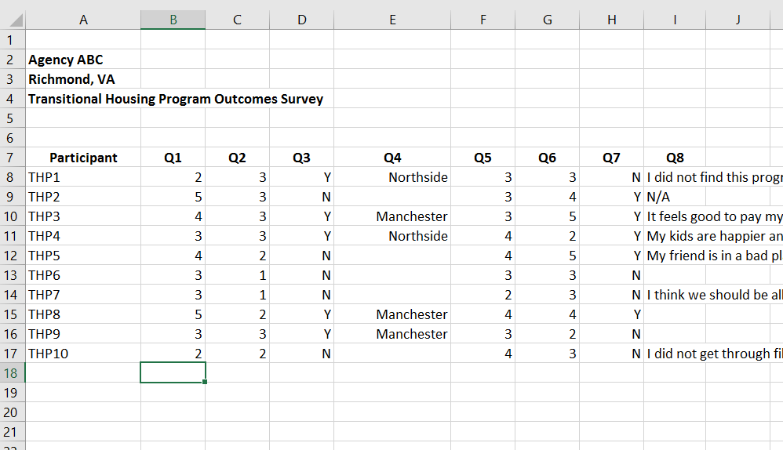
Ethical and Practical Considerations
Timing
Anonymity
(PCAR, n.d.)
Notes:
When beginning to brainstorm your program evaluation, there are also ethical and practical items to consider.
Timing the evaluation of a service. It does not make sense to try to evaluate a client’s forensic accompaniment experience during that accompaniment. When a client is in crisis, it is never ethical or practical to conduct a program evaluation. Timing may be better, for example, when you are debriefing with the client a day after their court accompaniment to evaluate their court accompaniment experience.
Anonymity. We all know that for victims, confidentiality is critical. In many ways, it is the core of all direct services provided to victims. Ethical research involves keeping all personally identifying information of research subjects confidential and in many ways anonymous. For example, you ask your client Ruth Wilder to participate in a survey to measure outcomes of the transitional housing program. You give her the survey which does not ask for any identifying information. At the top of the survey is a code THP10, which indicates that Ruth is the 10th person to take the survey on the transitional housing program. Therefore, when you go to enter data later in Excel, for Ruth’s survey, instead of entering her name, you would enter THP10 and then her survey responses. As you can see, this keeps all participants’ responses anonymous.

Slide 291
2. Goals and Objectives
Goal = what you want your program to accomplish, broader than an objective.
e.g. Provide transitional housing to domestic violence victims.
Objective = specific action that has to happen in order to reach the goal.
e.g. Create community partnerships with private landlords.
How do you know if your goals and objectives have been met?
(Boyd et al., 1997; PCAR, n.d.)
Notes:
The second step in program evaluation is defining your goals and objectives.
A goal is simply what you want your program to accomplish, broader than an objective. For example, Provide transitional housing to domestic violence victims.
An objective is a specific action that has to happen in order to reach the goal. For example, Create community partnerships with private landlords.
After creating the goals and objectives for your program evaluation, how will you know if your goals and objectives have been met?

Slide 292

3. Collect Data
Quantitative Data = Numbers! E.g. attendance records, questionnaires, Likert scales (scale of 1-5 or 1-10)
Qualitative Data = Words! E.g. document review, observations, interviews, focus groups. Open-ended questions in surveys or questionnaires also provides qualitative data.
(Boyd et al., 1997; PCAR, n.d.)
Notes:
You will know if your goals and objectives have been met after collecting and interpreting the data. The third step in program evaluation is collecting data. There are two primary methods of collecting data.
The first is quantitative data. This is simply numbers! An example would be creating a questionnaire with Likert scale questions, How satisfied were you with the transitional housing program? 1- Very Dissatisfied; 2-Somewhat Dissatisfied; 3- Neither Satisfied or Dissatisfied; 4- Somewhat Satisfied; 5- Very Satisfied.
The second is qualitative data. This is all about words! The focus is on finding themes in the environment through observation and analyzing written or verbal responses. For example, an open-ended question in a survey that asks, “How was your experience in the transitional housing program?”

Slide 293

4. Interpret Data
Recurring Themes: Victims consistently stated needing more assistance with childcare.
Data Analysis: Were there more clients who were Very Satisfied compared to Very Dissatisfied with the transitional housing program?
(Boyd et al., 1997; PCAR, n.d.)
Notes:
The final step in program evaluation is interpreting the data that you have collected.
When interpreting the data you’ve entered in Excel, you are looking for recurring themes. Such as victims consistently stating that they need more assistance with finding childcare.
When analyzing the quantitative (numbers!) data, you’ll be able to see if, for example, more participants indicated whether they were very satisfied or very dissatisfied with the transitional housing program.

Slide 294

Now What?
Continue or expand program
Change or remove program
Train staff and volunteers on identified areas
Report findings to board members, funders, new funding opportunities, community partners
(Boyd et al., 1997; PCAR, n.d.)
Notes:
You’ve interpreted all of your data from you program evaluation, so now what do you do with it?
Well, based on the data, you could have gained information that would lead you to continue or expand the existing program.
The information from your data could also tell you that you need to change or remove the existing program.
The data could have also given you insight on training areas needed for your staff and volunteers.
You can also use the findings from your program evaluation to share with your board, funders, in applications for new funding opportunities, and/or your community partners.

Slide 295
Logic Model
Concrete picture of what your agency is trying to achieve with each program/service and what resources your agency needs in order to provide each program/service
Components:
  Inputs: resources that allow a program to operate (e.g. staff, time, money, supplies)
  Activities: how the program utilizes its resources (e.g. prevention education, counseling, accompaniment)
  Outputs: direct impact of the program’s activities- a quantity such as number of clients served
  Outcomes: specific benefits clients experienced as a result of the program (e.g. client increased knowledge about healthy relationships). Outcomes are categorized as short-term, intermediate-term, and/or long-term.
(Boyd et al., 1997; PCAR, n.d.)
Notes:
Before we wrap up, we wanted to briefly go over logic models. This is a great tool to use in determining program outcomes. We encourage you to look more into logic models and using them at your agency. To start, what is a logic model?
A logic model is a concrete picture of what your agency is trying to achieve with each program/service and what resources your agency needs in order to provide each program/service.
Logic models are comprised of four components.
The first is Inputs: resources that allow a program to operate such as staff, time, money, supplies.
The second is Activities: how the program utilizes its resources such as prevention education, counseling, accompaniment.
The third is Outputs: the direct impact of the program’s activities, a quantity such as number of clients served.
The last component is Outcomes: specific benefits clients experienced as a result of the program such as client increased knowledge about healthy relationships. Outcomes are categorized as short-term, intermediate-term, and/or long-term.

Slide 296
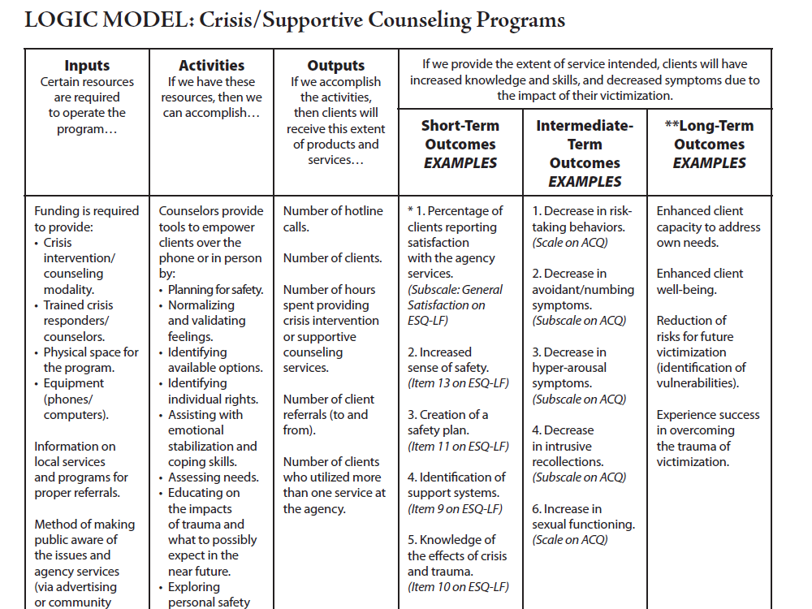
Logic Model
(PCAR, n.d.)
Notes:
Here is an example logic model on crisis/supportive counseling programs from the Pennsylvania Coalition Against Rape (PCAR). You can see how the logic model provides a nice flow of how outcomes are achieved for this example crisis/supportive counseling program.
The first is Inputs: resources that allow a program to operate such as staff, time, money, supplies.
The second is Activities: how the program utilizes its resources such as prevention education, counseling, accompaniment.
The third is Outputs: the direct impact of the program’s activities, a quantity such as number of clients served.
The last component is Outcomes: specific benefits clients experienced as a result of the program such as client increased knowledge about healthy relationships. Outcomes are categorized as short-term, intermediate-term, and/or long-term.

Slide 297
Resources
NSVRC Evaluation Toolkit
FVPSA Outcomes Project Information Center
VAdata Module 5 Documenting Our Work
National Center on Domestic and Sexual Violence: Evaluation/Program Evaluation
OVC Guide to Performance Measurement and Program Evaluation
Evaluation: Putting Evaluation to Work
Michigan State University: Program Evaluation for Domestic Violence Agencies
University of Wisconsin-Madison: Program Development and Evaluation
Notes:
Here is a sampling of program evaluation resources that we encourage you to utilize. All of these resources will assist you from start to finish in doing program evaluation. A few have more information on executing a logic model as well

Slide 298
References
Boyd, S. L., Boyd, S. E., & Rapp, K.A. (1997). Taking Stock: A practical guide to evaluating your own programs. Chapel Hill, NC: Horizon Research, Inc. Retrieved from http://www.horizon-research.com/taking-stock-a-practical-guide-to-evaluating-your-own-programs
Pennsylvania Coalition Against Rape (PCAR). (n.d.). Victim Service Program Evaluation. Harrisburg, PA: PCAR. Retrieved from https://pcar.org/resource/victim-service-program-evaluation

Slide 299

Questions?

Slide 300


Slide 301
Session Objectives
Purpose of compliance monitoring
State Administering Agency’s authority to monitor subrecipients
Grantee responsibilities
Risk assessments
Monitoring methods and plan
On-site monitoring procedures
Items for review for on-site visits
Frequent issues
Fiscal desk reviews

Slide 302
Grant Monitoring Overview
Monitoring is the process of reviewing, with staff of a grant-funded project, the project’s implementation, activities, performance and expenditures to determine if it is operating as proposed in the approved grant application and in accordance with grant requirements, conditions, as well as any applicable regulatory requirements, and to identify any technical assistance needs of the grant recipient.
Monitoring may include review of the fiscal and programmatic aspects of a grant-funded project.

Slide 303
Grant Monitoring Overview
The term “monitoring” is used to describe both the broad overall system of reviewing and tracking the use of federal and state funds, and the more specific day-to-day review processes to assure that a particular sub-grantee is in compliance with federal or state rules and regulations, and is meeting the goals and objectives of the grant.

Slide 304
Purpose
The Department of Criminal Justice Services (DCJS) Grant Monitoring Plan ensures that sub-grantees are in compliance with all grant conditions.
DCJS develops a risk-based monitoring plan, conducts fiscal and programmatic monitoring on all sub-grantees, and enhanced monitoring of sub-grantees determined to be medium and high risk.
Grant Monitors and the Grants Administration Staff are responsible for monitoring the activities of sub-grantees to ensure that awards are used for authorized purposes and in compliance with 2 C.F.R. §§ 200.303 and 200.331, and other federal statutes, regulations, and the terms and conditions of the awards.

Slide 305
Authority
Grant Monitors and the Grants Management Staff are responsible for monitoring the activities of sub-grantees to ensure that awards are used for authorized purposes and in compliance with 2 C.F.R. §§ 200.303 and 200.331, and other federal statutes, regulations, and the terms and conditions of the awards.
The DCJS grant solicitation, subsequent application and statement of grant award (SOGA) contain all of the required information listed in 2 C.F.R. § 200.331 (a).

Slide 306
Policy
As part of the application process new applicants that have not previously received federal grant funds from DCJS will be required to complete the DCJS New Sub-Grantee Questionnaire (Attachment 1).
This questionnaire meets the Uniformed Guidance required for pass-through entities outlined in 2 CFR 200.331 (b). The questionnaire is used by the grant monitor to complete a risk assessment and inform the monitoring plan for the upcoming award period.

Slide 307
Policy
Grant Monitors will conduct on-site monitoring visits and desk reviews of sub-grantees with the level and frequency based on the results of annual risk assessments.
The objectives of periodic reviews are to ensure sub-grantees:
  Carry out program activities as stipulated in the grant solicitation, grant application, and Statement of Grant Award (SOGA);
  Have adequate internal controls to protect federal funds;
  Claim reimbursements for costs that are allowable, reasonable, allocable, and necessary under program guidelines;
  Identify any conflicts of interests that exist; and,
  Maintain reported supporting documentation/records for future auditing purposes.

Slide 308
Grant Monitoring
Risk Assessment
As stated in the DOJ Financial Guide, DCJS should evaluate the subrecipient's risk of non-compliance with Federal statutes, regulations and terms and conditions of the subaward for purposes of determining the appropriate monitoring.
Notes:
In response, DCJS adopted a Monitoring Policy, effective March 5, 2019

Slide 309
Risk Assessment:
Monitoring Policy
The DCJS Monitoring Policy states:
  A risk assessment is completed by the Grant Monitor before the grant award period begins and/or annually to inform the monitoring plan for the following year
  Grant Monitors will complete a risk assessment using the Grant Monitoring Risk Assessment Tool with meets the required elements in 2 CFR 200.331 (b), to evaluate each sub-grantee’s risk of noncompliance.
  New sub-grantees will need to complete the New Sub-Grantee Questionnaire before they receive an award.

Slide 310
Risk Assessment:
Monitoring Policy
The risk assessment takes into consideration the following financial and programmatic factors:
  Total dollar amount of grant award
  Timeliness of financial reporting to DCJS
  Results of a Single-Audit
  When a site-visit was last conducted
  Timeliness of programmatic progress reporting to DCJS
  Turnover of DCJS-funded key staff
  Duration of sub-grantees grant experience
  Other issues of noncompliance and recurring or unresolved issues

Slide 311
Risk Assessment:
Scoring
One of three risk categories
  High (score of 14 or greater)
  Moderate (score of 7-13)
  Low (score of 6 or low)
The risk level may be adjusted to a higher level based on additional information that DCJS is aware of including,
  Results of other grant monitoring from partner agencies
  Financial instability
  Results from previous site visits
  Recurring or unresolved issues
  Concerns about internal controls
  Financial management issues
Notes:
A weighted numeric value is assigned to each factor, with higher numbers indicating higher risk.
Based on total risk score, sub-grantees will be placed in to one of three risk categories
High (score of 14 or greater)
Moderate (score of 7-13)
Low (score of 6 or lower)
The risk level may be adjusted to a higher level based on additional information that DCJS is aware of, including,
Results of other grant monitoring from partner agencies
Financial instability
Results from previous site visits
Recurring or unresolved issues
Concerns about internal controls
Financial management issues

Slide 312
Risk Assessment:
Monitoring Plan
Risk assessment scores are used to develop a Monitoring Plan.
Determines which programs receive an on-site monitoring visit during the fiscal year (July-June)
High Risk scores will be monitored annually until they meet compliance.
Moderate and Low risk scores will be monitored every two years as required by federal regulations
Grant Monitor can modify the monitoring plans to reflect a new risk level throughout the year
Notes:
The Grant Monitor will use the risk assessment scores, and other information, to develop a Monitoring Plan.
The scores will also be used to determine if additional technical assistance or monitoring is needed to help the program come into compliance
If issues arise that cause the sub-grantee’s risk level to be reclassified, the Grant Monitor will modify the monitoring plans to reflect the new risk level and to ensure proper accountability and compliance with program requirements and achievement of performance goals.

Slide 313
Risk Assessment:
High Risk Monitoring
High Risk Sub-grantee can expect:
  On-site monitoring visit annually
  Fiscal desk review annually of at least 20 randomly selected individual expenditure lines
  On-site training and technical assistance

Slide 314
Risk Assessment: Moderate Risk Monitoring
Moderate Risk Sub-grantees can expect:
  On-site monitoring visits every two years
  Fiscal desk review annually of at least 10 randomly selected individual expenditure lines
  Resources for training and technical assistance

Slide 315
Risk Assessment:
Low Risk Monitoring
Low Risk Sub-grantees can expect:
  On-site monitoring visits every two years or as the grant program requires
  Fiscal desk review annually of at least 5 randomly selected individual expenditure lines

Slide 316
Monitoring Frequency
Based on the assessed level of risk, DCJS Staff will conduct monitoring visits according to the following schedule:
  For subgrantees determined to be high risk, visits will be conducted annually
  For subgrantees determined to be moderate risk, visits will be conducted every 2 years
  For subgrantees determined to be low risk, visits will be conducted every 2 years

Slide 317
Monitoring Practices
There are four key components of the DCJS Monitoring Program Model:
  Subrecipients are monitored according to the risk-based monitoring policy
  Monitoring efforts focus on the areas of most risk
  All monitoring findings are addressed through appropriate corrective actions; and
  Ongoing financial and programmatic training and technical assistance is provided to subrecipients to enable them to complete the terms and conditions of the award and maintain their funding

Slide 318
Grant Monitoring Practices
Grant monitors will:
  Perform a pre-award risk assessment to determine the fitness of sub-grantee to receive new grant funds.
  Review quarterly financial and programmatic reports required by DCJS.
  Ensure that sub-grantees take timely and appropriate action on all deficiencies pertaining to the grant award detected through audits, on-site monitoring visits, desk reviews, and other monitoring activities.
  Conduct trainings and/or provide technical assistance for sub-grantees to help administer the grant.

Slide 319
Grant Monitoring Practices
Grant monitors will:
  Evaluates any newly revealed information that may affect sub-grantees’ risk score and modify the monitoring plan as necessary.
  Coordinates with the DCJS Grants Management Section for the issuance of management decisions for audit findings relating to DCJS grant funding.
  Conducts on-site monitoring visits of sub-grantees to ensure financial and programmatic compliance.

Slide 320
Notification
The DCJS Grant Monitor will send a formal notification letter at least 30 calendar days before the visit to confirm dates and scope of review; provide details of documentation needed for the review; specify expected timeframe for the review; and ensure key officials (project director, project administrator, and finance officer, and grant-funded staff) are available during the visit.
Should an immediate visit be necessary, notice will be sent and arrangements made to meet at the soonest time available for both parties.
The Grant Monitor will also provide the sub-grantee with the On-Site Monitoring Checklist and request that supporting documentation be compiled by the start of the on-site monitoring visit. Additional documents may be required for VOCA and OJJDP grant programs.

Slide 321
File Review & Preparation
In preparation for an on-site monitoring visit, the Grant Monitor will review all documentation in the sub-grantees file, including the grant application, Statement of Grant Award, special conditions, financial and progress reports, drawdown history (payments made to the sub-grantee), and copies of recent audit reports.

Slide 322
Supporting Documentation, Data Gathering and Analysis
During the review, the Grant Monitor will complete the Sub-grantee Monitoring Tool and address noted concerns with the sub-grantee.
The Grant Monitor will track each step followed during the review process, document conversations with sub-grantee staff and key grant officials, and inspect the progress of the project/program.
The length of a site visit varies and is based on many factors, including the number and complexity of awards being monitored, the nature of the program(s), and the analysis of variables that inhibit a grant program from being in compliance and auditable according to all appropriate federal and state grant provisions.

Slide 323
Supporting Documentation, Data Gathering and Analysis
DCJS advises that most site visits can be completed, on average, between three to five hours. The grant monitor will then have 90 days from the end of the site visit to complete site visit documentation, including post-site visit letters.

Slide 324
Items for Review
General Grant Documentation for the current grant year and past three grant years:
  Signed award documents
  Financial and programmatic reports
  Signed and accepted grant application
  Grant adjustment documentation
  Property records for any grant-funded equipment

Slide 325
Equipment
The subgrantee must ensure that when practicable, any equipment purchased with grant funds be prominently marked as:
  “Funds Provided by the Department of Criminal Justice Services Grant #XX-1234XXXX”

Slide 326
Publications
Any publications (written, visual or sound) whether published at the recipients or the governments expense shall contain the following statements:
  “This project was supported in whole or part by grant no.__________ awarded by the Virginia Department of Criminal Justices Services (DCJS) from funds authorized by the federal (insert awarding agency) and awarded to Virginia by the U.S. Department of Justice. The opinions, findings, conclusions or recommendations expressed are those of the authors and do not necessarily reflect the views of DCJS or the U.S. Department of Justice.”

Slide 327
Property Records
At a minimum, the subgrantee must maintain property records (inventory), which must include:
  Description of the property
  Serial number or other identification number
  Source of the property (what grant/project funded it)
  Identification of the title holder
  Acquisition date
  Cost of the property
  Location of the property
  Use and condition of the property
  Disposition data, including the date of disposal and sale price

Slide 328
Equipment Disposal
When disposing of items purchased with grant funds that have a fair market value of less than $5,000:
  You may use it for other activities without reimbursement to DCJS or the Federal government.
  You may sell the property and retain the proceeds.
  You may surplus or otherwise dispose of the property.
  You must maintain a record of the disposition, including the date of disposal and sale price (if applicable).
  The Code of Federal Regulations related to property is also available here: https://www.law.cornell.edu/cfr/text/2/200.313

Slide 329
Items for Review
Program Development
  Client service logs, surveys, sign-in sheets, program brochures, etc.
Financial Records
  Cumulative budget to actual amounts for each approved budget category
  A copy of the most recent audit or financial review
Personnel Records
  Payroll documentation, timesheets, accounting records, position descriptions, training records, etc.
Policies/Protocols
  Organizational chart, human resource policies, volunteer program documents, client records, confidentiality and release of information forms

Slide 330
Fiscal Accountability
Commingling of funds on either a program-by-program or project-by-project basis is prohibited.

Slide 331
Fiscal Accountability
The subgrantee’s accounting system must maintain a clear audit trail for each source of funding for each fiscal budget period and include the following:
  Separate accountability of receipts, expenditures, disbursements and balances. (Separate accounts for each grant)
  Itemized records supporting all grant receipts, expenditures and match contributions in sufficient detail to show exact nature of activity.
  Data and information for each expenditure and match contribution with proper reference to a supporting voucher or bill properly approved.
  Hourly timesheets describing work activity, signed by the employee and supervisor, to document hours personnel worked on grant related activities. (Match hours must be documented in same manner.)

Slide 332
Fiscal Accountability
  Payroll authorizations and vouchers.
  Inventory records for equipment purchased, rented, and contributed.
  Records for consumable supplies (i.e., paper, printing) purchased. (Equipment and publications must have the proper attribution statement)
  Travel records (i.e., mileage logs, gas receipts).
  Lease agreements, contract services, and purchases of equipment that adhere to established procurement processes.

Slide 333
Financial Management Requirements
Subgrantees should have management processes and controls in place to ensure that the grant funded program(s) achieves the intended results, that resources are protected from waste, fraud, abuse, and mismanagement, and application laws and regulations are followed.
An adequate financial management system has strong internal controls. A system of internal controls should allow recipients and subgrantees to exercise effective control and accountability for all federal funds, real and personal property, and other assets.
Separation of duties is a key internal control concept that establishes procedures for certain types of financial transactions where no one person is enabled to execute the entire procedure alone. The most commonly used example concerns initiating a payment (writing the check) and authorizing a payment (signing the check).

Slide 334
Financial Management Requirements
Subrecipients must ensure all of the following:
  Establish and maintain effective internal control over the federal award that provides reasonable assurance that you are managing the federal award in compliance with Federal statutes, regulations, and the terms and conditions of the Federal award.
  Comply with federal statutes, regulations, and the terms and conditions of the federal award.
  Take prompt action when instances of noncompliance are identified, including those identified in audit findings.
  Take reasonable measures to safeguard protected personally identifiable information and other information designated as sensitive, or considered sensitive, consistent with applicable federal, state, local, and tribal laws regarding privacy and obligations of confidentiality.

Slide 335
Frequent Findings
Budgets and Reports
  Missing grant documentation
  Differences between financial reports and accounting records
  Costs not included in the approved budget
  Costs not properly documented, recorded, tracked
  Major variances between budgeted to actual expenditures
  Inadequate system of tracking match

Slide 336
Frequent Findings
Questioned or Unallowable Costs
  Missing source documentation
  Costs paid before or after grant period
  Costs that are not in the approved budget
  Costs that are not supported with documentation
  No separation of costs by grant or grant year
  Indirect costs charged at unapproved, outdated, or inappropriate rates

Slide 337
Frequent Findings
Financial Reports
  Delinquent (not submitted or late)
  Inaccurate-mistakes in calculations from previous periods, needed revisions
  Multiple requests for budget amendments
  Reporting budgetary instead of actual expenditures
  Reporting the same amount each quarter as ¼ of the award

Slide 338
Frequent Findings
Personnel Records
  Missing, incomplete or improper timesheets
  Timesheets not signed and dated by grant-funded staff and supervisor
  Timesheets that do not provide the percentage of time that staff are paid per funding source
  Missing out outdated personnel policies, position descriptions, organizational charts

Slide 339
Frequent Findings
Programmatic Records
  Missing documentation of client service logs
  Missing documentation of client satisfaction surveys
  Missing data collection evidence of services provided to recipients
  Missing documentation of project staff changes, changes to grant goals and objectives

Slide 340
Exit Conference
At the end of the on-site monitoring visit, the Grant Monitor will meet with key officials to present the tentative findings noted from the financial review. The exit conference should cover the following objectives:
  Present preliminary results of the site visit
  Provide an opportunity for the sub-grantee to discuss any disputed findings
  Obtain additional documentation from the sub-grantee to clarify or support their position
  For findings discussed, there should be a clear understanding of any remaining action(s).

Slide 341
Following the Visit
Post Visit Letter
  After the on-site monitoring visit, the Grant Monitor will issue a Post-Review Letter to the sub-grantee within 90 calendar days documenting recommendations for corrective action and requiring the submission of a corrective action plan within 45 calendar days by the sub-grantee.
Corrective Action Plan Review
  The Grant Monitor will monitor all corrective action taken. If any findings were not corrected, or were partially corrected, provide the sub-grantee with the timeframe for each resolution.
Closure of the Visit
  If adequate documentation is received to resolve each finding, the Grant Monitor will send a closure letter to close the site visit.

Slide 342
Fiscal Desk Reviews
The Grant Monitor/Grants Management staff may request:
The completed “Administrative Financial Review” section of the Sub-grantee Monitoring Tool with documents and analyze the responses for items that may represent non-compliance.
A randomly selected sample of documentation for grant funded expenditures that supports information provided on the Quarterly Financial Reports, including general ledger detail, and proper documentation for each expenditure in the form of a purchase invoices, vendor receipts, payroll register, time cards, dates of training, descriptions of training, match support, and time and attendance records.
If necessary the Grants Management Section may send a representative for an on-site visit or accompany the Grant Monitor depending on need and risk.

Slide 343
Fiscal Desk Reviews
The Grant Monitor/ Grants Management staff will review supporting documentation for each item selected and review for allowable costs and proper support.
When a match is provided in a budget, sub-grantees records must clearly show the source, the amount, and the period during which the match was allocated.
In-kind contributions should be determined at their fair market value. The basis for determining the value of personal services, materials and equipment must be documented and to the extent feasible, supported by the same methods used by the sub-grantee for its own paid employees.

Slide 344
Fiscal Desk Reviews
Volunteer Services used as in-kind match will also be reviewed.
Volunteer services may be professional or technical services, consultants, skilled, or unskilled labor assisting on the project.
Records must be maintained documenting all service delivery, with verifying signatures of both the volunteer and the person who supervises them.
The value shall not exceed the independent sector determination for volunteer hours without written supporting documentation.
After reviewing the documentation, the grant monitor will report all findings to the Grants Compliance Section for further review.

Slide 345
Fiscal Desk Reviews
The Grants Management staff will conduct in-depth financial reviews of programs identified during the fiscal desk reviews as needing further review.
If it is determined that corrective action is required of the sub-grantee the Grants Management staff will work with the Grant Monitor to communicate concerns to the sub-grantee and monitor compliance with corrective action plans.

Slide 346
Conclusion
As the awarding agency, it is our authority to:
  Ensure compliance with all rules, regulations and requirements
  Safeguard Federal funds against fraud, waste, and abuse
  Help identify actual and potential issues
  Identify technical assistance and training needs
  Ensure follow-up on issues that impact award compliance and performance and issue corrective actions as appropriate

Slide 347
For More Information:
Financial Consulting
  Contact the DCJS Grants Compliance Supervisor, Mark Fero,
  Mark.fero@dcjs.Virginia.gov or (804) 225-2782
Programmatic Consulting
  Contact your DCJS Grant Monitor
Visit the Victims Services Website
  https://www.dcjs.virginia.gov/

Slide 348
Activity
You are now a DCJS Grant Monitor. You have just visited DVSA, Inc.
You have a recap of the visit in front of you
Discuss with your group any areas of concern that you might have as a monitor
What could the ED have done to better prepare for the visit?

Slide 349


Slide 350
Budget Construction
In order for costs to be approved, you must provide:
  An itemized Excel Spreadsheet (.xls, .xlsx)
  A budget narrative (.doc, .docx)
Costs must be in the appropriate line item:
  Salary
  Fringe
  Consultants
  Travel
  Equipment
  Supplies/Other
  Indirect Costs
Notes:
Cost in your budget are not approved until your budget is listed as approved in GMIS and your SOGA is returned signed.

Slide 351

Direct & Indirect Costs
Understanding the differences between expenses that can be attributed to your grant and how you calculate the indirect cost rate for your award.

Slide 352
Direct Costs
From the Code of Federal Regulations, direct costs are defined as…
“those costs that can be identified specifically with a particular final cost objective, such as a Federal award, or other internally or externally funded activity, or that can be directly assigned to such activities relatively easily with a high degree of accuracy.”

Slide 353
Direct Costs
Direct costs would be the expenses that support the provision of the grant program’s services. Examples of these costs include:
Staff salaries
Consultant/contractual expenses
Travel expenses
Equipment
Supplies and materials

Slide 354
Indirect Costs
Indirect costs are costs of an organization that are not readily assignable to a particular project, but are necessary to the operation of the organization and the performance of the project
Indirect costs are those that benefit more than one activity and are common or joint purpose costs
Notes:
IDCs will be covered in depth in another part of this training.

Slide 355
Indirect Costs
From the Code of Federal Regulations, direct costs are defined as…
“those costs incurred for a common or joint purpose benefitting more than one cost objective, and not readily assignable to the cost objectives specifically benefitted, without effort disproportionate to the results achieved.”
Indirect costs would be the organizational expenses that cannot be attributed solely to the grant program. Examples of these costs include:
Payroll and payment processing
Procurement
Human resources

Slide 356
Modified Total Direct Costs (MTDC)
When determining the portion of your grant award that can cover indirect costs, you must calculate the Modified Total Direct Cost (MTDC) to which you can apply your approved indirect cost rate or de Minimus rate (10%).
According to the CFR, MTDC means all direct salaries and wages, fringe benefits, materials and supplies, services, travel, and subawards/subcontracts up to the first $25,000
Exclude equipment, capital expenditures, charges for patient care, rental costs, tuition remission, scholarships and fellowships, participant support costs and the portion of each subaward/subcontract in excess of $25,000

Slide 357
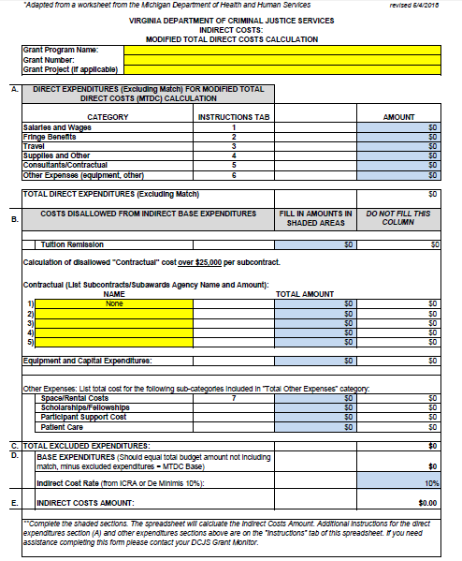
MTDC Calculation Sheet
Complete this form to determine the total amount of indirect costs in your grant.

Slide 358
Reminders
To calculate indirect costs, you must first determine the Modified Total Direct Costs (MTDC) amount of your budget.
Indirect costs that can be requested are not based on the entire project budget, but on the MTDC amount.
The actual MTDC amount will determine the amount of Indirect Costs to be reimbursed for that quarter.
In other words, the amount of Indirect Costs reimbursed should/will vary from quarter to quarter.
For more information, contact the Grants Compliance Supervisor, Mark Fero, mark.fero@dcjs.virginia.gov

Slide 359
Reminders:
The MTDC Worksheet must be submitted quarterly to: grantsmgmt@dcjs.virginia.gov
The amount of Indirect Costs requested for reimbursement each quarter cannot simply be the total for the year divided by four; the amount must be based on actual MTDC amounts.

Slide 360
Salary and Fringe
List each position by title (and name of employee, if available)
Show the annual salary rate for the employee and the hours to be devoted to the project by the employee
Typically, full-time employees work 2,080 hours annually
Indicate each type of benefit included and the total cost to employees assigned to the project
Notes:
Justification may include documentation demonstrating that requested salaries are consistent with salaries paid to other positions with similar responsibilities, within the program, or at other organizations in the service area. All requested amounts must be reasonable given the complexity of work, and consistent with the grantee’s staff compensation plan.

Slide 361
Consultants
List each type of consultant or service (with numbers in each category and names of major consultants when available), the proposed daily fee rate, and the amount of time to be devoted to such services
The U.S. Department of Justice Grants Financial Guide requires that compensation for “individual consultant services is to be reasonable and consistent with that paid for similar services in the marketplace.”
An individual consultant's rate may not exceed $650.00 per day; Reasonable travel expenses may be reimbursed
Notes:
Requests in this category will be carefully reviewed. Justification should be provided that describes how the use of outside consultants will significantly and permanently enhance project effectiveness.
For organizations performing professional services, including professional associations and educational institutions, indicate the type of services being performed, staffing levels, and estimated contract price.

Slide 362
Travel
Itemize total travel expenses of project personnel by local mileage, non-local mileage, and subsistence (food and lodging)
If the grantee does not have an established local travel policy, then the grantee must adhere to federal/state travel policy
  www.gsa.gov/travel/plan-book/per-diem-rates
  www.doa.virginia.gov/reference/CAPP/CAPP_Topics/20335-2015.pdf
  If local travel policy differs from the federal/state travel policy, please provide or describe the policy in the justification
Notes:
Grantees must clearly explain the basis for all calculations. Justify travel by explaining why costs are necessary and essential.
DCJS will consider requests to support attendance at appropriate national training conferences. Grantees must document that the requested training is needed and is unavailable within the state. Registration fee expenses should be detailed in the “Supplies and Other Expenses” category. DCJS will approve requests for funds to support out-of-state travel, or airfares to attend training conferences, with adequate justification. grantees should demonstrate that attendance is cost effective and will facilitate essential improvements in service delivery.
Local mileage is considered travel within the immediate service area (satellite offices, court, meetings, etc.). Non-local mileage is outside of the immediate service area (trainings, conferences, meetings, etc.). Include a description for each request and justify why the request is necessary.

Slide 363
Equipment
Tangible personal property (including information technology systems) having 1) a useful life of more than one year and 2) a per-unit acquisition cost of $5,000 or greater”
Any equipment requests must include a written estimate of cost and local contract guidelines, if necessary. Grantees must document the necessity and cost effectiveness of requested expenditures
Notes:
Each major item to be purchased must be listed separately with unit cost. List each item to be leased or rented with the cost associated with the lease or rental. Justify equipment expenses by documenting that items will enhance direct services to crime victims. Grant funds cannot support the entire cost of an item that is not used exclusively for victim related activities; however, grant funds can support a pro-rated share of such an item.
If equipment is requested to replace outdated or “old” equipment, please briefly describe why replacement is necessary and when the “old” equipment was acquired.

Slide 364
Supplies and Other
All costs should be itemized within this category by major types (office supplies, postage, etc.)
Show the basis for computation (“x” dollars per month for office supplies; “y” dollars per person for training materials; telephone - long distance at “z” dollars per month, etc.)
Additionally, the rationale used to determine the basis for each computation should be explained, as appropriate (e.g., the photocopying cost estimate was determined based on factors including X crime and Y court caseload statistics generating Z anticipated number of copies).
Notes:
Grantees should document actual expenses for each line item requested when possible (for example: “Last year we spent $400 on postage. For FY 2020, we anticipate spending $475, due to stamp rate increase.”).
DCJS will carefully examine office space rental and equipment maintenance requests, especially costs related to computer maintenance, network access, and the provision of technical support. grantees must thoroughly document the necessity and cost effectiveness of requested expenditures.
All computers purchased with DCJS funds must be equipped with updated anti-virus protection software. grantees are encouraged to limit computer purchase requests to $1500 per workstation and to discuss computer hardware and software needs with DCJS Computer Services staff, Lisa Self, at 804-786-8475.

Slide 365
Budgeted Costs Must Be:
Allowable
Reasonable
Necessary
Allocable

Slide 366
Allowable
Costs must be allowable under the federal grant that funds your program
Check the DCJS Grant Guidelines and authorizing language of the applicable funding stream for specific information about allowability:
  VOCA (VSGP, Victim Witness, etc): VOCA Rule https://www.govinfo.gov/content/pkg/FR-2016-07-08/pdf/2016-16085.pdf
  SASP
  https://www.dcjs.virginia.gov/sites/dcjs.virginia.gov/files/grants/cy-2020-sexual-assault-services-program-sasp/cy2020saspguidelinesfinal.pdf
  VSTOP: https://www.dcjs.virginia.gov/sites/dcjs.virginia.gov/files/grants/cy-2019-2021-violence-against-women-v-stop/cy2019-2021-vstop-grant-guidelines.pdf
  DOJ Financial Guide: https://ojp.gov/financialguide/doj/pdfs/DOJ_FinancialGuide.pdf

Slide 367
Reasonable
Requested costs must be reasonable
The Department of Justice Financial Guide defines reasonable as: “Those costs that a prudent person would have incurred under similar circumstances.”
Notes:
In order to determine if a cost is reasonable, all requested budget line items must be itemized. Your grant monitor should be able to easily understand how you arrived at or estimated the requested cost.

Slide 368
Necessary
Requested costs must be necessary to the operation of the program and delivery of services for crime victims
The justification for each requested cost should make the necessity of the item clear

Slide 369
Allocable
A cost is allocable if the goods or services involved are assignable to that Federal award
The justification should make it clear that costs are allocable (e.g. stating that a computer purchased with grant funds will be used 100% of the time by a grant funded staff person)
Notes:
If a cost is not readily assignable to a specific project but is necessary to the operation of the organization/project, it might be an indirect cost.
Costs must occur in the grant period in order to be approved!

Slide 370
Budget Tips
Look at the allowable/unallowable expenses for your particular funding stream
Double check your math!
If a cost is in your itemized spreadsheet, then a matching cost should be justified in your narrative
When justifying expenses, it should be clear:
  How much the expense will total
  How did you determine that total
  What is the intended outcome or service from this expense
Notes:
If someone who is completely unfamiliar with your program picks up your budget, these three things should be clear.

Slide 371
Review/Approval Process
Grantee submits amendment request in GMIS
Grantee’s Finance Officer reviews and approved request
Grant Monitor reviews and approved request
Grants Management Unit reviews and approves request
GMIS is updated to reflect the approved budget
Grantee may make purchases as listed in the approved revised budget
Notes:
Grantees should be advised that this process can take up to 21 days to be completed.
If the request doesn’t meet the justification requirements or has calculation errors, the grant monitor can deny it in GMIS, provide details on the reasons why the request was denied and ask the grantee to contact the grant monitor for further guidance. Upon denying the request, the Finance Officer will be notified to make further revisions. After the grant monitor approves the revised request, GMU will receive it for final review and approval. GMU can also deny a budget amendment, in which case, the process starts over from step 1.
Again, it’s helpful to work with your grant monitor on the development of your budget amendment request prior to submission in GMIS.

Slide 372
Budget Revisions
Any changes to your approved budget MUST be approved by your DCJS grant monitor in advance of funds being obligated and/or expended!
There are two ways that budgets can be changed: A budget amendment and an in-line budget adjustment

Slide 373
Budget Amendment
Allows grantees to move a portion of the approved budget from one line item to another (for example, Salary to Supplies)
No more than 2 budget amendments will be permitted during the grant period
Budget amendments must be submitted no later than 45 days prior to the end of the grant period
The budget amendment request must make it clear:
  Why the change is being requested
  Where the funds are being moved from
  Where the funds are being moved to
Notes:
Submitted in GMIS; it is helpful to email your grant monitor with your plans to submit a budget amendment prior to GMIS submission.
All proposed changes must be itemized and appropriately justified.
The budget amendment narrative template may be used to submit this information to your monitor.

Slide 374
In-Line Budget Adjustments
In-Line Budget Adjustments allow grantees to move money within one line item
Can be reviewed anytime during the year, but must be approved by your grant monitor prior to the end of the fiscal year and prior to funds being expended

Slide 375
To Request an In-Line Budget Adjustment
Grantees should send an email to the grant monitor that explains:
  Why the change is being requested
  Where the funds are being moved from
  Where the funds are being moved to
Once the adjustment has been approved, the grantee should retain documentation of the budget adjustment for their records.

Slide 376
When requesting changes to your budget…
Remember:
  Any changes must be approved prior to funds being expended!
  Proposed costs must occur in the grant period
  Double check the allowables/unallowables for your particular funding stream
  Double check your math and that any documentation matches what’s submitted in GMIS
  The normal requirements for justifications, etc. apply.

Slide 377
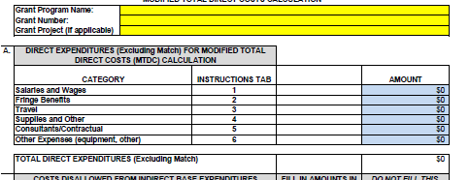
Step 1a: Complete Part A of MTDC form
Fill in blue cells, taking totals from the federal portion of your budget. (see next slide)

Slide 378


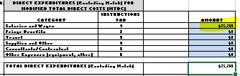
Step 1b: Complete Part A of MTDC form
Only include federal portion of budget on MTDC form as both local match and general funds are considered part of the “match” for the grant award

Slide 379
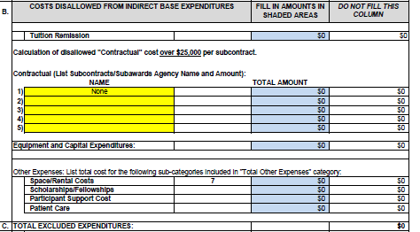
Part 2a: Complete Part B of MTDC form
Make sure to tally up all costs disallowed from indirect base expenditures and like in part A, only the federal portion (see next slide).

Slide 380
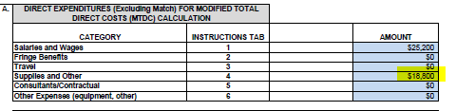
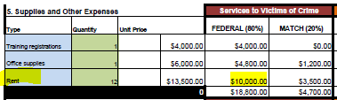
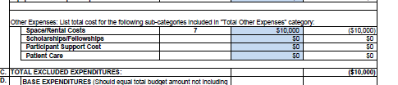
Step 2b: Complete Part B of MTDC form
Part A would include the total of the entire budget category
Part B would include just the total of the excluded expense

Slide 381
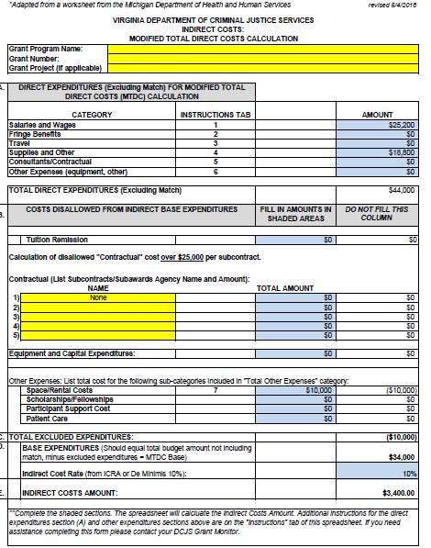
Part 3a: Set Your Indirect Cost Rate and Finish Calculation
You are able to set the indirect cost rate at 10% or lower per de Minimis or at your approved Indirect Cost Rate, if you have one. This worksheet must be submitted quarterly to grantsmgmt@dcjs.virginia.gov

Slide 382
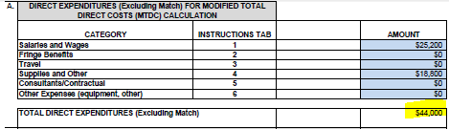
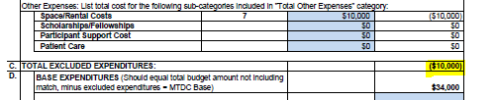
Your rate calculation is based on Part D (base expenditures), which is the total of Part A (total direct expenditures less match) and subtract Part C (excluded expenditures
Take your set rate and multiply that by the base expenditures to determine indirect costs totals for the grant

Slide 383
Training & Technical Assistance for Subgrantees

Slide 384
Committed to Your Success
Technical assistance (TA) is the process of providing targeted support with a development need or problem to assure compliance with grant conditions and successful project implementation.
Division of Programs and Services, Office on Victims Services Staff provide grant funding, training, technical assistance, and written resources to programs and individuals serving crime victims.
DCJS has been strengthening staffing devoted to victims services in order to improve responsiveness and increase support to subrecipients.
TA may be delivered in many different ways (e.g. phone and/r web conferencing, on-site, email, letter, small group facilitation) across a number of topics (e.g. program update forms, report requirements, budget amendments, allowable costs, GMIS).

Slide 385
Availability
DCJS is committed to providing all subgrantees with the best subject matter and programmatic technical assistance possible.
Subgrantees can request program-specific training and technical Assistance by reaching out to the assigned grant monitor.
Grant monitors will contact your agency to schedule a conference call or in-person session to meet your agency’s specific needs.

Slide 386
Standards of Practice
The goal is for subrecipients to receive grant guidance and support through consistent, professional customer service and a variety of technical assistance opportunities.

Slide 387
Standards of Practice
Grant monitors will:
Provide Direct, timely, and transparent communication to grantees, constituents, and other stakeholders;
Continue regular communication and collaboration activities to improve relationships with grantees and other stakeholders;
Provide regular opportunity for constituent and stakeholder feedback.

Slide 388
Responsiveness
Monitors will respond to phone email inquiries within 2 business days.
Requests submitted in GMIS (i.e. progress reports, budget amendment requests) will be reviewed within 2 weeks.
Final approval for budget amendments is issued by Grants Administration and can take up to 21 working days (pending no additional revisions).
Check GMIS for the status of all requests.

Slide 389
Technical Assistance Services
To ensure subrecipients are educated regarding grant requirements, high-risk problem areas are identified and tracked through the monitoring process and serve as the basis to plan and formulate technical assistance and training for subrecipients.
Monitors provide technical assistance (either group or one-on-one), webcasts, phone conferencing, and on-site visits, through the provision of the DCJS Monitoring Policy
Monitors maintain ongoing communication with project directors and other key officials to provide programmatic guidance, identify issues, ensure achievement of goals and objectives and provide tailored technical assistance as needed.
Notes:
To ensure subrecipients are educated regarding grant requirements, high-risk problem areas are identified and tracked through the monitoring process and serve as the basis to plan and formulate technical assistance and training for subrecipients.

Slide 390
Technical Assistance Resources
For programmatic assistance related to your project:
  Contact your Grant Monitor
For financial reporting & requests for funds:
  Mark.fero@dcjs.virginia.gov
For assistance with GMIS:
  grantsweb@dcjs.virginia.gov

Slide 391
Fiscal Grants Management Technical Assistance Websites:
DOJ Grants Financial Guide
Federal Accounting Standards Advisory Board Generally Accepted Accounting Principles
Victims of Crime Act Final Rule

Slide 392
National Best Practices & Technical Assistance Websites:
OVC, Training and Technical Assistance Center (OVCTTAC)
National Organization for Victim Assistance (NOVA)
National Center for Victims of Crime (NCVC)
National Coalition Against Domestic Violence (NCADV)
National Network to End Domestic Violence (NNEDV)
National Sexual Violence Resource Center (NSRVC)
National Stalking Resource Center (NSRC)
Rape, Abuse, Incest, National Network (RAINN)

Slide 393
Statewide Best Practices & Technical Assistance Websites:
Virginia Sexual and Domestic Violence Action Alliance
Virginia Victim Assistance Network
Virginia Poverty Law Center
Virginia Commonwealth University Center on Aging

