Slide 1
DCJS Online Application
Initial Registration Application
for unarmed Security Officer/Courier
Disclaimer:
All names, addresses and other data used are for example only and are fictitious. Any resemblance to actual persons, living or dead, or actual data is purely coincidental.

Slide 2
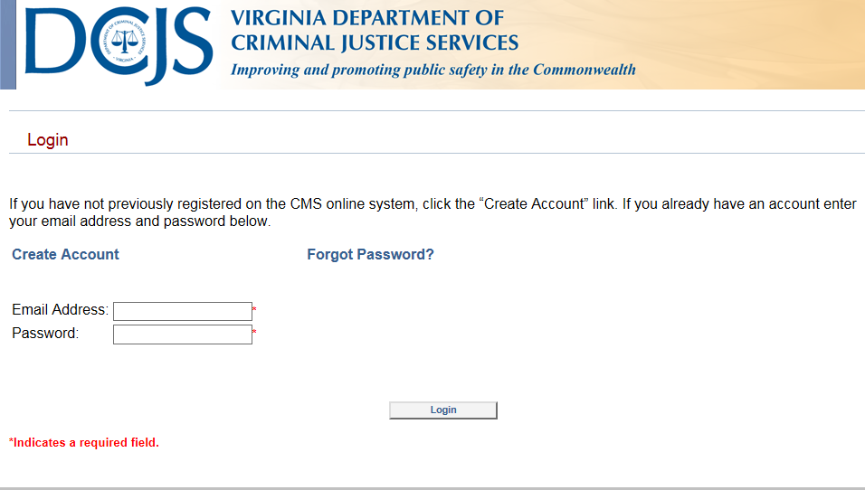
Creating a DCJS Online application
Creating the account 1 of 5.
To begin an online application please go to this link.
https://www.cms.dcjs.virginia.gov/GLSuiteWeb/Clients/VADCJS/Private/Shared/Login.aspx
Create an account by clicking on the create account link.

Slide 3
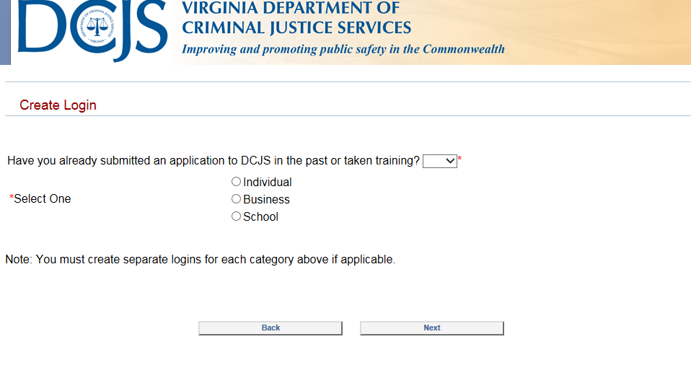
Creating a DCJS Online application
Creating the account 2 of 7.
Once you’ve clicked on “Create Account” it will bring you to the screen below.

Slide 4
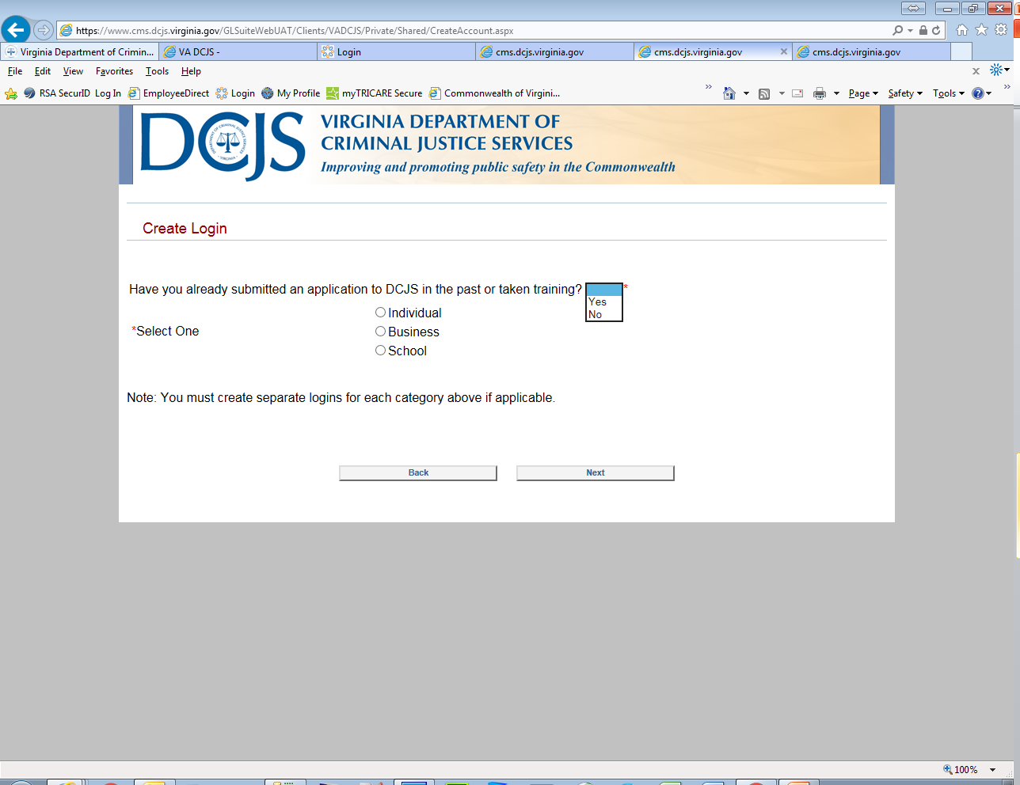
Creating a DCJS Online application
Creating the account 3 of 7 .
Creating the login requires that you answer a few questions before entering your biographical data. Click on the drop down “Have you already submitted an application to DCJS in the past or taken training?” and select the appropriate response. Select “Yes” if you have taken any recent training . Otherwise, select "No”. (Please try to complete this account creation within 20 minutes or it will time out on you and you will need to start over.

Slide 5
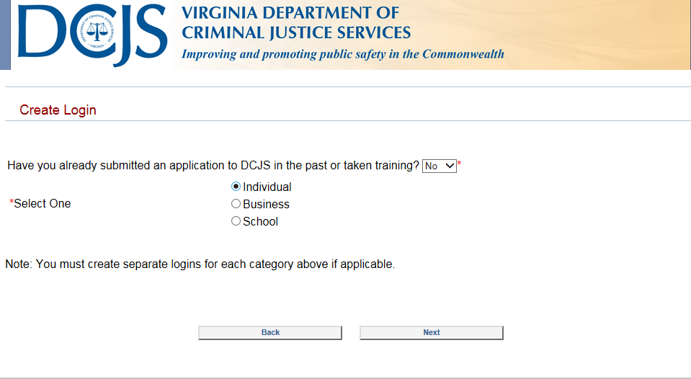
Creating a DCJS Online application
Creating the account 4 of 7 .
Next, you will select the category applicable to your application. Since this guide is targeted to individuals applying for an Unarmed Security Officer/ Courier, we will select “Individual” and then click “Next”. Please note, you will need to create a different online account for each type of account, e.g. Individual, Business and School all require separate accounts.

Slide 6
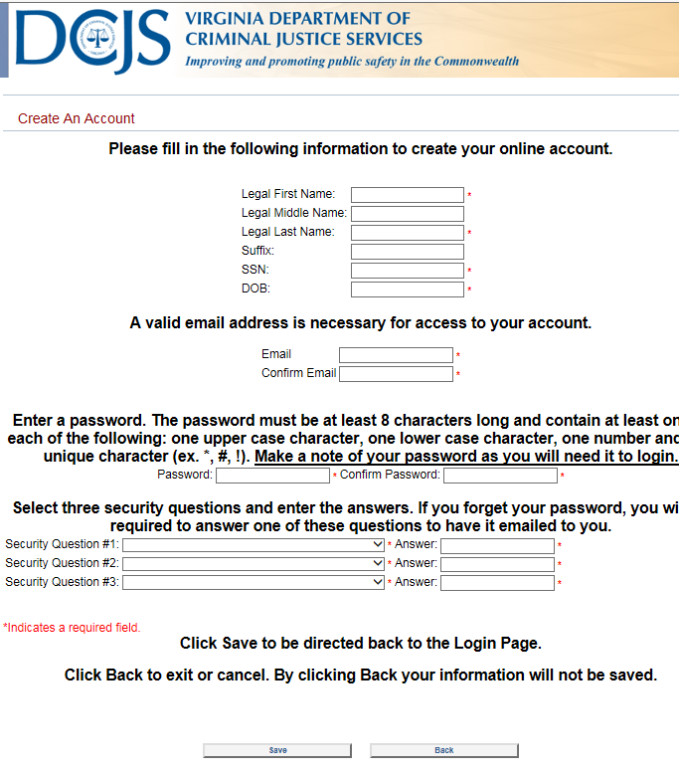
Creating a DCJS Online application
Creating the account 5 of 7.
After you click “Next” you will be brought to the screen below that will allow you to enter your biographical data..

Slide 7
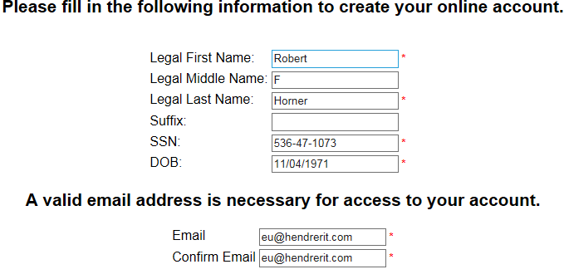
Creating a DCJS Online application
Creating the account 6 of 7.
Enter your data in the fields as requested in the format of the example below. Please note that your email will need to be entered twice and that any field with a red asterisk to the right, is a required field. Complete the suffix field if you have a suffix such as Sr, Jr or the III( Do not use a period after Jr or Sr). (Please note all dates are entered in MM/DD/YYYY format)

Slide 8
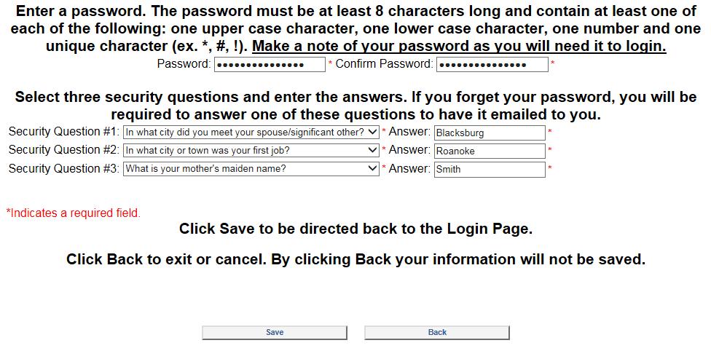
Creating a DCJS Online application
Creating the account 7 of 7.
Enter a password in the Password and Confirm Password fields that is eight characters long. The characters of your password will not be displayed and you will need to ensure that the characters in both password fields are identical in every way. The password must contain; one upper case alphabet character, one lower case alphabet character, one numeric character and one special character that is non alphanumeric. Then select three Security Questions and enter their Answers. When done, click the “Save” button and you will be redirected to the Login Page where you will be asked to login using the email and password that you created here.

Slide 9
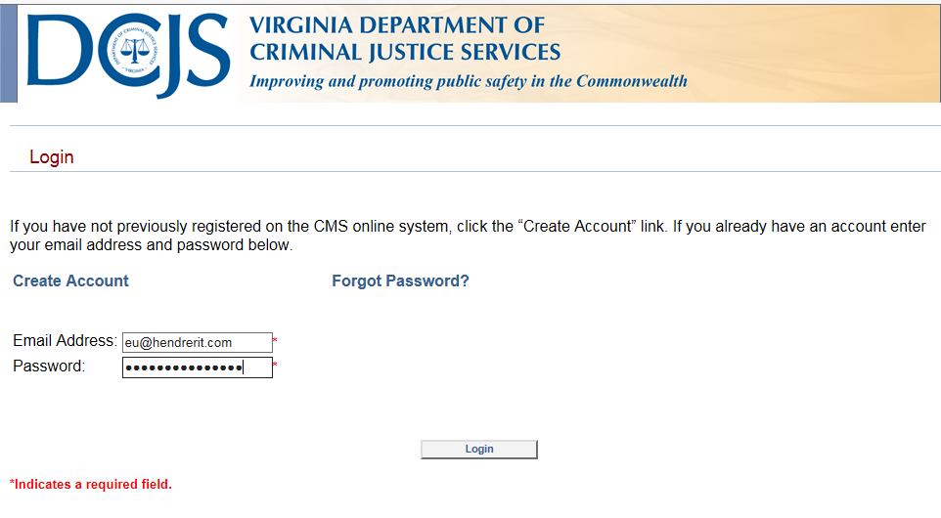
Creating a DCJS Online application
Logging into your account 1 of 2.
Enter your email address and password when you are presented with the login screen. Again, your password will not be displayed so you will not have an opportunity to ensure that you’ve typed the correct characters in the field.

Slide 10
Creating a DCJS Online application
Logging into your account 2 of 2.
After you have typed in your “Email Address” and your “Password”, right click on the “Login” link.

Slide 11
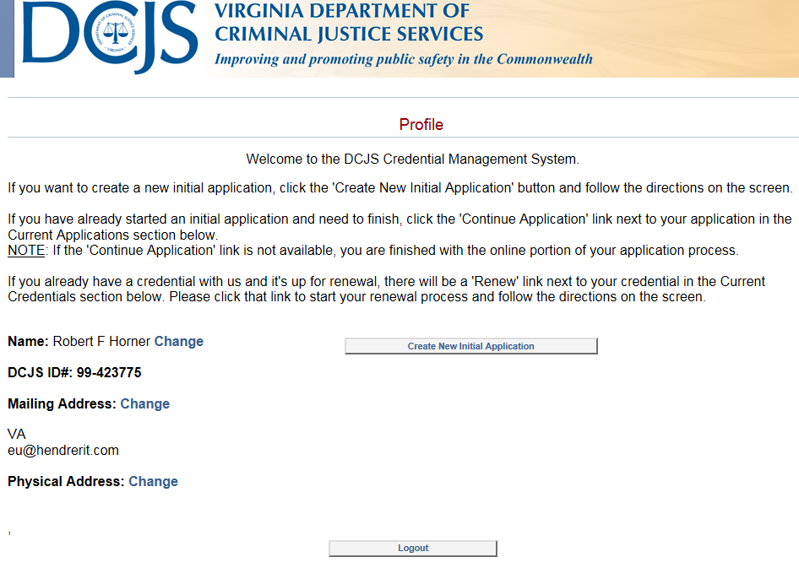
Creating a DCJS Online application
Creating an Initial Application 1 of 14
You will be presented with the screen below. Right click on “Create New initial Application”

Slide 12
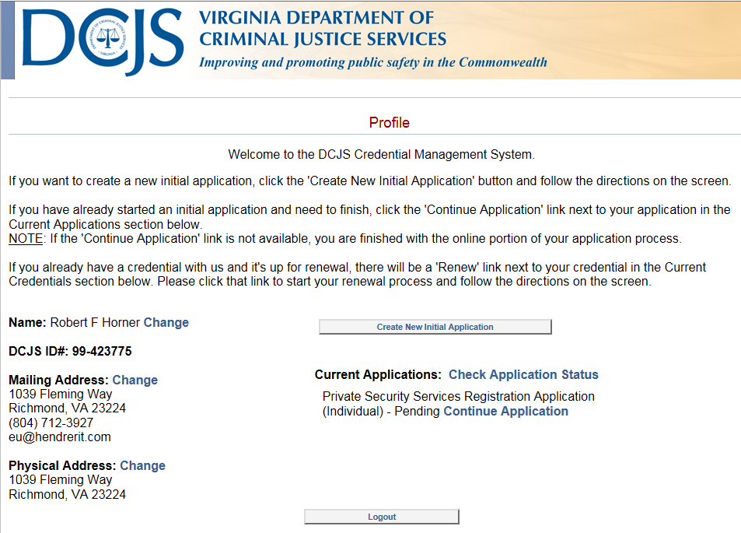
Creating a DCJS Online application
Creating an Initial Application 2 of 14
If you did not complete the application and logged back in, the screen below will present itself and you can click “Continue Application”

Slide 13
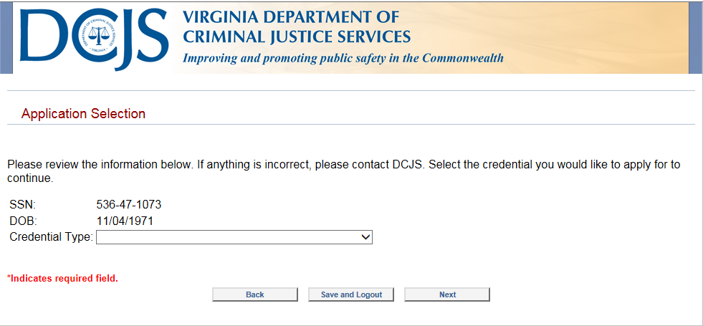
Creating a DCJS Online application
Creating an Initial Application 3 of 14
After you have logged in, the screen below will display. This screen gives you the options to update your biographical data or create a new initial application. To create a new initial application

Slide 14
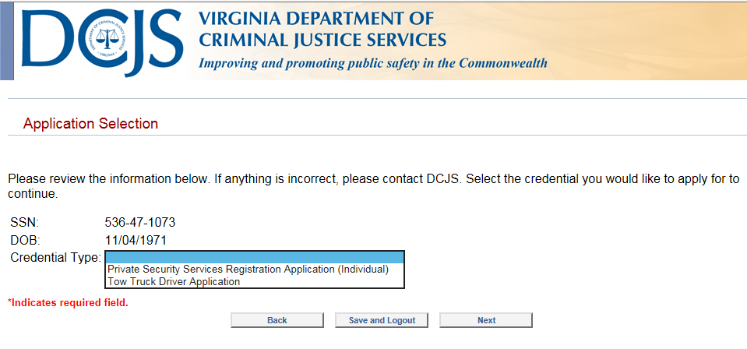
Creating a DCJS Online application
Creating an Initial Application 4 of 14
Click on the “Credential type” field to select your application type from the drop down. Then click “Next”

Slide 15
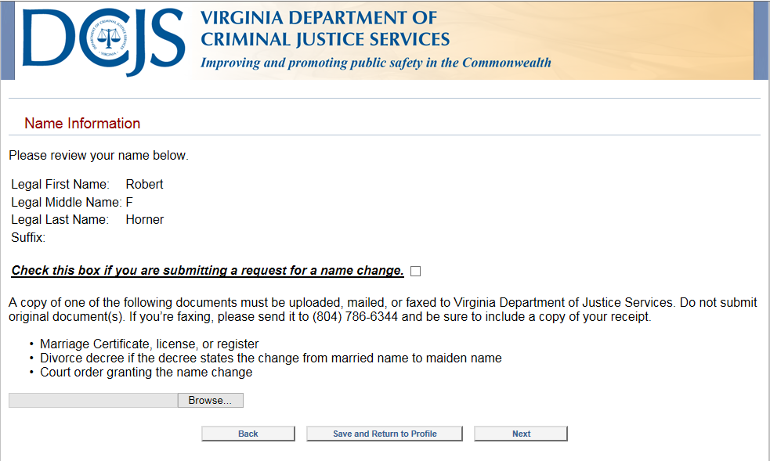
Creating a DCJS Online application
Creating an Initial Application 5 of 14
Click next to go to the address data screen.

Slide 16
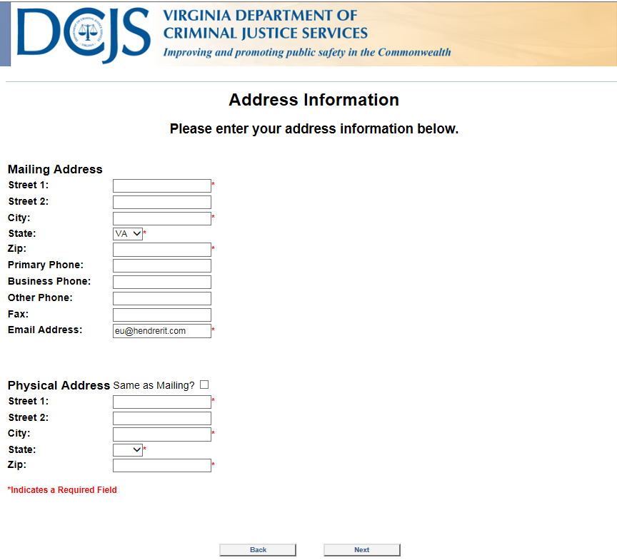
Creating a DCJS Online application
Creating an Initial Application 5 of 14
This is the Address data screen

Slide 17
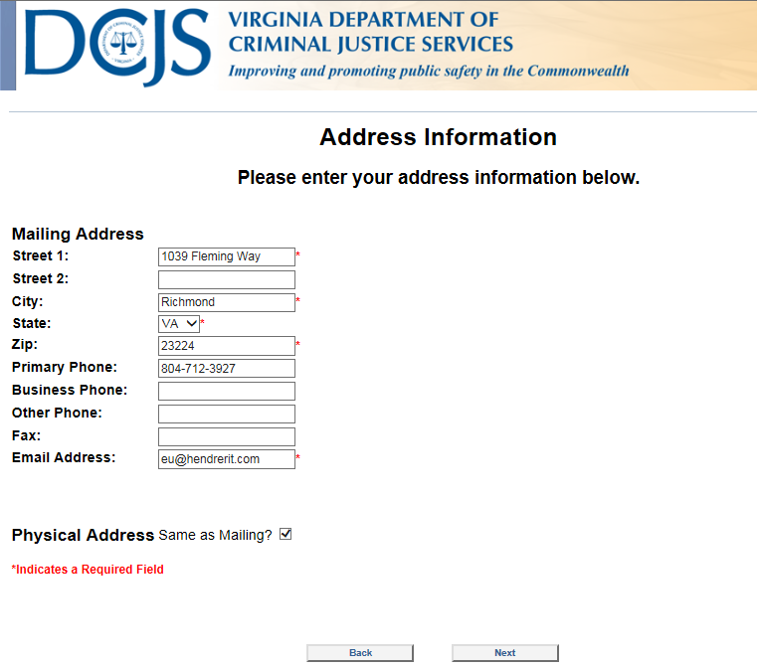
Creating a DCJS Online application
Creating an Initial Application 6 of 14
Go ahead and complete the Required fields on this screen indicated by the red asterisks. Click on the “Next” button after you’ve completed entering your data.

Slide 18
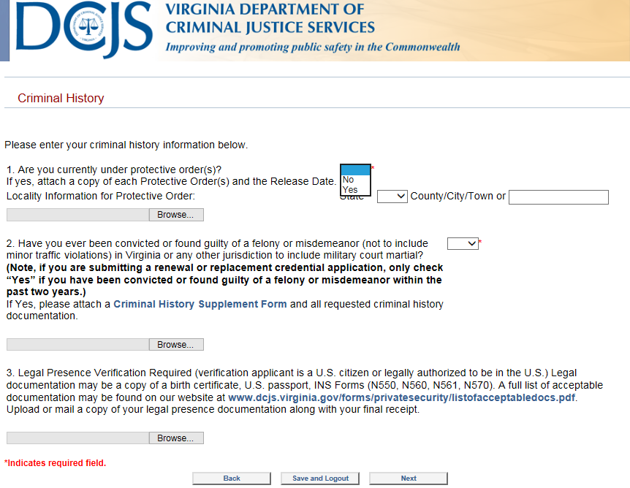
Creating a DCJS Online application
Creating an Initial Application 7 of 14
This screen will be presented after clicking Next on the address screen. Here you will complete the Criminal History questions. Use the dropdown lists to make selections. You have the option to upload documents if you answer “Yes” to question 1 or question 2. Additionally, you may upload Legal Presence Verification documents. Documents are uploaded by clicking on browse and opening the document you wish to upload.

Slide 19
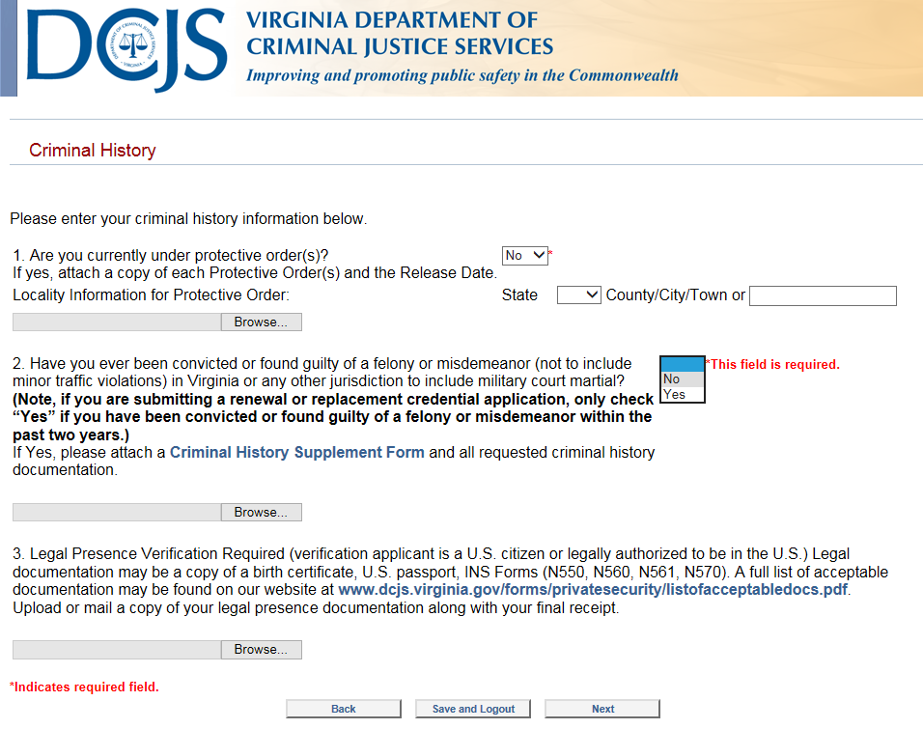
Creating a DCJS Online application
Creating an Initial Application 8 of 14
Continue by answering the second question then click on the “Next” button.

Slide 20
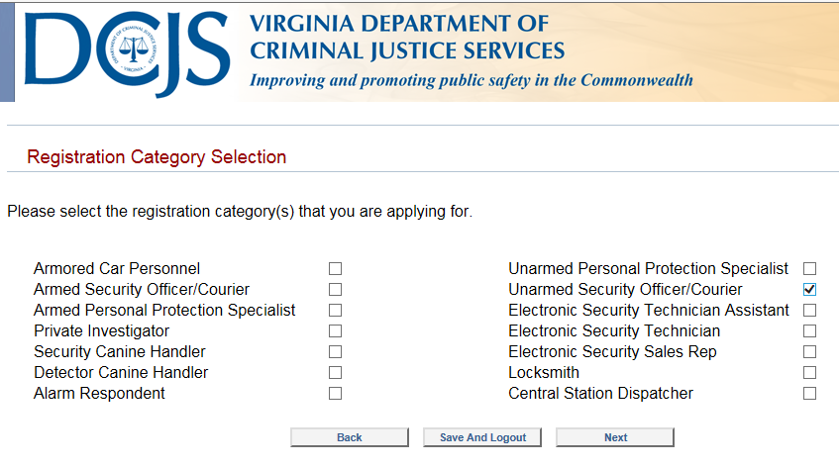
Creating a DCJS Online application
Creating an Initial Application 9 of 14
Check the box to the category of your application then click the “Next” button.

Slide 21
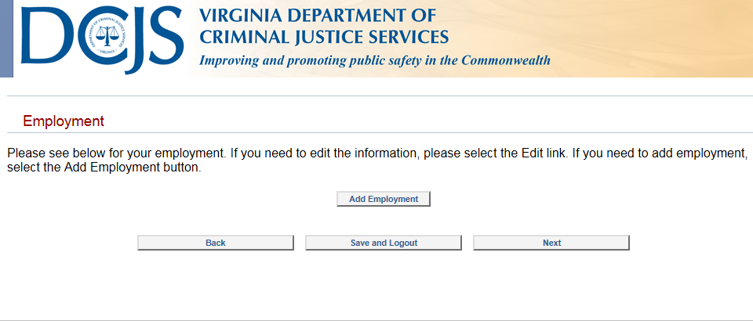
Creating a DCJS Online application
Creating an Initial Application 10 of 14
Click on the “Add Employment” if you want to associate your account with your employer. Otherwise, click the “Next” button.

Slide 22
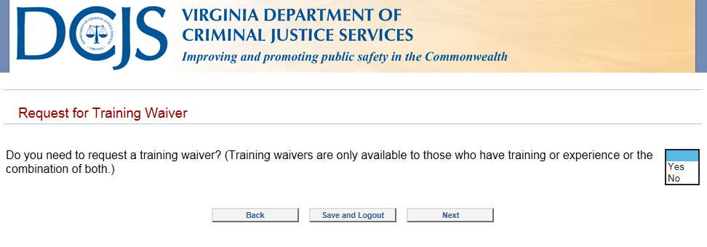
Creating a DCJS Online application
Creating an Initial Application 11 of 14
Use the drop down list to select the training waiver option. Select “Yes” if you have documentation that will support your training waiver request. Otherwise, click on the “Next” button.

Slide 23
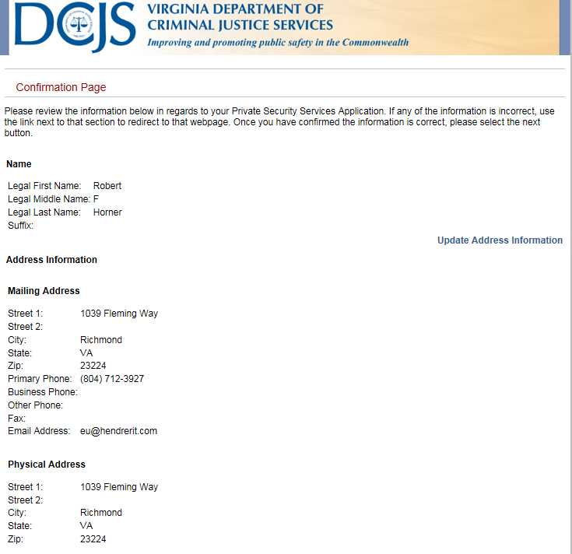
Creating a DCJS Online application
Creating an Initial Application 12 of 14
The “Confirmation Page” will present itself. The image below is the upper half of the page.

Slide 24
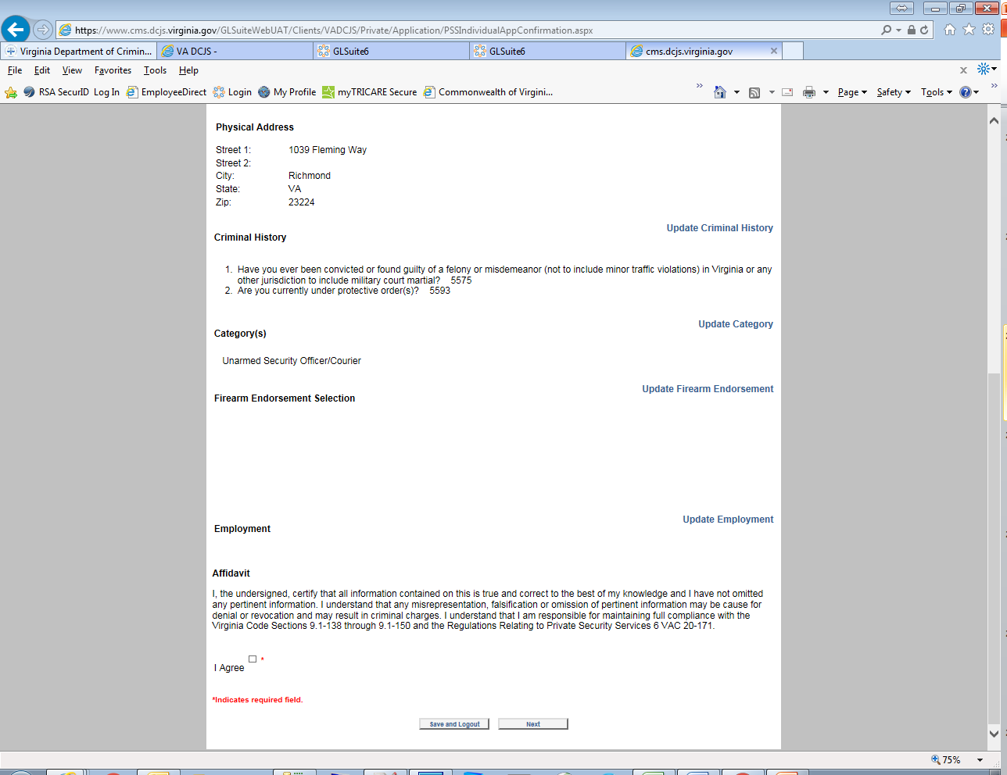
Creating a DCJS Online application
Creating an Initial Application 13 of 14
The lower half of the “Confirmation Page”

Slide 25
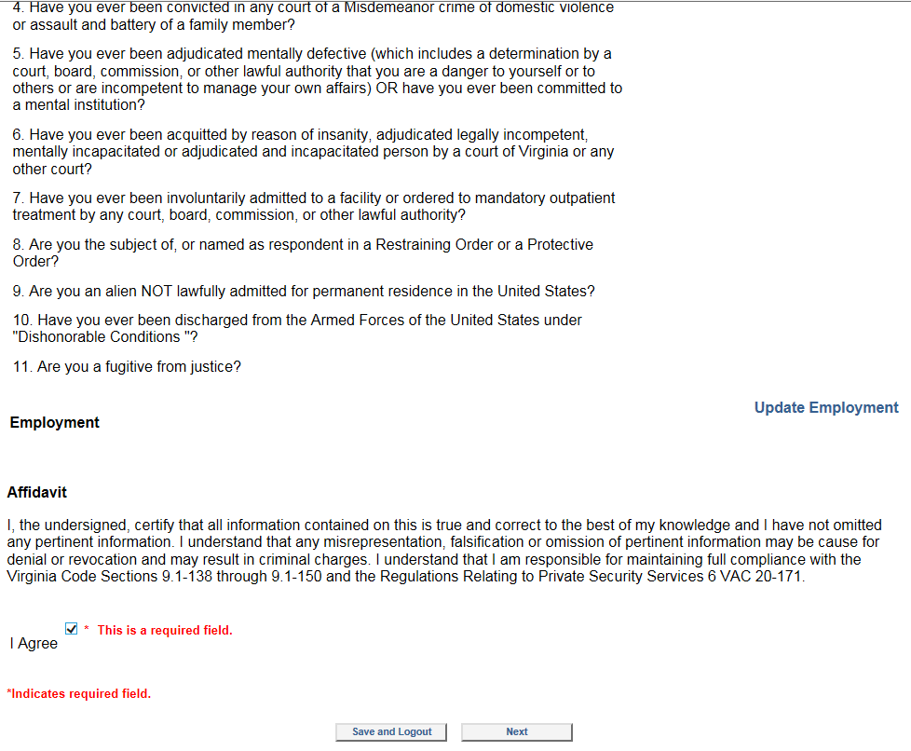
Creating a DCJS Online application
Creating an Initial Application 14 of 14
Click on the “I agree” check box and then click next.

Slide 26
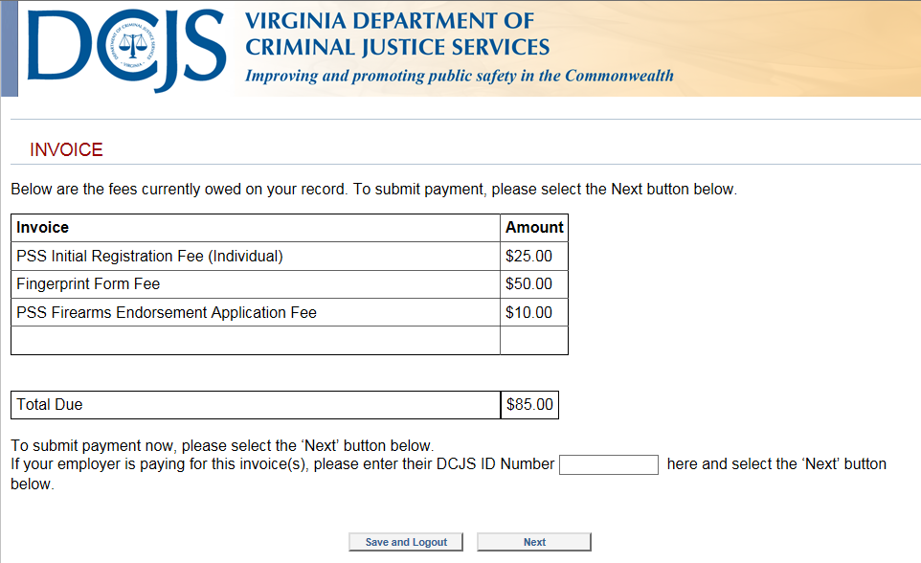
Creating a DCJS Online application
Your invoice
Click next to pay your invoice or complete the DCJS ID number if your employer is paying your fees.

Slide 27
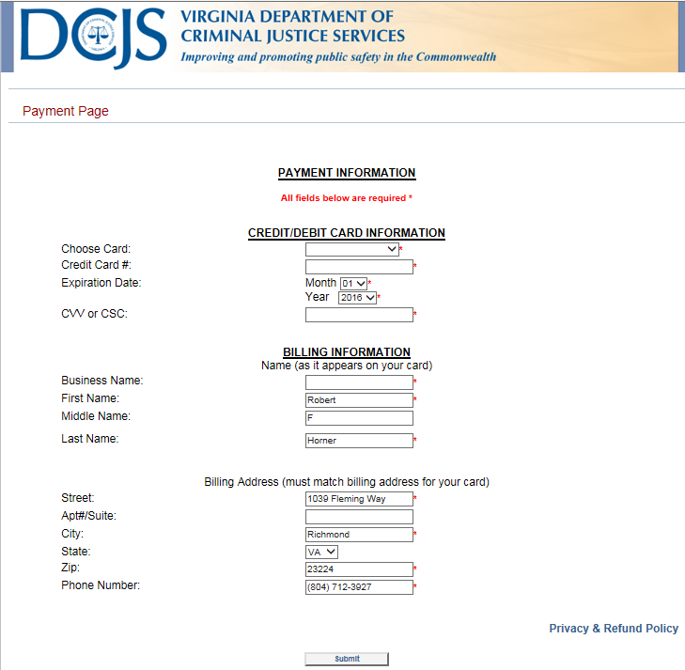
Creating a DCJS Online application
Paying your fees 1 of 3
Here is the “Payment Page”. The fields appearing on this screen appear by default.

Slide 28
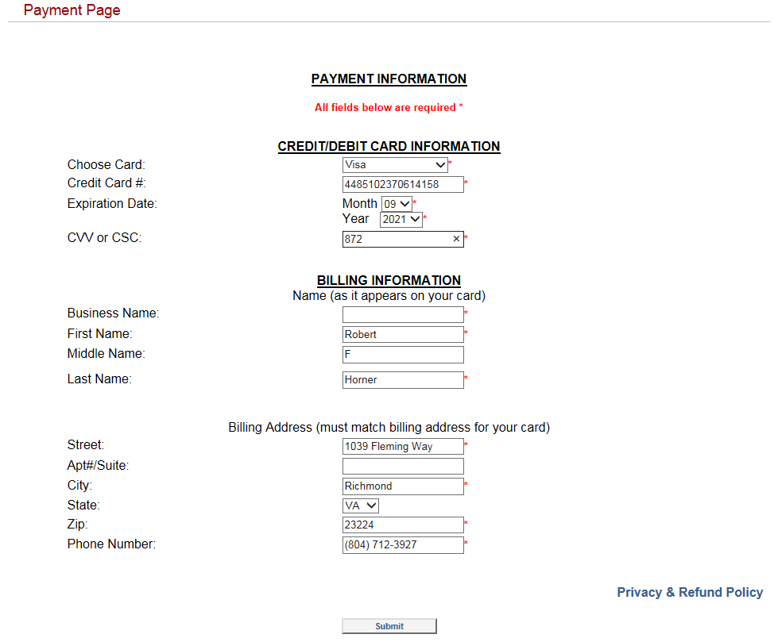
Creating a DCJS Online application
Paying your fees 2 of 3
Complete your payment information and click submit. Note the highlighted fields are required.

Slide 29
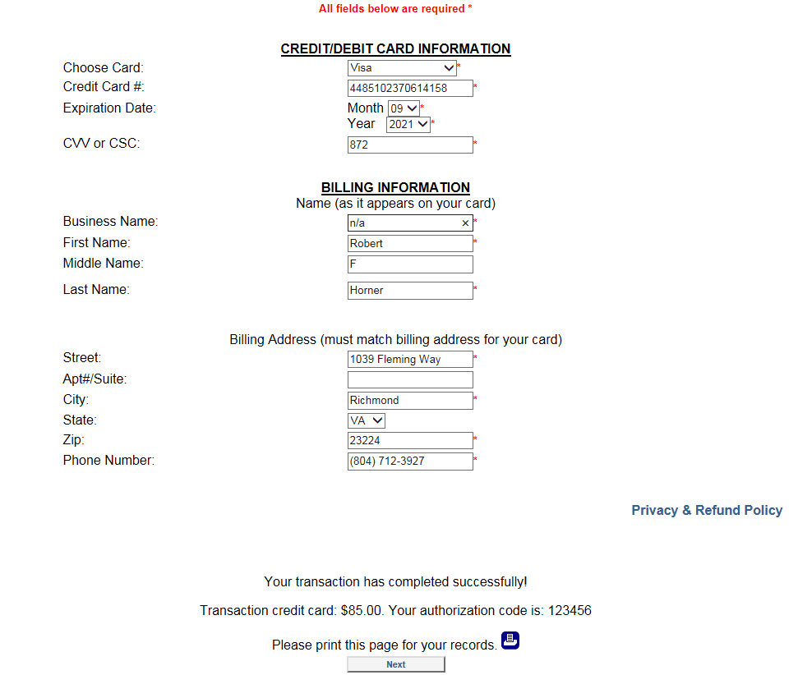
Creating a DCJS Online application
Paying your fees 3 of 3
The transaction will be completed at this time if your credit card info has been accurately and successfully completed.

