Slide 1
Osprey Replacement
Training Management System (TMS)

Slide 2
Create an Account

Slide 3
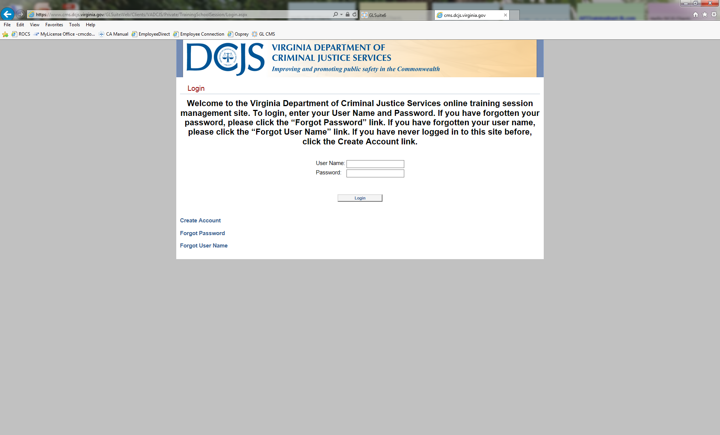
Create an Account
Create a new account with your school information. Must have your registration code to create a new account.

Slide 4
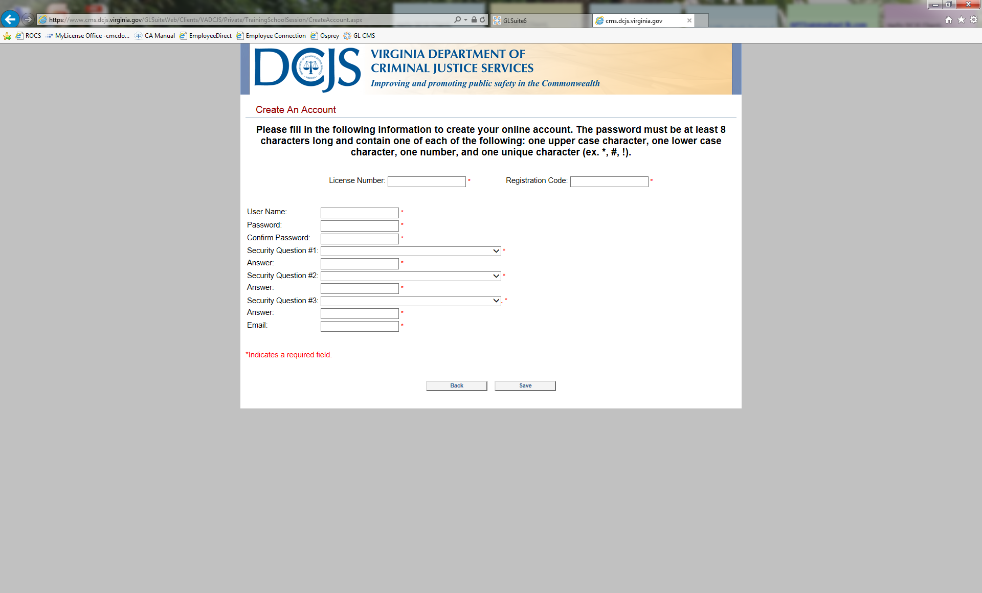
Create an Account
Fill in all fields marked with an asterisks

Slide 5
New Session Entry

Slide 6
New Session Entry
Log in using the username and password you created in step 1

Slide 7
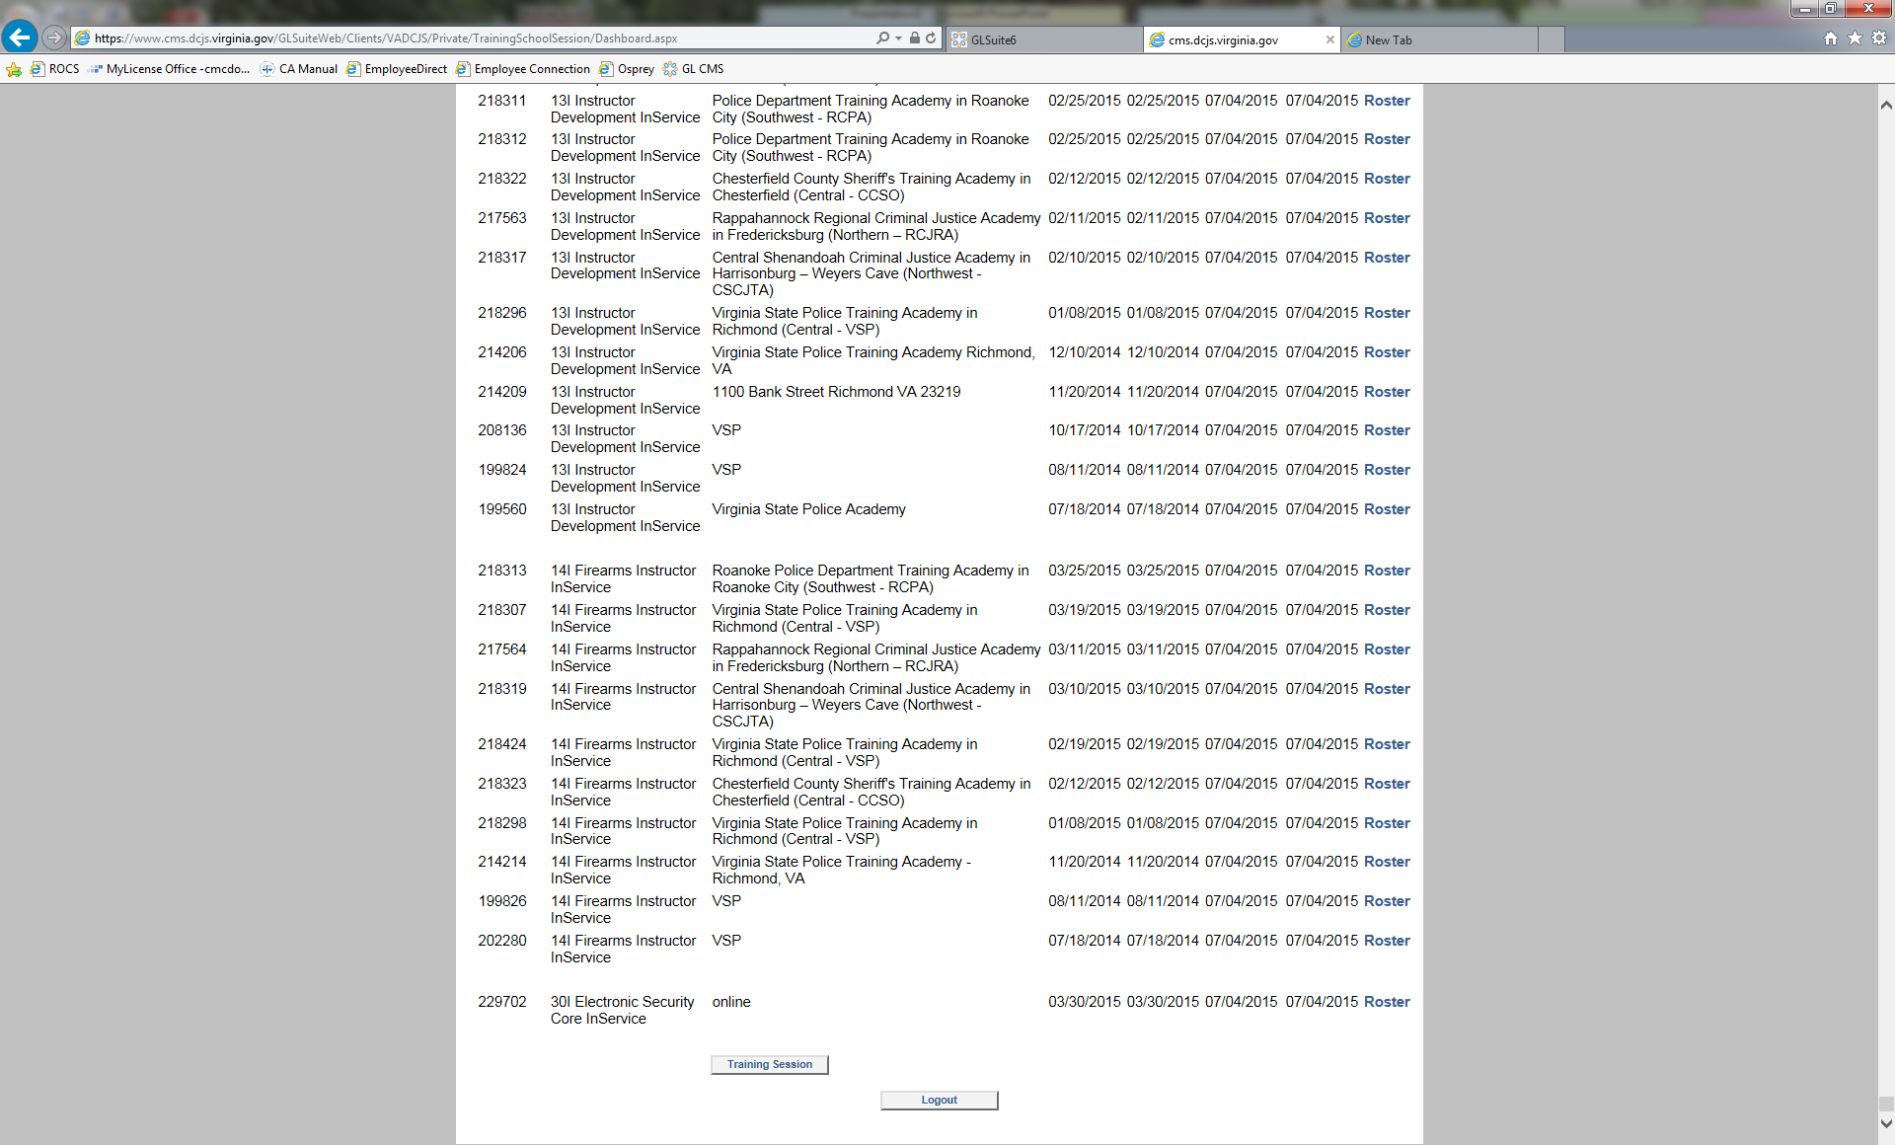
New Session Entry
To edit/cancel a training session scroll to the bottom of the page and select training session

Slide 8
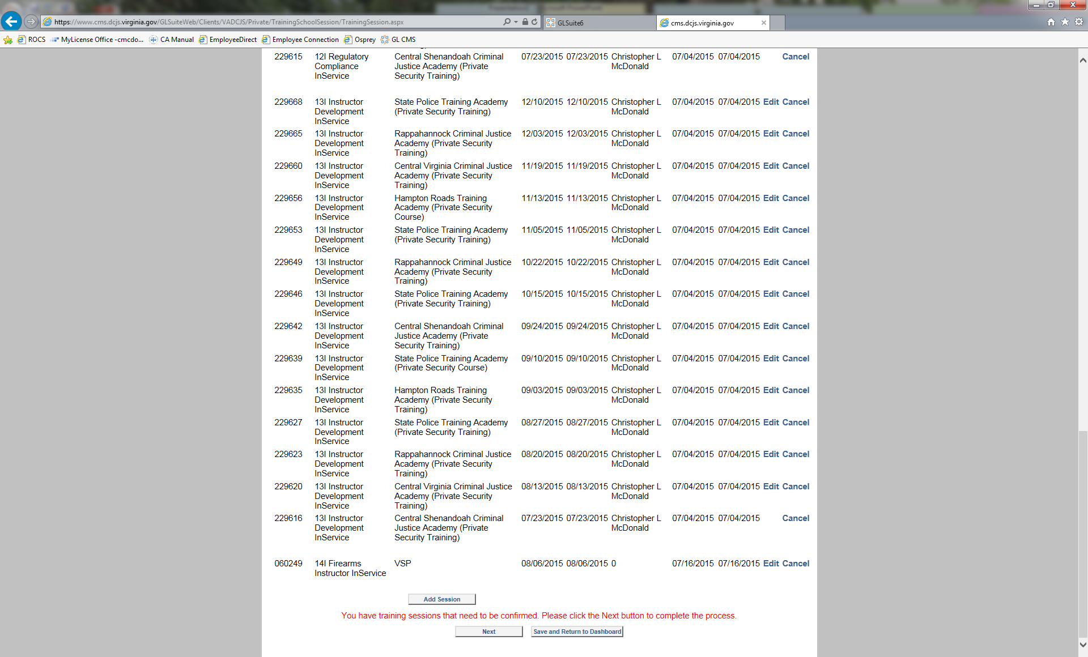
New Session Entry
On the next page scroll to the bottom and select add session

Slide 9
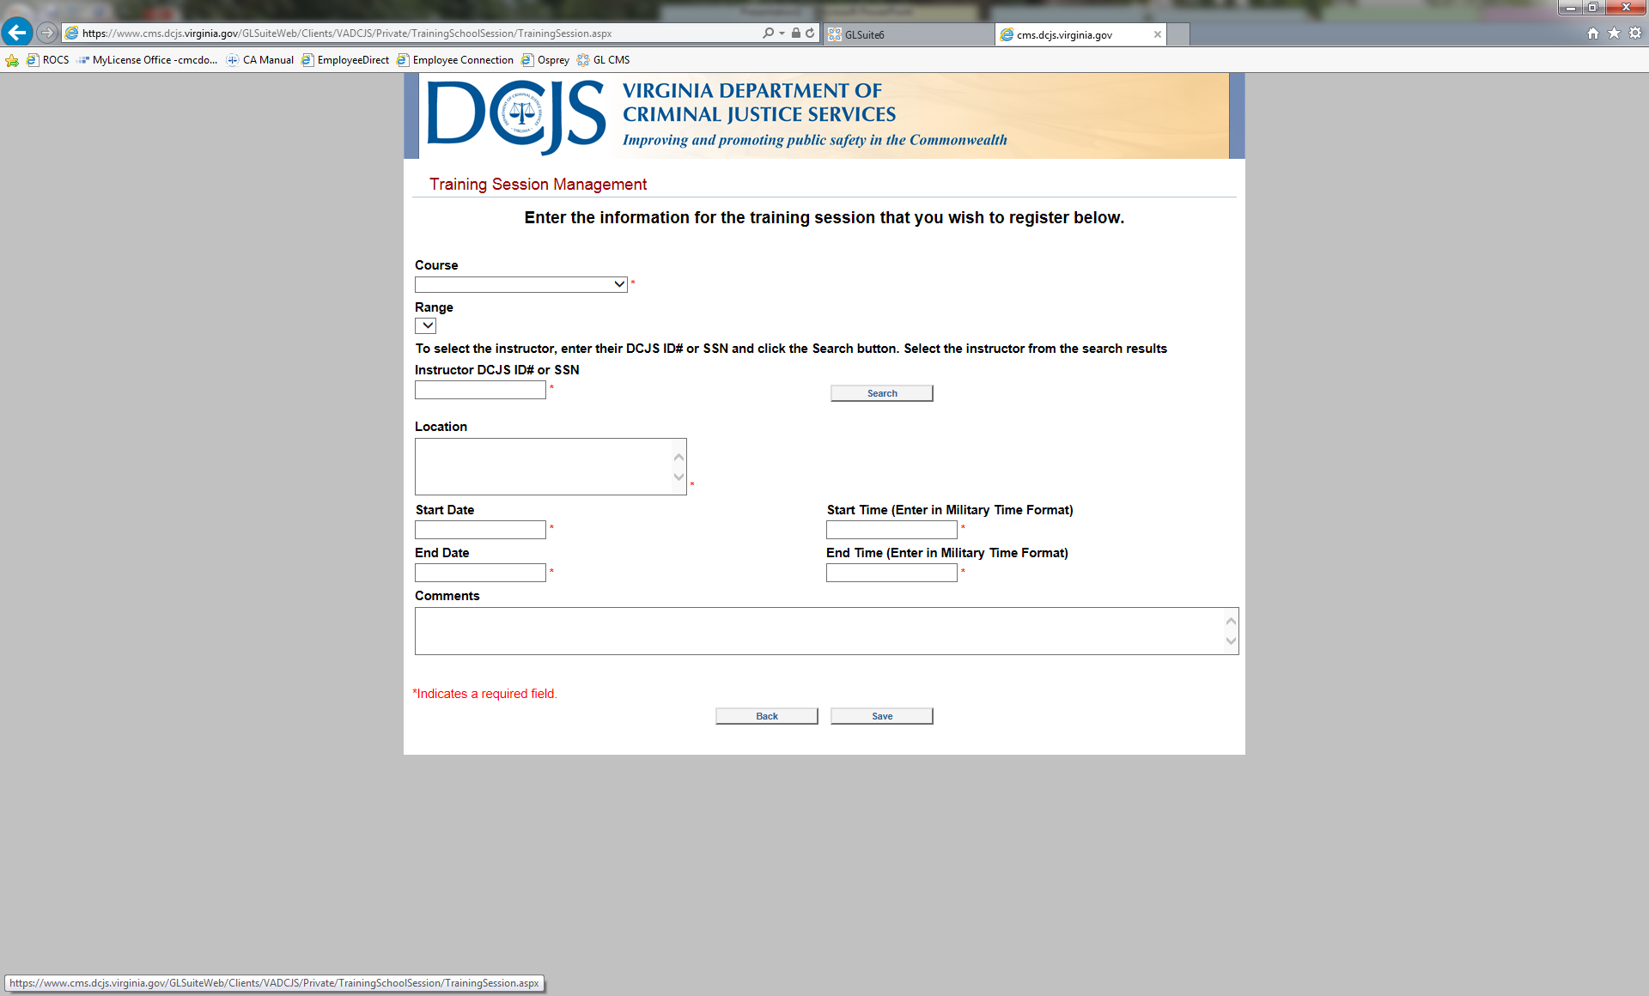
New Session Entry
On the training session management page, fill in all mandatory fields marked with a red asterisk

Slide 10
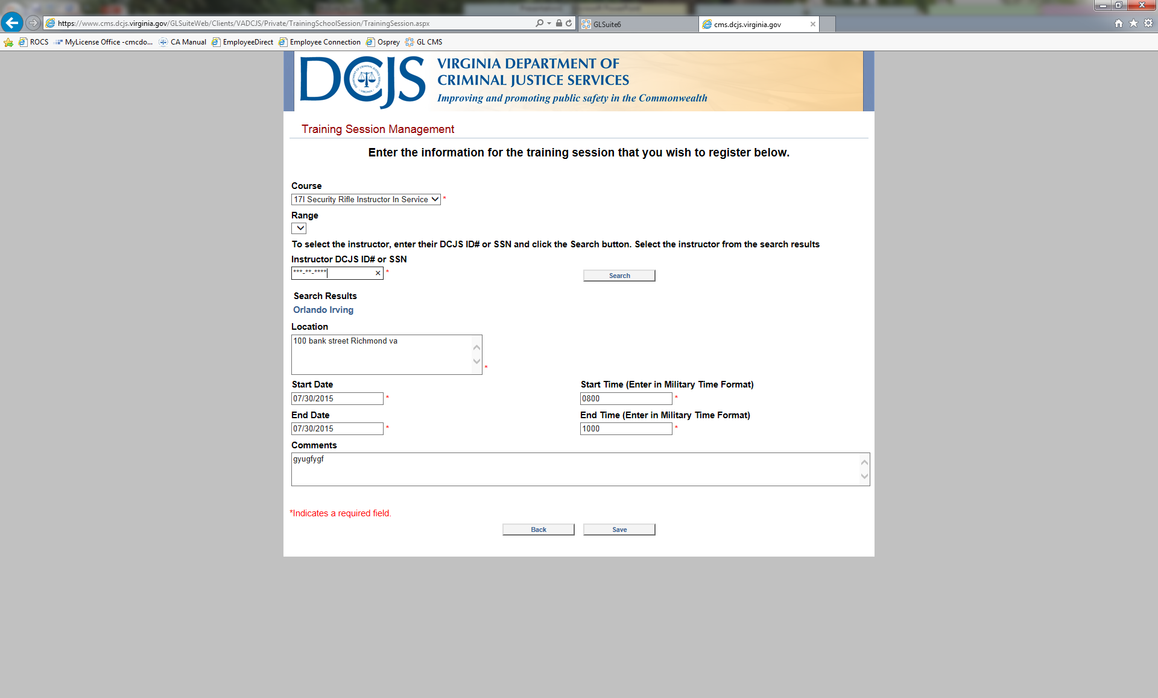
New Session Entry
Select save at the bottom of the page

Slide 11
Cancel or Edit a Training Session

Slide 12
Cancel/Edit a Session
To create a new training session scroll to the bottom of the page and select training session

Slide 13
Cancel/Edit a Session
Select Cancel to cancel the session- Once you cancel it cannot be undone.
Select edit and you will go to another screen

Slide 14
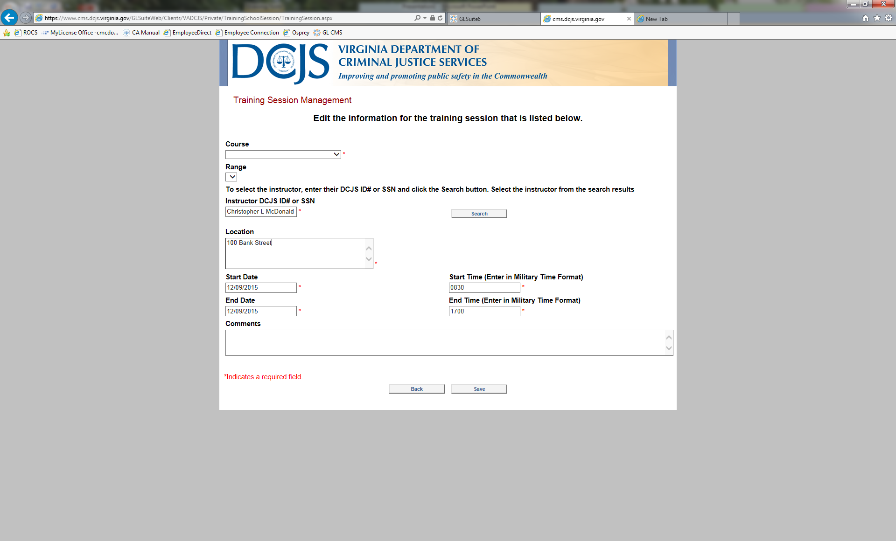
Cancel/Edit a Session
Edit session here please fill in all necessary fields marked with a red asterisks
Select Save

Slide 15
Enter a Roster

Slide 16
Enter a Roster
Find the session you wish to add a roster to and select roster at the end of the line

Slide 17
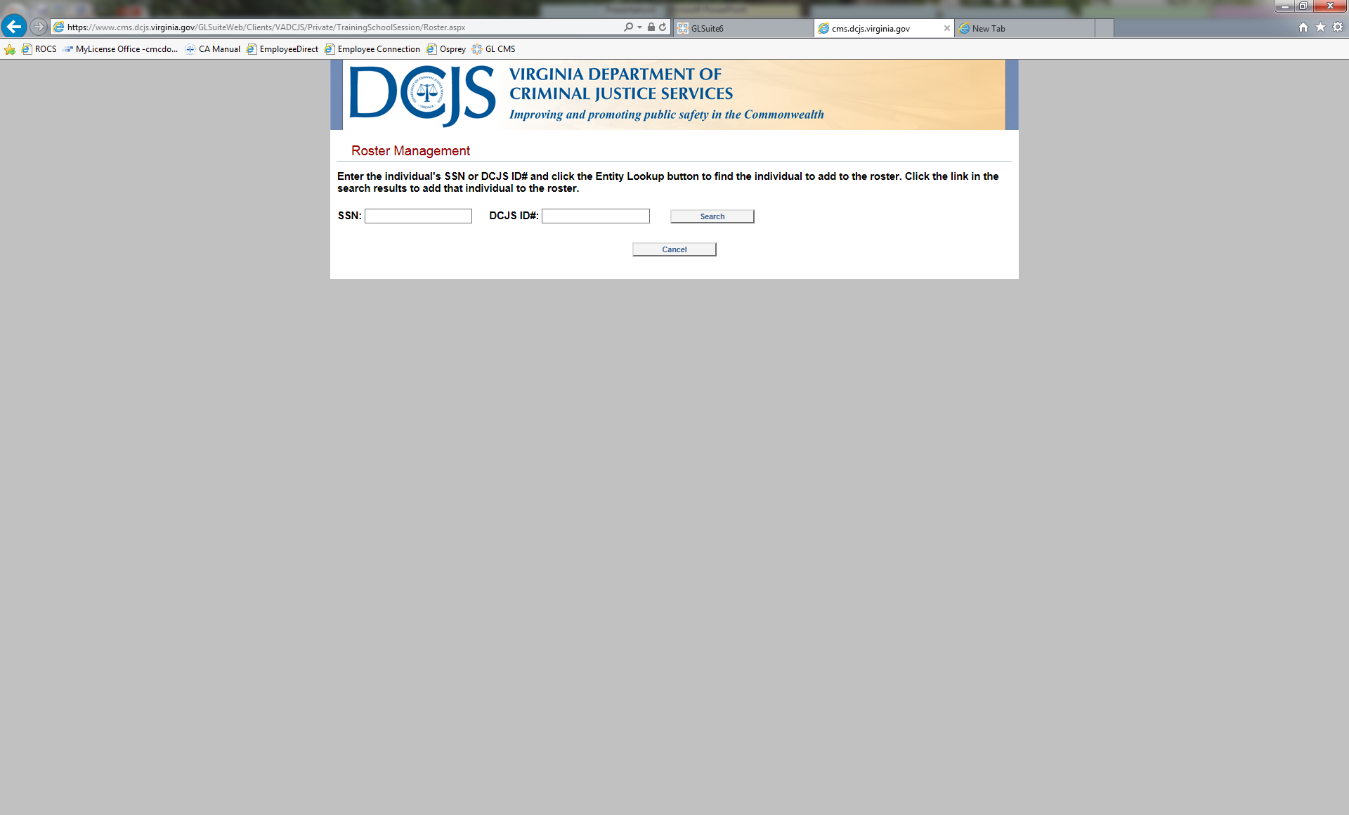
Enter a Roster
Type in social or DCJS number select search

Slide 18
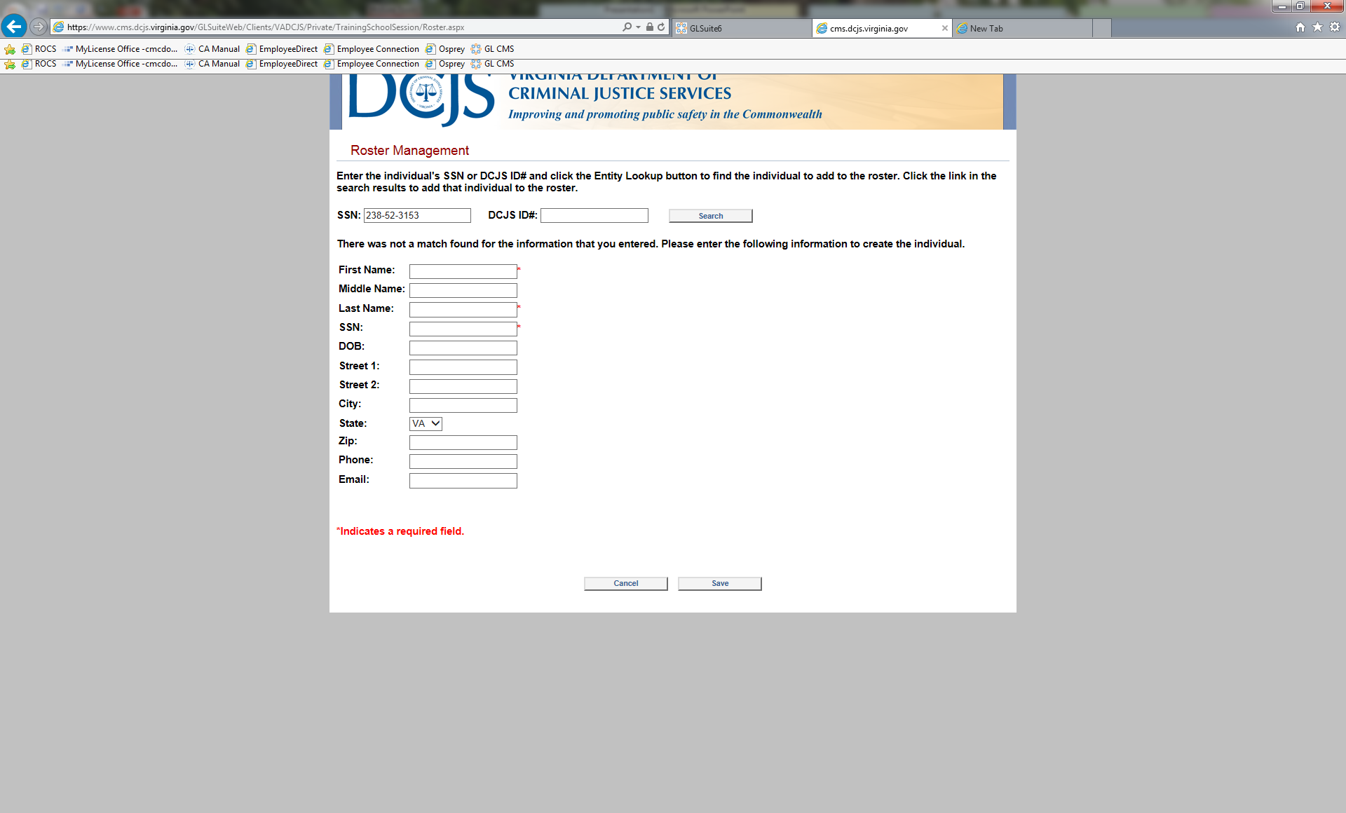
Enter a Roster
if no record found enter in the information in the

Slide 19
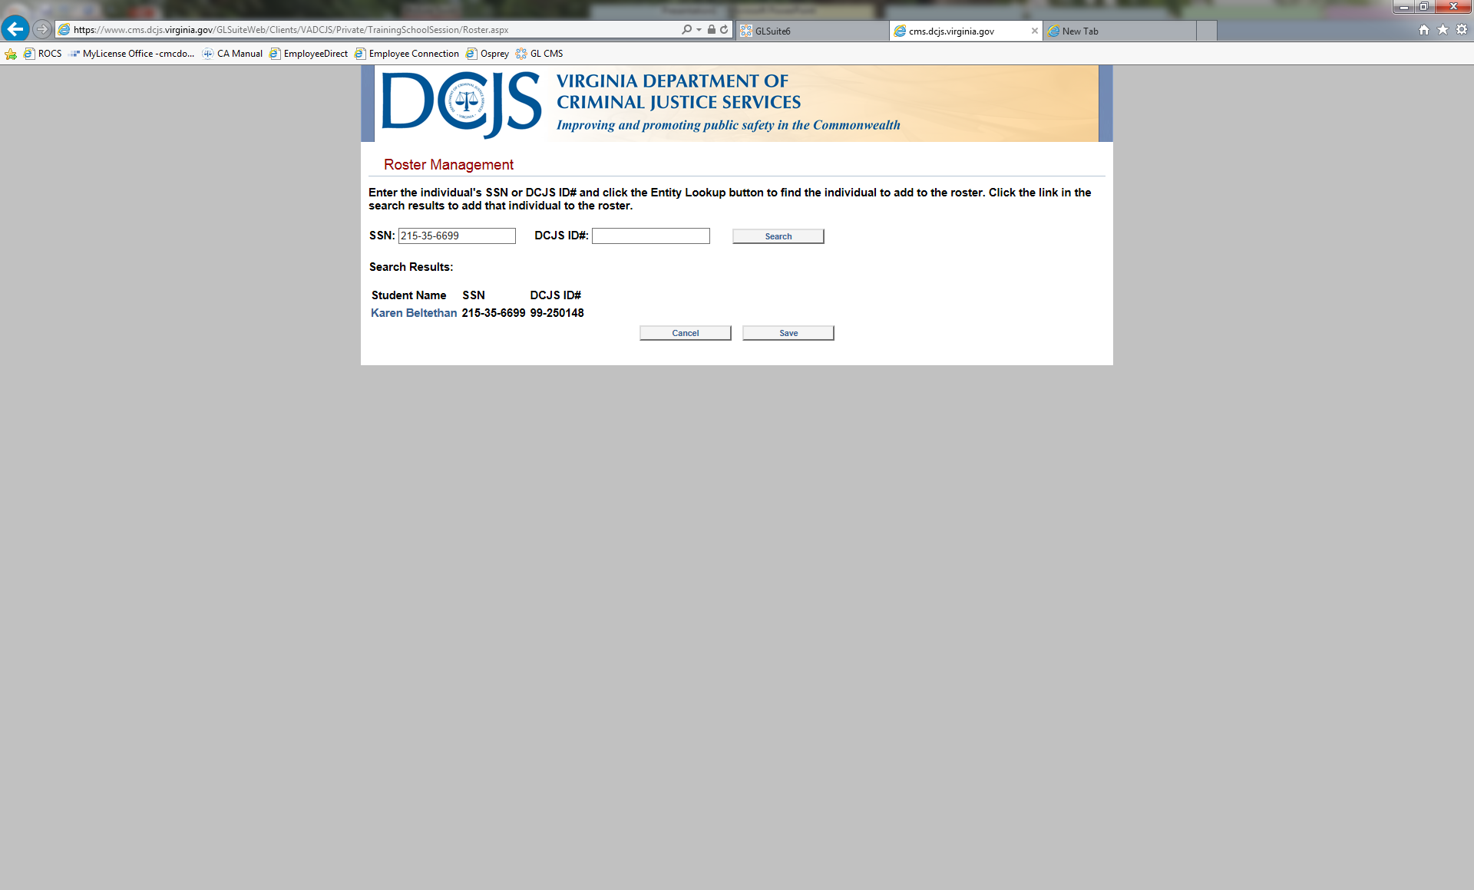
Enter a Roster
If record is found, select the name

Slide 20
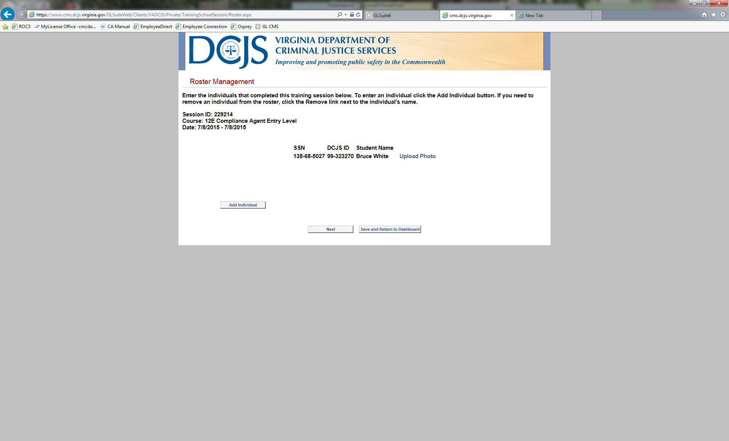
Enter a Roster
Here you can upload a photo.
Select upload a photo
A pop up will show
Select photo from file then click open
The buttons will say processing (please wait till the system is finished processing before you select anything else)
Note : As of July 1st SCOP no longer require a photo upload

Slide 21
Enter a Roster
Select next to finalize or save and return to dashboard to add participants later

Slide 22
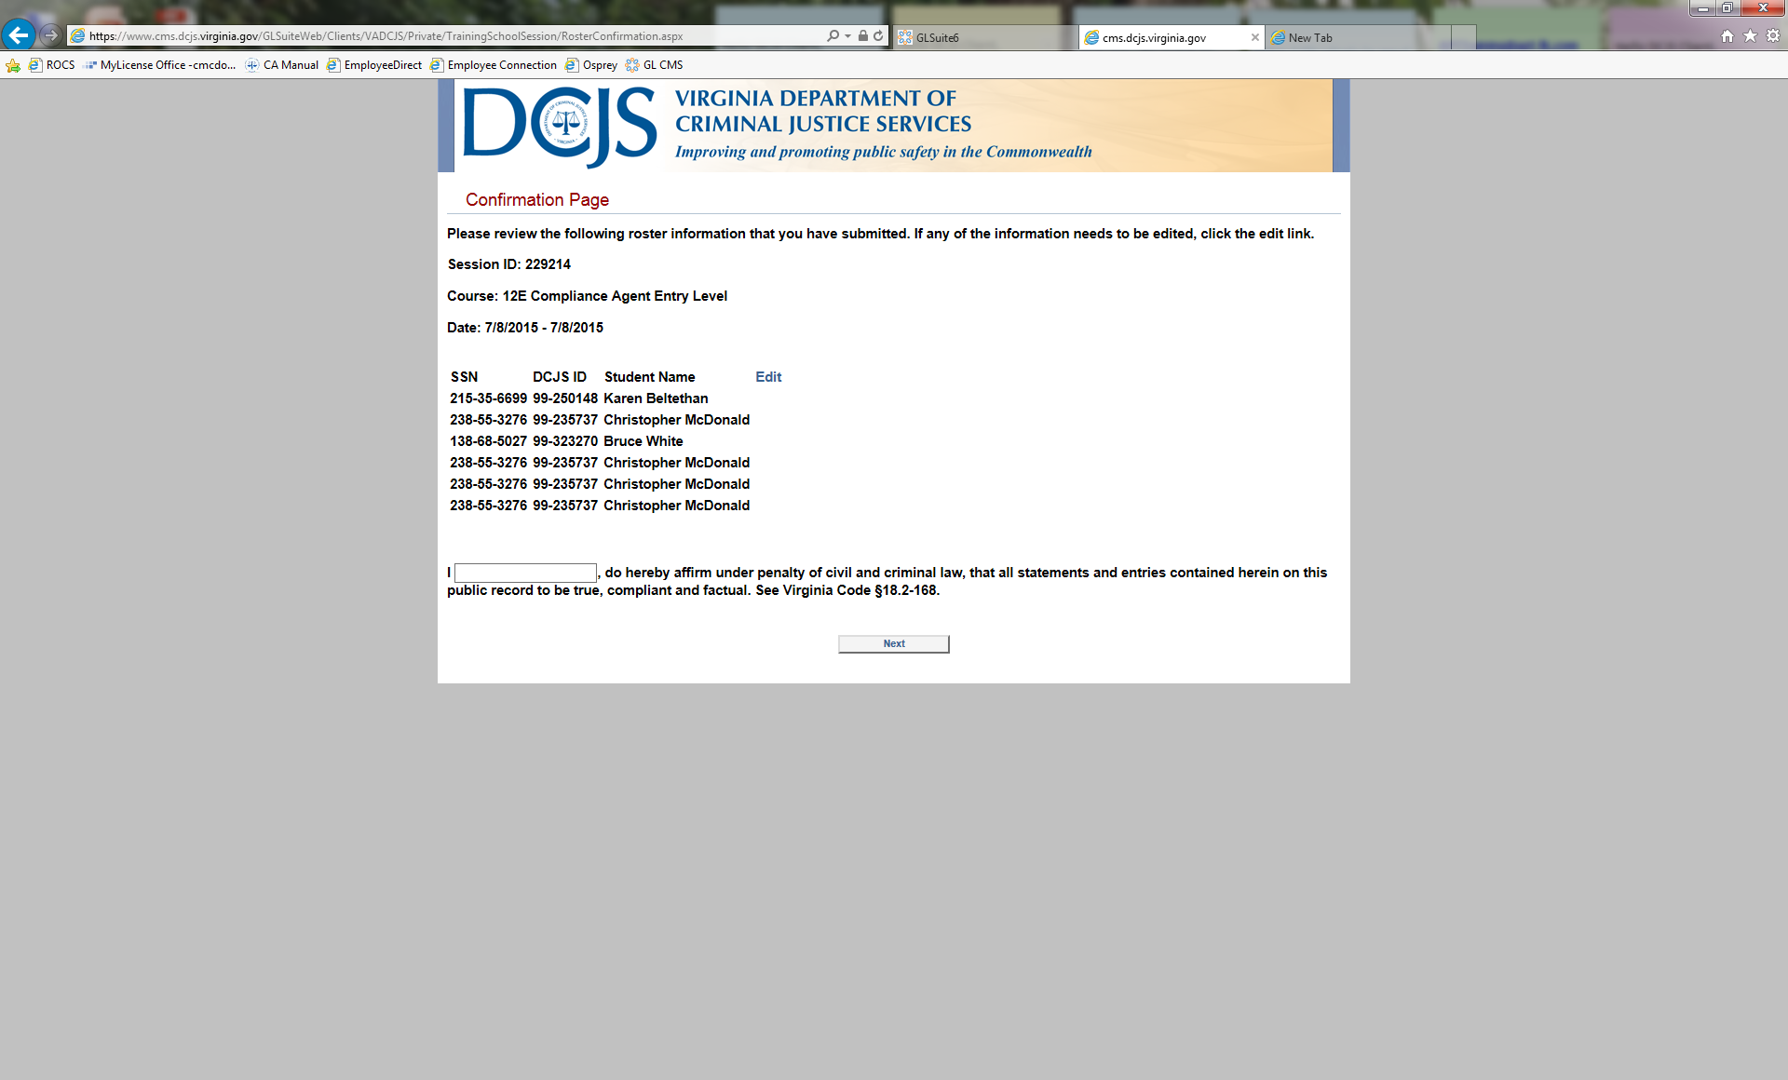
Enter a Roster
After you select next enter your name on the affirmation page and select next or edit to add a name only

Slide 23
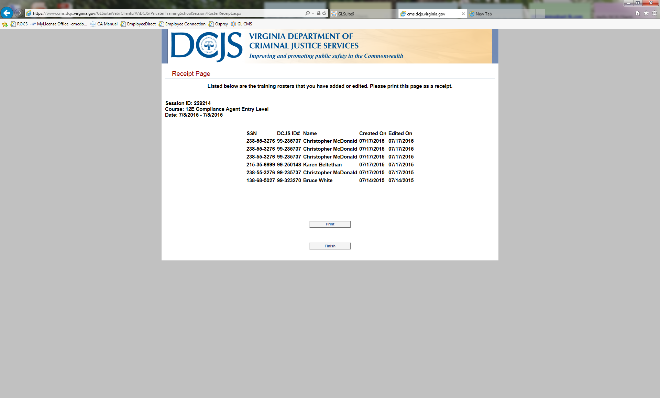
Enter a Roster
On this page you may print your roster
(you cannot recall this page again) select finish

Slide 24
End Show

