Slide 1
Byrne/JAG Grant Program
POST AWARD

Slide 2
What to expect?
Statement of Grant Award Package (“SOGA”)
Conditions and Requirements of Grant Program
Documentation Retention
Reporting Requirements
Online Grants Management System (OGMS) items including claims, status reports, encumbrances, and contract amendments
DCJS Contacts

Slide 3
Award Package
Acceptance of the grant award constitutes its agreement that the grantee assumes full responsibility for the management of all aspects of the grant and the activities funded by the grant.
By signing the Statement of Grant Award/Acceptance, the grantee agrees to comply with all the special conditions outlined.
Contains the Statement of Grant Award (SOGA).
The signed SOGA should be sent to the DCJS grants administration division as outlined in the award package (please copy your grant monitor on the email).

Slide 4
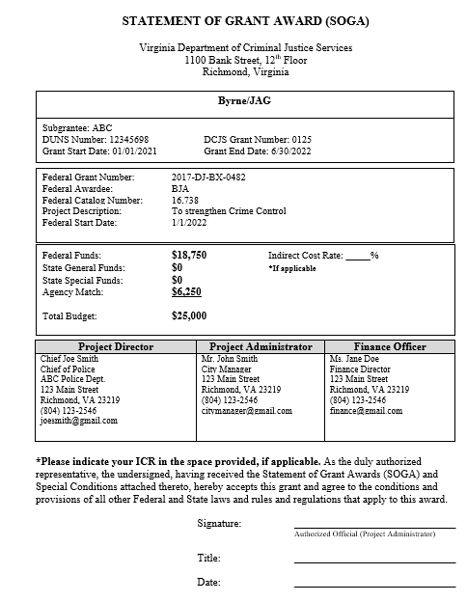

Slide 5
Grant Conditions and Requirements
All Grant requirements can be found at www.dcjs.virginia.gov/grants/grant-requirements
Byrne/JAG grant conditions include reporting requirements, grant restrictions, contract amendments for the grant program, financial audits, and the reporting schedule.
Notes:
All grant conditions and requirements can be found on the DCJS website. You will need to review these in their entirety to ensure compliance with the Byrne/JAG grant program.

Slide 6
Byrne/JAG Specific Conditions of Note
40. Required Reports
The subgrantee agrees to submit, on or before scheduled due dates, such reports as required by DCJS.
For this grant program, DCJS requires quarterly reporting to the Bureau of Justice Assistance, Office of Justice Programs (“OJP”), Performance Measuring Tool (“PMT”) Management system to ensure compliance with federal reporting guidelines. The quarterly reporting completed on the OJP federal site will need to be uploaded to the DCJS OGMS system as your quarterly status report. Failure to comply in a timely manner may result in DCJS withholding disbursement of grant funds and/or termination of the grant. DCJS will set up the grantee in the BJA OJP federal site so the grantee is able to complete the required reports before the first quarterly reporting period ends.
Notes:
A Condition/requirement of note is the required reports for the Byrne/JAG Program. Reports are required quarterly and must be uploaded into OGMS. Status reports are completed on the Department of Justice Office of Justice Programs website. This will be discussed later in the presentation.

Slide 7
Reporting Requirements
PROGRESS (Status) REPORTS for this grant program are due within 15 days after the end of each calendar quarter and must be approved by your DCJS Grant Monitor. Please reference #40 above for further information.
BUDGET (Contract) AMENDMENTS – may be submitted for consideration through OGMS. Please review your Special Conditions carefully to determine the requirements and procedures for amending budgets. For budget amendment questions, contact your assigned Grant Monitor.
REQUEST FOR FUNDS- to draw down grant funds a Claim must be submitted via the DCJS OGMS system
FINANCIAL REPORTS & REIMBURSEMENTS (Claims) – OGMS Detail of Expenditure/Reimbursement forms are due within 45 days after the end of the grant period. If the due date falls on a weekend or non-business day, the report is due on the next business day. For financial questions, contact Mark Fero at 804-225-2782 or via email at Mark.Fero@dcjs.virginia.gov

Slide 8
Documentation Retention
Records pertinent to the award must be retained for a period of three (3) years from the date of submission of the final expenditure report.
Subgrantee must provide access, including performance measurement information, in addition to the financial records, supporting documents, statistical records, and other pertinent records indicated at 2 C.F.R. 200.333.

Slide 9
Byrne/JAG Status Reports
Status reports are completed on the federal Office of Justice Programs website https://ojpsso.ojp.gov/
A designated person from your agency will be granted access to complete the required DOJ OJP Performance Management Tool (“PMT”) report (the primary contact listed in OGMS will likely be the person granted access unless otherwise told by the grantee)
Once the report is completed, the grantee will need to save or print the report, and upload the report into OGMS as their quarterly status report.
Resources on how to complete, save, and upload PMT/status reports will be forthcoming before the first quarterly reporting period.
Notes:
The Byrne/JAG grant program is a federally funded grant program. Federally funded grants must complete a Performance Management Tool “PMT” report via the Office of Justice BJA website to ensure reporting compliance with the grant program. The PMT report is completed on the OJP website then printed, scanned and uploaded into OGMS as your required DCJS quarterly status report.

Slide 10
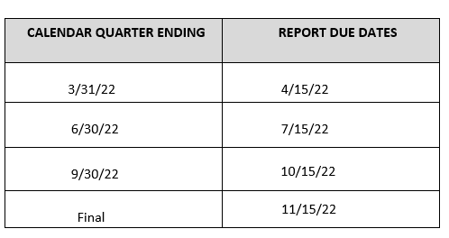
Reporting Schedule:
9-month grant – Equipment & Training
Notes:
Reporting schedule for the Byrne/JAG training and equipment grants

Slide 11
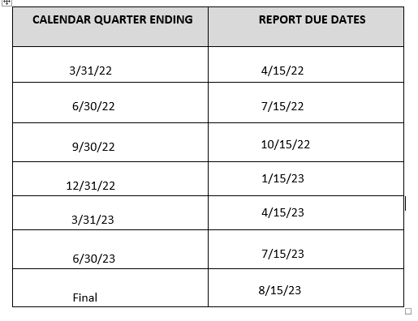
Reporting Schedule:
18-month grant – Public Safety Based Programs
Notes:
Reporting schedule for the Byrne/JAG public safety based programs

Slide 12
Register in OGMS
Every user that manages a DCJS grant will need to register for an account.
This includes those within your locality that are responsible for submitting a grant application, uploading status reports, entering financial reports, and reimbursements.
Project Directors, Project Administrators, and Finance Officers are recommended to register.
Information on how to register for OGMS can be found on the DCJS website at www.dcjs.virginia.gov/grants/ogms-training-resources
Notes:
It’s important that anyone in your locality that will work on the application or the grant must register in the system. This would include Project Directors, Project Administrators, Finance Officers, and anyone who will be submitting reports and completing the application.
It’s important to note that OGMS is compatible with many different browsers but when you are in the system, it’s recommended that you use the OGMS menu and not the browser menu. OGMS tends to work better in Google Chrome.

Slide 13
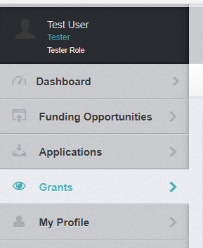
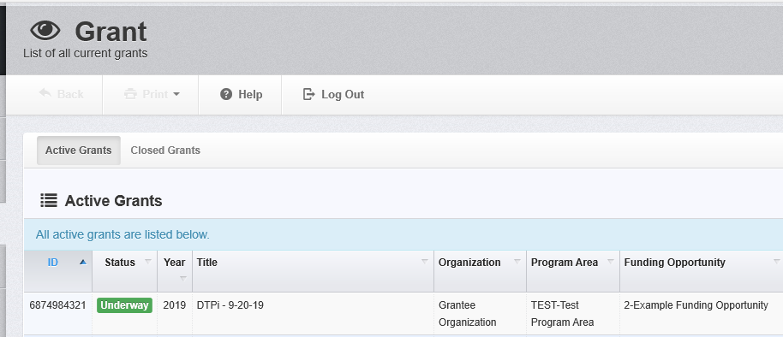
Accessing your Grant
From the Side Menu:
Click on ‘Grants’
Select the Grant you would like to access in the ‘Active Grants’ listing.
If you need to access a closed grant, click on the ‘Closed Grants’ tab.
Notes:
Once you are registered in OGMS you should have access to any grants you are listed on.
To access your grant, click on ‘Grants’ in the vertical tool bar on the left hand side of the screen. This will bring you to the list of ‘Active Grant’s where you can select the grant you would like to access. If you don’t see the grant in this list, contact your Project Director to add you as an additional contact on the grant.
If your grant is listed as ‘Awarded’ and not ‘Underway’ that means DCJS grants administration has not received the signed SOGA. You will not have access to all grant components until it has been received and reviewed.

Slide 14
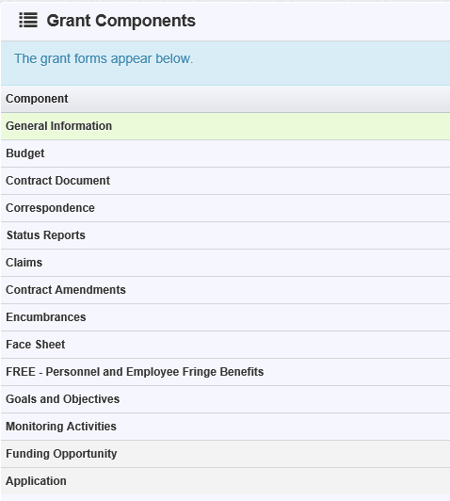
Accessing your Grant (continued)
Once you have selected the Grant, you will be directed to the ‘Grant Components’.
Components may not be the same for all grant programs.
‘General Information’ is where the Project Director can add additional contacts
Notes:
After you click on the grant you will see the list of grant components. The grant components may be different for each grant program.
Under ‘General Information’ is where the Project Director can add any needed additional contacts.
The other components that will be used frequently will be the Claims, Status Reports, Correspondence and possibly Encumbrances and Contract Amendments.

Slide 15

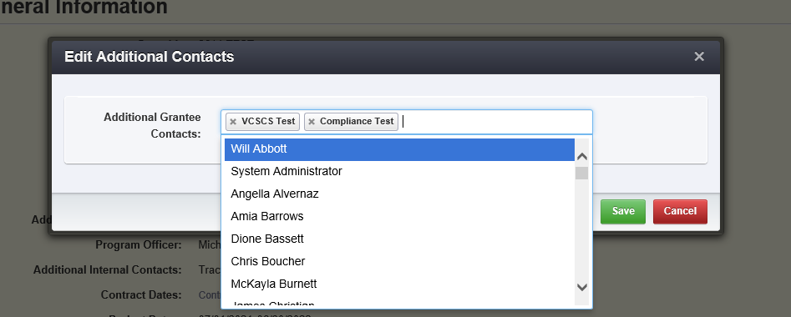
Accessing your Grant (continued)
* Individuals listed as a contact have full access to all grant components.
To add or remove someone from the grant click ‘Edit Additional Contacts’
Click in the box and choose the individual you want to add
To remove, click the ‘x’ next to the name in the box
Notes:
It is important to notes that individuals listed as contacts on the grant have full access to all grant components so it’s important for the grantee to discuss roles and responsibilities in OGMS.
To add someone to the grant, or remove them, click ‘Edit Additional Contacts’.
Click in the ‘Additional Grantee Contacts’ box and a drop down box will appear with all the individuals associated with the same organization. Choose the person you want to add and click ‘Save’.
To remove someone, click the ‘x’ beside their name in the box and select ‘Save’.

Slide 16

Starting a Claim
Choose ‘Claims’ from the components list.
Click ‘Add Claim’ on the right side of the screen.
Notes:
The ‘Claims’ component is where a grantee will request a drawn down of funds for payment/reimbursement in the OGMS system for the grant program.
When you click on ‘Claims’ it will bring you to a screen that lists claims that are in editing status, have been submitted, or were withdrawn.
To start a claim, click the ‘Add Claim’ button.

Slide 17
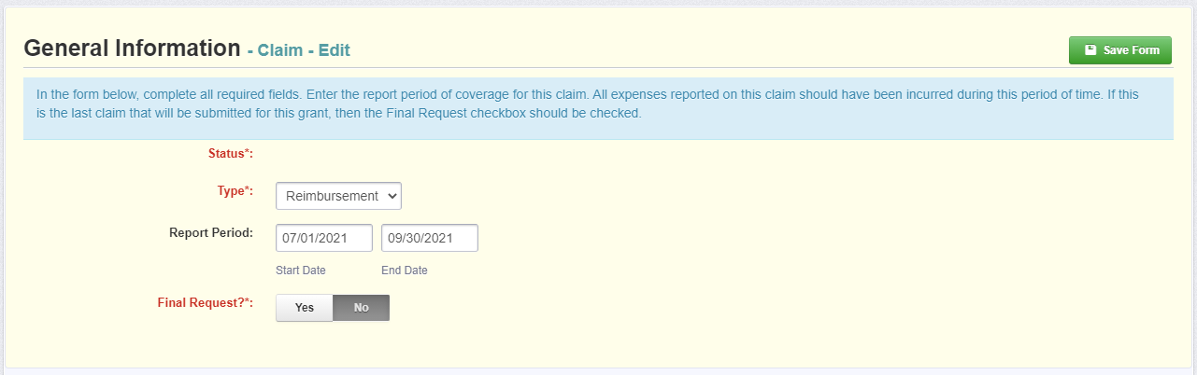
Starting a Claim (continued)
The status will be auto populated
Type: Reimbursement
Reporting Period: the beginning and end of the quarter
Final Request: Do not select ‘Yes’ unless this is your final quarterly Claim submission
Click ‘Save Form’
Notes:
OGMS will ask you to complete the General Information portion of the claim before you can save it.
The status will be auto populated
Under Type, choose ‘Reimbursement’
The report dates are the beginning and end of the quarter. Please refer to your specific reporting schedule for your grant program as shown earlier or in grant conditions/requirements. (Example: 01/01/22-03/31/22 ; 04/14/22- 06/30/2022; 07/01/2022-09/30/2022 etc…)

Slide 18
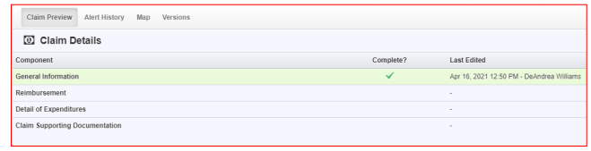
Starting a Claim (continued)
Claim number is auto populated
Reimbursement – enter quarterly expenses to be reimbursed and report local match
Detail of Expenditures – describe the funds expended during the quarter
Notes:
Once the ‘General Information’ has been completed, you will see the ‘Claim Details’ page. A claim cannot be submitted until all components have been marked as complete.
Note: the system has created a claim number as soon as you clicked ‘Save Form’. If you log out of the system at this point or any future point, you will click on the existing claim until it has been submitted
The ‘Reimbursement’ form is where you will enter the quarter’s expenses and local match.
The ‘Detail of Expenditures’ is where you will describe the funds that were expended during the quarter and break it down between Federal funds and Match.
The “Claim Supporting Documentation” can consist of any invoices or such that may be required by the grant. Byrne/JAG grants require a Claim Certification form be uploaded with EVERY claim.

Slide 19
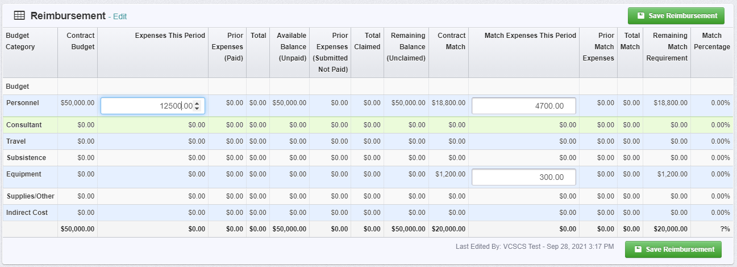

Reimbursement
Click ‘Edit Reimbursement’
Enter line item totals
Click ‘Save Reimbursement’
Notes:
Click on ‘Edit Reimbursement’
The grid will only allow you to enter amounts in the categories where there is an approved budget.
Enter line item totals for all federal funding under the ‘Expenses This Period’ column.
All local match should be reported under the ‘Match Expenses This Period’ column.
When complete, click ‘Save Reimbursement’. If you do not save the form and you either back out of the form or section of the form, your information will be lost.

Slide 20
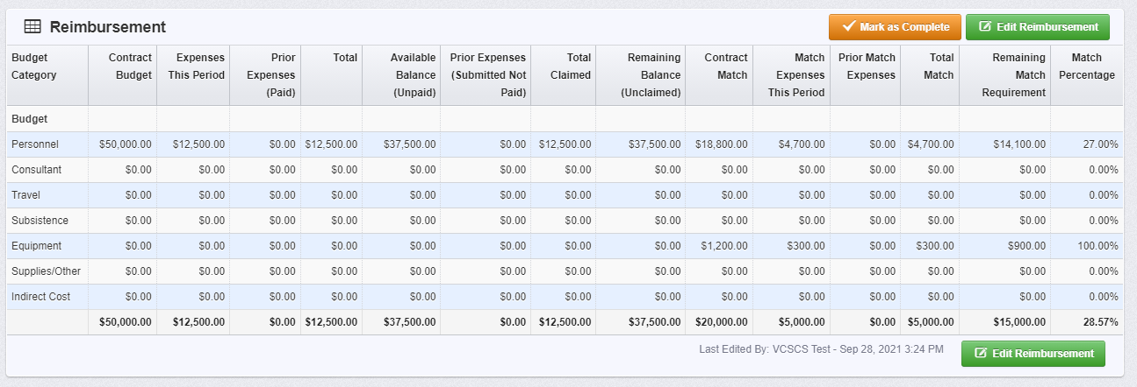
Reimbursement (continued)
‘Match Percentage’ will be calculated after the form
has been saved
Match can be met anytime through the grant year
Notes:
After you’ve saved the form, you will see the ‘Match Percentage’ in the far right column.
Match can be met anytime through the grant year as long as you’ve met the total match by the end of the fiscal year. Grantees must properly track and maintain adequate supporting documentation for local match provided.

Slide 21
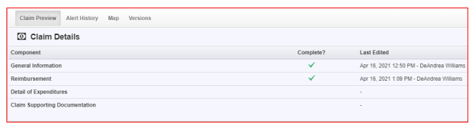
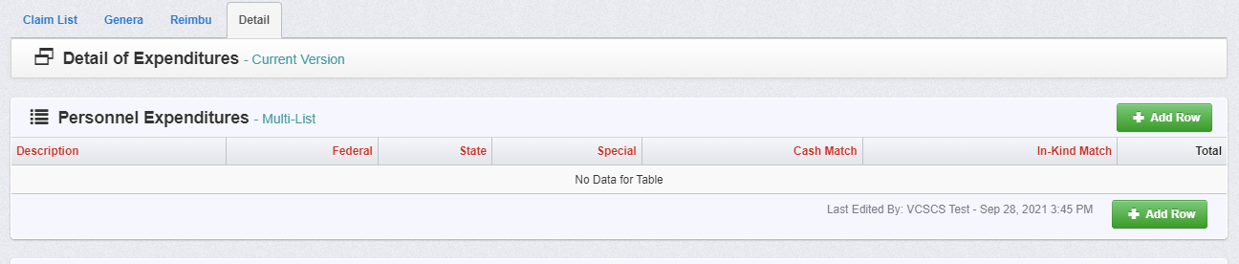
Detail of Expenditures
Must correspond with the expenditures reported in the reimbursement section
Notes:
Now we will discuss how to complete the ‘Detail of Expenditures’ component.
This section must correspond with the expenditures reported in the reimbursement component but this is where the expenditures are broken down.
To enter your detailed expenditures, click on the ‘Detail of Expenditures’ form and then the green ‘Add Row’ button on the right hand side.

Slide 22
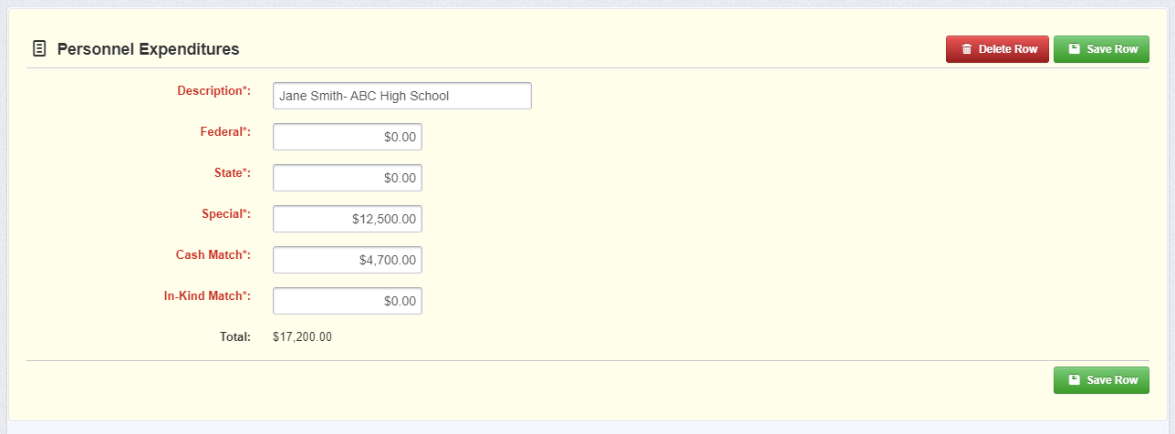
Detail of Expenditures (continued)
‘Personnel Expenditures’ should include salary and fringe benefits
‘Description’: Employee’s name
  If more than one employee on a grant, include the school
Expenses should be broken down between Special and local match if applicable.
Notes:
For the purpose of this presentation we will only go over the ‘Personnel Expenditures’.
Under the ‘Personnel Expenditures’ section you will include expenditures for salary and fringe benefits.
For the description you need to enter the employee’s name.
After you’ve entered the personnel expenses click ‘Save Row’.
Once you’ve completed all sections you can click ‘Mark as Complete’.

Slide 23
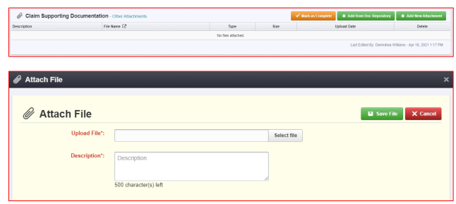
Claim Supporting Documentation
Notes:
You will then be directed to the Claim Supporting Documentation component
Claim supporting documentation is required for this grant and any federal grants. Complete the fields on the form, then click Save Form.
All information must be saved by clicking “Save” on the forms. If you do not click “Save” and you back out of the form or section of the form, your information will be lost.

Slide 24
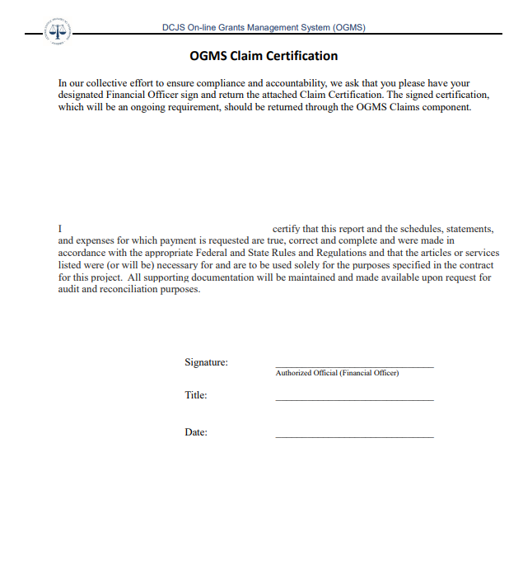
OGMS Claim Certification Form
Notes:
This form must be submitted with every claim to ensure compliance and accountability. This form must be signed by the Financial Officer and be attached with the claim.
This form can be found on the DCJS Website at https://www.dcjs.virginia.gov/grants/forms under the General Forms.

Slide 25
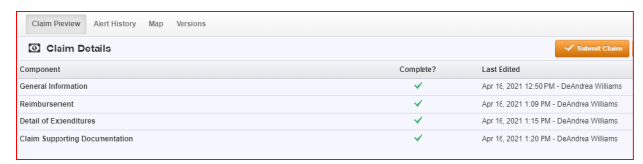
Submitting the Claim
‘Preview Claim’ to verify the amounts in both sections are inline
Submit Claim
You are not able to delete a claim but can withdraw
Notes:
All sections must be marked as complete before you can submit the claim (must have green check marks). After you’ve reviewed the information, and it’s accurate according to your approved budget, click ‘Submit Claim’

Slide 26
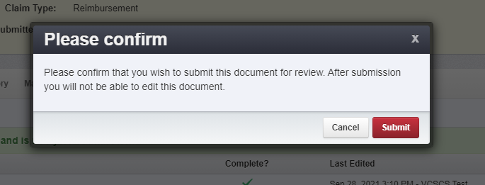
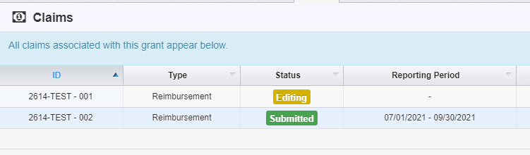
Submitting the Claim (continued)
Claim has been submitted
Verify you wish to submit the claim
Notes:
The last step is to verify that you are ready to submit the claim. You are not able to delete a claim but you can withdraw the claim before it has been submitted. It will remain in your list of all the claims associated with your grant.
Once you have filled out all the required fields and you have marked each form as complete, you can Submit the Claim. Once submitted, you will not be able to go back and edit. If corrections need to be made, please contact ogmssupport@dcjs.virginia.gov
After you’ve submitted the claim you can return to the ‘Claims’ component to see that it’s been submitted.

Slide 27
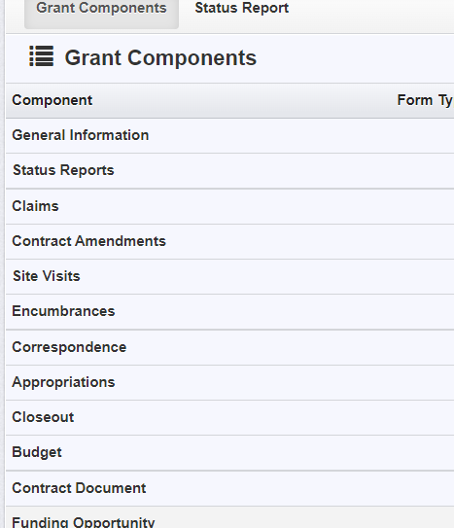

Starting a Status Report
Choose ‘Status Reports’ from the components list.
Click ‘Add Status Report’ on the right side of the screen.
Notes:
To submit the required quarterly status reports, you will choose the ‘Status Reports’ component.
When you click on ‘Status Reports’ it will bring you to a screen that lists reports that are in editing status, have been submitted, or were withdrawn.
To start the process to submit and upload a status report, click the ‘Add Status Report’ button.

Slide 28
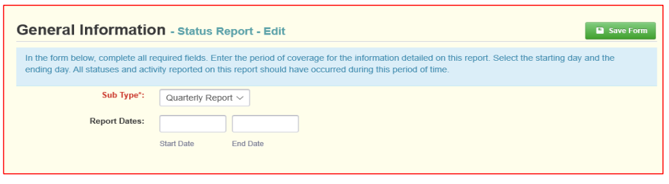
Starting a Status Report (continued)
The Status Report will auto populate
Sub-Type: “Quarterly Report”
Enter the report dates for the reporting period, e.g., start date: 01-1-22 end date: 03-31-22 (see the reporting schedule for appropriate reporting period dates)
Notes:
OGMS will ask you to complete the General Information portion of the report before you can save it.
The status will auto populate.
Under Sub Type, Byrne/JAG Grants will need to chose Quarterly Report.
Reports are due 15 days after the reporting period ends. For example, if the first reporting period is January 1, 2022 through March 31, 2022 so the first status report is due by April 15, 2022. Please refer to the reporting schedule for future reporting dates.

Slide 29
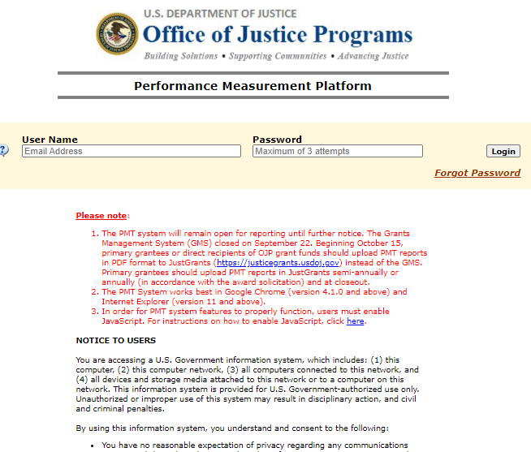
Accessing Performance Management Tool “PMT” Reports for required Status Reports
Once your grant is awarded and before the first reporting period DCJS staff will register you in the OJP BJA reporting system at https://ojpsso.ojp.gov/
Notes:
Status reports are to be completed via BJA’s Performance Measuring Tool management system that can be found at https://ojpsso.ojp.gov/ . DCJS will add the primary contact person for the grant as a user to the PMT website. An email will be sent to allow that person access to the system. Please check your junk/spam email in case you did not receive it. You must log in within 3 days of the PMT access email. If you did not receive an email or need to have another person have access to the account, please let DCJS know. Please ensure you are reporting for the correct grant (as many localities have multiple grants) by making sure the grant numbers match the grant you are doing the reporting for.
Once you complete the BJA PMT report, please print and scan into OGMS as your status report for the current reporting period. This is now your status report for the grant. This report is required for all federal grant programs and must be completed to be in compliance with your DCJS federal grant award.
If you have any questions, please do not hesitate to contact your grant monitor.

Slide 30
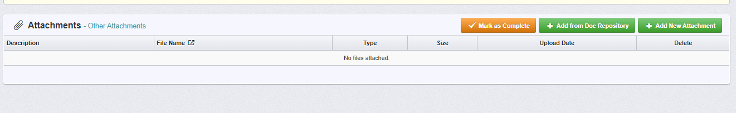
Submitting Status Report
Notes:
DCJS hopes to have all grantees uploaded into the BJA PMT system in time to enter the next progress report for the quarter ending on March 31, 2022. Once the BJA PMT report is complete it will need to be printed/scanned/saved then uploaded as an attachment as your DCJS OGMS status report. You will select “Add New Attachment” upload the report, then click on “Mark As Complete” to submit the needed report.

Slide 31
Encumbrances
Encumbrances are actions that need to be taken before you can implement the project or submit a claim.
Notes:
Encumbrances are actions that need to be taken before you can implement the project or submit a claim. Encumbrances were previously known as “special conditions”.
Encumbrances can be viewed while the grant is in ‘Awarded’ and ‘Underway’ status and it is the grantees responsibility to check this component for any actions they need to take.
An encumbrance, with a hold on payments, can be entered if status reports and other requested documentation are not provided on time.

Slide 32
Encumbrances (continued)
Status will let you know if it’s been completed
Compliance Date will tell you when it was approved
Description will tell you what needs to be done
Due Date will tell you when you must complete the action by
Hold Payment, when yes, indicates you will not be able to submit a claim until it has been met
Notes:
The status will let you know if the encumbrance has been completed. The box will either say Pending, Compliant, or Cancelled. ‘Pending’ status means you still need to complete the action. ‘Compliant’ means the action has been taken and the Grant Monitor and/or Grants Management have approved. If it says ‘Cancelled’ then the encumbrance is not longer needed.
‘Compliance Date’ will let you know when the action was completed and approved by the Grant Monitor and/or Grants Management.
‘Description’ will explain what action you need to take to be in compliance. If the description is not clear, contact your Grant Monitor for additional guidance. It is preferable to submit any information via the ‘Correspondence’ component in OGMS unless it says otherwise.
Due date is the date when the action must be completed by and submitted to DCJS.
If there is a ‘Yes’ under ‘Hold Payment’ then you will not be able to submit a claim for reimbursement until you are in compliance with the encumbrance.

Slide 33
Contract Amendments
Contract Amendments is a request to change the grant
Any changes must be approved by DCJS before it can take effect
Types:
  Budget Revision
  Amendment
  Budget Revision
  In Line Adjustment
  Change Grant Funded Staff
  Change in Authorized Official
  Change in Award Sponsorship
  Grant Award Period Extension
  Project Scope of Work Revision
  Reporting Extension
  Other
Notes:
A ‘Contract Amendment’ is the request to make a change to your grant.
There are several types of contract amendments that are now completed in OGMS. If you have any questions about a specific contract amendment, please contact your grant monitor.

Slide 34

Contract Amendments (continued)
Choose ‘Contract Amendment’ from the components list
Click ‘Add Amendment’
Notes:
To start a ‘Contract Amendment’ choose it from the components list under your grant.
If you’ve previously started a contract amendment it will show up in the amendments list and include the type of amendment and status.

Slide 35
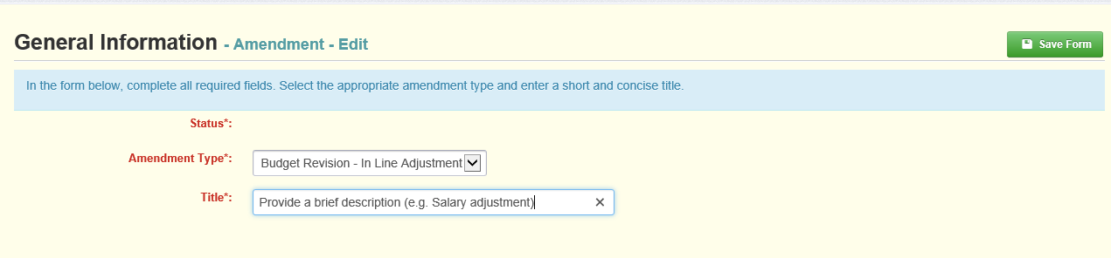
Contract Amendments (continued)
General Information will be the same for all amendments
The status will be auto populated
Choose the amendment type from the drop down box
The title should include a brief description of the amendment (e.g., budget amendment request for equipment)
Notes:
You will be asked to complete the general information which is the same for all contract amendment types.
The status is auto populated and the type is chosen from the drop down box.
For the title, you want to briefly describe the request you are submitting. For a ‘Budget Revision-In Lind Adjustment’ it could be something like, “Budget Amendment Request for Equipment”

Slide 36
Contacting DCJS
Status reports: Grant Monitor
Goals and Objectives: Grant Monitor
Budget Amendment: Grant Monitor
Financial Reporting/Claims: Will Abbott or Mark Fero
Grant Closeout: Andrew Wooldridge or Mark Fero
OGMS technical support: ogmssupport@dcjs.virginia.gov
For financial questions, contact:
  Will Abbott: (804) 997-5195 or will.abbott@dcjs.virginia.gov
  Mark Fero: (804) 225-2782 or mark.fero@dcjs.virginia.gov.
  Andrew Wooldridge: (804) 225-1863 or andrew.wooldridge@dcjs.virginia.gov
Notes:
Here is some guidance for who to contact and when.
If you have questions about your grant’s status reports, goals and objectives, budget amendments or other programmatic issues, you will need to contact your grant monitor.
For questions on claims and reimbursements, please contact Will Abbott. You can find their contact information on the bottom of this slide or in the award package.
Contact Andrew Wooldridge or Mark Fero if you have any questions about the grant closeout.
When contacting various staff at DCJS about your grant, please have your grant number and grant program and feel free to copy your grant monitor.

Slide 37
Who is your main contact person?
This should be the person who will have day-to-day responsibility for managing the project and who will be the contact if DCJS needs project-related information.
If this person is different than the one listed as the Project Director on the grant, send name, email address, and phone number to your Grant Monitor.

Slide 38
Division of Law Enforcement – Grant Staff
Ms. Nicole Phelps, Criminal Justice Grant Program Specialist (Byrne/JAG grants, Body Worn Camera grants, Critical Incident Stress Management grants, and Local Law Enforcement grants)
804-263-3388 Nicole.Phelps@dcjs.virginia.gov
Mr. Chris Boucher, Criminal Justice Grant Program Specialist (Coronavirus Emergency Supplemental Funding grants)
804-584-0510 Christopher.Boucher@dcjs.virginia.gov
Mr. Tracy Matthews, Law Enforcement Training and Grants Supervisor (Combating Hate Crimes grants and Substantial Risk Protective Order grants)
804-371-0635 Tracy.Matthews@dcjs.virginia.gov
Notes:
Here is the contact information for the DCJS Law Enforcement Division Grants Staff
Nicole Phelps is the grant monitor for all Byrne/JAG grants. Her normal business hours are Monday through Friday, 7:30 am to 4 pm.
If she is not available and you need immediate assistance, you can contact Chris Boucher or Tracy Matthews and they will try to help you in her absence.

