Slide 1
Office of First Responder Wellness (OFRW)
Grant Program
FY26 OFRW Guidelines and
Application Procedures
Notes:
Hello and welcome to the Office of First Responder Wellness Grant Program webinar. We will get started in just a moment.​
​
​
Welcome everyone, to the Office of First Responder Wellness Grant Program Webinar. My name is Phyllis Vaughan, and I am a Grant Program Specialist for the Virginia Center for School and Campus Safety. Today we will discuss the basics of the Office of First Responder Wellness Grant program and the core components of the grant application process. ​Just a few housekeeping notes. All participants have been muted. And this presentation is being recorded. This PowerPoint presentation will be made available to potential applicants following the conclusion of this webinar.
​
Please note that this presentation is an overview of the funding opportunity posted on the DCJS website and the DCJS online grant management system. It does not cover all the information contained in the funding opportunity, so it is the applicant’s responsibility to read all instructions and guidelines provided. If there is any discrepancy between this presentation and the Funding Opportunity, please refer to the Funding Opportunity for instructions.​
​
If you have any questions as we go through the presentation, please drop them in the chat, I will be pausing periodically so we can answer any questions you may have. If you have any questions after the webinar concludes, please reach out to me directly.

Slide 2
What to expect?
Introduction to the Office of First Responder Wellness (OFRW) Grant Program and Funding Opportunity Overview
Eligibility to Apply
Creating an On-line Grants Management System (OGMS) Account
Application Instructions
Application Review Process
Notes:
Before we dive in, let me give you a quick rundown of what we'll be covering today. First, we’ll introduce the Office of First Responder Wellness Grant Program and the funding opportunity. Then, we’ll walk through the eligibility requirements, followed by some key instructions on how to create your Online Grants Management System account and start your application. Lastly, we’ll go over how the competitive review process works.

Slide 3
Program Overview
First responders work in law enforcement, fire, emergency medical services, emergency communications, and corrections.
Designed to support mental, emotional, and physical well-being.
Funding supports first responder wellness for current and retired first responders.
Notes:
Before we move on to the funding opportunity details, let’s take a moment to discuss the Office First Responder Wellness and briefly overview the grant program. ​
​
The Virginia Department of Criminal Justice Services (DCJS) Office of First Responder Wellness is offering funding to support first responder wellness for current and retired first responders. The mission of the Office of First Responder Wellness is to adopt a public health approach to first responders through primary prevention, early intervention, response, and recovery initiatives. This includes developing training and resources that not only save the lives of our first responders but also improve their overall wellness.
The First Responder Wellness Grant Program is designed to enhance the mental, emotional, and physical well-being of first responders across the Commonwealth of Virginia. This funding aims to provide resources to agencies and non-profit organizations focused on promoting the overall health and wellness of those who serve on the front lines of public safety.​
​
A First Responder is defined as a current or retired law enforcement officer, firefighter, emergency medical services (EMS) provider, emergency communications officer, or corrections officer. ​
​
In the next few slides, we’ll review the rules and requirements for the Office of First Responder Wellness Grant Program and the funding opportunity in more detail.

Slide 4
Funding Opportunity
Total award amount: $2,700,000
Project period: July 1, 2025 – June 30, 2026
Applicants are eligible to apply for up to $30,000
Applications due March 17, 2025, by 5:00 pm
Notes:
The DCJS Office of First Responder Wellness will be awarding up to $2,700,000 to first responder agencies and non-profit organizations. The funding is intended to support training opportunities and help establish or enhance wellness programs and peer support services for first responders.​
​
This is a 12-month funding opportunity, starting on July 1, 2025, and running through June 30, 2026.​
​
Eligible applicants can request up to $30,000 in their grant applications. Be sure to submit your application using the Online Grants Management System (OGMS) by 5:00 pm on March 17, 2025.​
​
The system will not allow submissions after the deadline. Applications submitted late or outside the system will not be considered, and we will not accept paper or emailed copies of the application.​
You’ll need to register in OGMS to apply, so make sure to allow enough time for registration and any potential technical issues.
Please note that this funding opportunity does not have a match requirement or continuation funding available. ​
Grants will be awarded on a competitive basis and will depend on the funding availability.
​

Slide 5
Objectives
The OFRW grant will fund:
First responder wellness training for agency employees.
Registration fees, lodging, and per diem for agency employees to attend conferences related to first responder wellness.
Support costs for a therapy/support dog or costs for a dog already owned by an agency to attend training.
The purchase of therapeutic wellness equipment.
Non-profit organizations to provide wellness training, resources, or direct services to first responders in Virginia.
Notes:
This grant program is designed to support first responders by funding programs that focus on emotional, physical, and overall personal wellness. Applicants can request funding for a variety of needs, including:​
First responder wellness training for agency employees​
Registration fees, lodging, and per diem for agency employees to attend first responder wellness conferences​
Support costs for a therapy or support dogs or funding for a dog already owned by an agency to attend training​
The purchase of therapeutic wellness equipment, and​
Funding for non-profit organizations to provide wellness training, resources, or direct services to first responders in the Commonwealth of Virginia​
This funding aims to improve the health and well-being of those who serve on the front lines of public safety. ​
​
Now that we've covered the grant objectives, let’s move on to the eligibility requirements for applicants.

Slide 6
Eligibility
First responder agencies:
Must be based in Virginia and serve first responders (e.g., fire, EMS, law enforcement, etc.).
May include state, municipal, county, and regional departments.
Non-profit organizations:
Must be registered as a 501(c)(3) organization or equivalent with a demonstrated track record of providing wellness services, training, or resources to first responders.
Notes:
First responder agencies and non-profit organizations are eligible for funding, applicants must meet the following criteria:​
​
First Responder Agencies, must be based in the Commonwealth of Virginia and employ first responders. A first responder agency includes those that employ law enforcement officers, firefighters, EMS providers, emergency communications officers, or corrections officers. Eligible agencies can be state, municipal, county, or regional agencies.​
​
Non-Profit Organizations: Non-profits can apply for funding to provide wellness training, resources, or direct services to first responders in Virginia. To qualify, the organization must have a proven history of providing first responders wellness services, training, or resources and must be registered as a 501(c)(3) or equivalent.​
​
Next, we'll go over some application restrictions to keep in mind.​

Slide 7
Allowable: Equipment and Supplies
Equipment: tangible personal property with more than one year of useful life and a per-unit cost that equals or exceeds $10,000. All other expenses should be itemized as supplies.
Equipment and supply expenses include, but are not limited to:
  Massage chairs
  Meditation pods
  Exercise balls, foam rollers, yoga mats
  Materials to support first responder wellness training
Notes:
Under this grant, applicants can request funding for first responder wellness equipment and supplies.​
​
Equipment is tangible personal property with a useful life of more than one year and costs $10,000 or more per unit. If an item costs less than that, it should be classified as a supply in your grant application.​
​
It’s also important to note that grant funds can’t cover the entire cost of an item unless it’s used exclusively for the grant project. However, if an item is used partially for the grant program, you can request funding for a pro-rated share or percentage of the cost.​
​
Equipment and supply expenses can include, but are not limited to:​
Massage Chairs​
Meditation Pods​
Exercise Balls​
Foam Rollers​
Yoga Mats​
Materials to support first responder wellness training​
This is not exhaustive list and other equipment and supplies can be requested to support grant initiatives.
​

Slide 8
Allowable: Programming
Education-based programming to enhance first responder wellness.
Expenses can include, but are not limited to:
  First responder wellness training or awareness materials for first responder agencies
  Support costs for a therapy/support dog
  First responder wellness training, resources, or direct services by non-profit organizations
Notes:
In addition to equipment and supplies, grant funds can be used for education-based programming that enhance first responder wellness.​
​
Expenses can include, but are not limited to: ​
​
First responder wellness training or awareness materials for first responder agencies ​
Support costs for a therapy/ support dog - this includes dogs an agency or non-profit already owns. A therapy or support dog is trained to provide comfort, affection and emotional support to people in various locations.​
First responder wellness training, resources or direct services by non-profit organizations ​
​

Slide 9
Allowable: Travel and Subsistence
Travel and subsistence expenses to attend first responder wellness conferences, including:
  Registration fees
  Lodging
  Per diem
  Mileage
Notes:
Funds from this grant program can be used to cover travel and subsistence expenses related to attending first responder wellness conferences, including: ​
Registration fees ​
Lodging ​
Per diem ​
Mileage

Slide 10
Application Restrictions
Funds cannot be used for:
  Therapy/support dogs cross-trained in narcotics detection, ignitable liquid detection, explosive detection, or tracking/trailing canines.
  Stationary, weightlifting, or aerobic gym equipment.
  Gym renovations.
Notes:
Just a quick note on application restrictions: funding from this grant cannot be used for expenses related to therapy or support dogs that are cross-trained for detection or tracking purposes. This includes dogs trained to detect narcotics, ignitable liquids, and explosives or used in search and rescue or human tracking.​
​
Additionally, the grant cannot cover expenses for stationary, weightlifting, or aerobic gym equipment, nor can it be used for gym renovations.​

Slide 11
Application Restrictions
  Funds cannot be used for:
  Purchase of firearms, handcuffs or other wrist restraints, or any stun weapons as defined in Code of Virginia §18.2-308.1
  Food or beverage for any meeting, training, or event outside of wellness conference events
  Capital expenses
  Expenses incurred before the start or after the end of the grant period
Notes:
​
Additionally, state funds cannot be used for expenses related to the purchase of firearms, handcuffs, or other wrist restraints, or any stun weapons as defined in §18.2-308.1 of the Code of Virginia. ​
Food or beverage for any meeting, training, or event outside of attendance for wellness conference events​
Capital expenses ​
Expenses occurred before the start or after the end of the grant period

Slide 12

On-line Grants
Management System (OGMS)
Notes:
PAUSE FOR QUESTIONS
Next, we will discuss how to register for the Online Grants Management System, also known as OGMS, and how to use this system to apply for funding opportunities.

Slide 13
Register in OGMS
Every user who manages a DCJS grant will need to register for an account.
Includes individuals responsible for submitting a grant application, completing status reports, entering claims, and requesting funds.
Project Directors, Project Administrators, and Finance Officers are encouraged to register.
Individuals must be added as an additional contact on the application to have access.
Notes:
First, I’m going to discuss how to register in OGMS.
It’s important that anyone in your locality or organization who will be working on the application or the grant register for an OGMS account.
This would include Project Directors, Project Administrators, Finance Officers, and anyone who will submit reports and complete the application. To access the application, someone must be added as an additional contact, which I will be explain in more detail in the following slides.

Slide 14
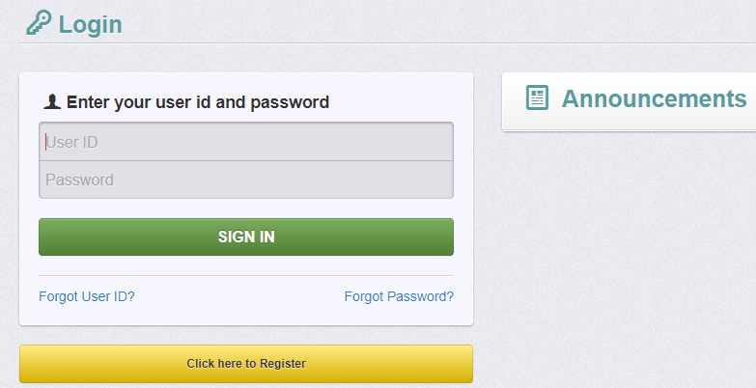
Register as a New User
URL: ogms.dcjs.virginia.gov
Click on “Click here to Register”
Notes:
To register a new user, first go to OGMS at ogms.dcjs.virginia.gov
Once you are on the Login page, choose "Click here to Register”

Slide 15
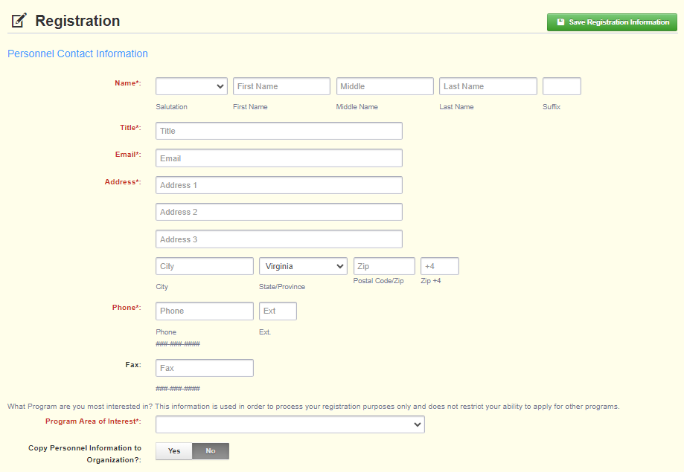
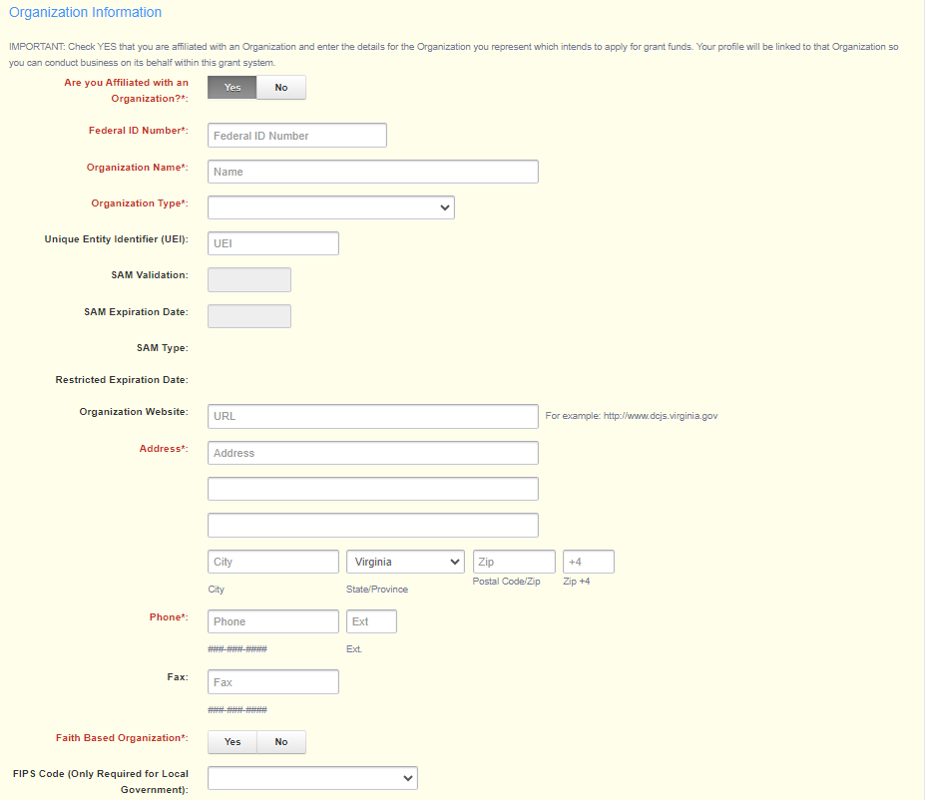
Register as a New User
All required fields are shown with a red asterisk (*)
Program Area of Interest is “FREE”
Notes:
On the Registration page, enter the personal contact and organization information requested. ​
All required fields will have a Red Asterisk, and red font. ​
​
Under Program Area of Interest, you will want to choose "FREE". ​
​
This will not prevent you from seeing or applying for opportunities in other program areas, it is used only for registration purposes. ​
​
To register, you will need your locality or organization's unique entity identifier number (UEI).​
​
At the very bottom of the registration, it will ask for a FIPS Code. The FIPS Code is only required for Local Government Agencies. If you are applying as a Local Government Agency, you will choose your locality from the drop-down list if this applies to you. If you do not see your agency in the list and you are a local government agency, please contact the OGMS support email and copy me.

Slide 16
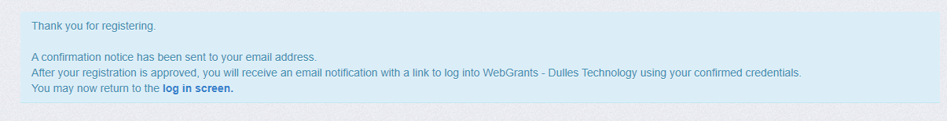
Register as a New User
You will receive a confirmation of your registration stating that an alert notification has been sent to your email address.
Notes:
After completing the required fields and clicking "Save Registration Information," you will receive a message letting you know that a confirmation email was sent to the email address you entered.
This is not an approval of your registration but confirming we received your information.

Slide 17
Register as a New User
Alerts/notifications come from
VAgrantsDCJS@webgrantsmail.com
Email #1: Your registration is under review
Email #2 & 3: Provides User ID and temporary password
Log in
Note: Each email provides the URL for OGMS
Notes:
After you submit your registration for an OGMS account, you will receive three separate email alerts; the first one will say your registration is under review. Once your account has been approved you will receive a second email with your username and third email with your temporary password.
Once you’ve received your username and password, you can log into the DCJS On-line Grants Management System.

Slide 18
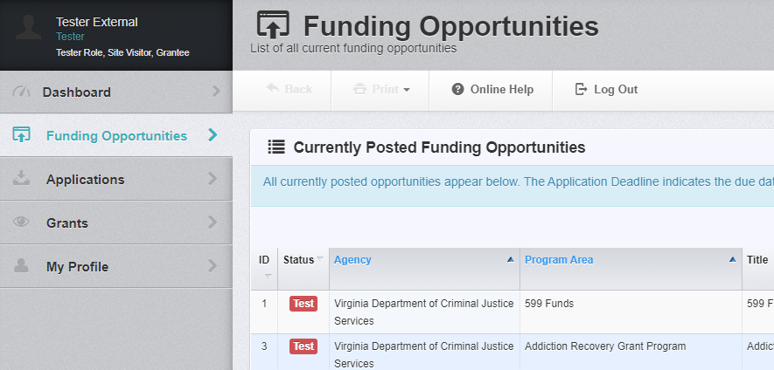
Find a Funding Opportunity
After logging in, select “Funding Opportunities” and then
click on the opportunity for which you want to apply.
Notes:
Once you have been granted access to OGMS, you can search for funding opportunities and submit applications.​
​
To find funding opportunities, sign in to your OGMS account. Once you sign in, you will see a toolbar on the left-hand side of the page. ​
​
Click Funding Opportunities. Once you are on the funding opportunity screen, you can search for funding opportunities by program area or by funding opportunity number. For this grant program, you can search “Office of First Responder Wellness” or ”OFRW” or by opportunity number “#547066” to locate the funding opportunity in OGMS.

Slide 19
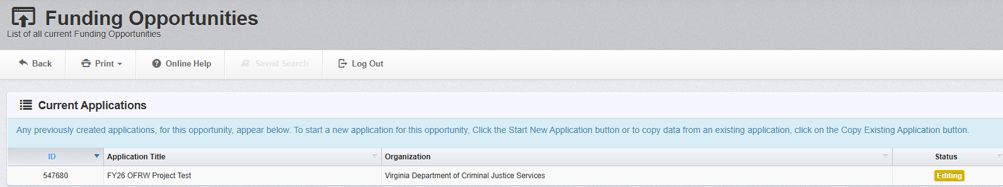
Funding Opportunity
In the Funding Opportunity, “Current Applications” shows any previously created applications for this opportunity.
The “Status” column shows if an application has been submitted or if it is still in the editing phase.
Notes:
When you click on the funding opportunity, at the top, it will display any current applications your associated organization has under that funding opportunity.​
​
It will show you if the application has been submitted or if it’s still in editing status.​
​
If you’ve started an application and do not plan to submit it, we recommend withdrawing it to eliminate any confusion. ​
​

Slide 20
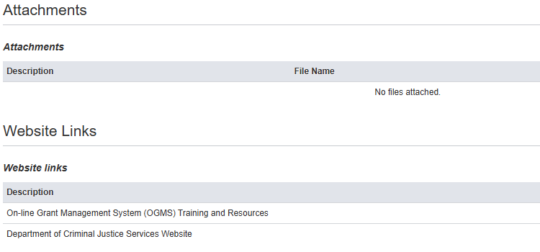
Funding Opportunity
After clicking on the funding opportunity, you will find a description that provides an overview, including; introduction, eligibility, grant application deadline, grant period, match requirements, funding restrictions, and availability of continuation funding.
  At the bottom of the page, “Attachments” and “Website Links” show documents or website addresses that will assist you with completing the application.
Notes:
When you click on the appropriate funding opportunity, its description will display. ​
​
The grant requirements and instructions are in the "Attachments" section of the opportunity. You must read the attached funding opportunity in its entirety for all requirements and instructions. ​
​
The attached funding opportunity instructions provide a detailed line-by-line explanation of how to complete each application section.​
​
Lastly, you will find website links at the bottom of the funding opportunity. These links will provide additional guidance on creating an OGMS account, completing an application in OGMS, and a link to the funding opportunity webpage. This section will be updated as more resources become available for applicants.

Slide 21
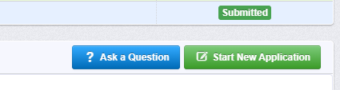
Start an Application
Start New Application: Click to create a new application. You must go through the Wizard before the application can be saved. Once saved, you can go back anytime to edit.
Ask a Question: If this appears at the top right of the Funding Opportunity Details, you can ask questions that will appear at the bottom of the funding opportunity (FO) for other applicants.
Notes:
PAUSE FOR QUESTIONS ABOUT CREATING AN OGMS ACCOUNT OR LOCATING A FUNDING OPPORTUNITY
Now that we have located the funding opportunity, let’s walk through starting a new application.​
​
To start your application, click on "Start New Application“​
​
Note for applicants who have applied for funding through OGMS previously. Since this is a brand-new funding opportunity, You will not have the option to copy existing applications like you may have had under other funding opportunities. ​
​
At any time, you can click on "Ask a Question" to submit a question in OGMS. ​
​
When someone from DCJS answers your question, you will receive an email alert. ​
​
Please remember that your questions and answers from DCJS staff may be posted at the bottom of the funding opportunity for other applicants to see.

Slide 22
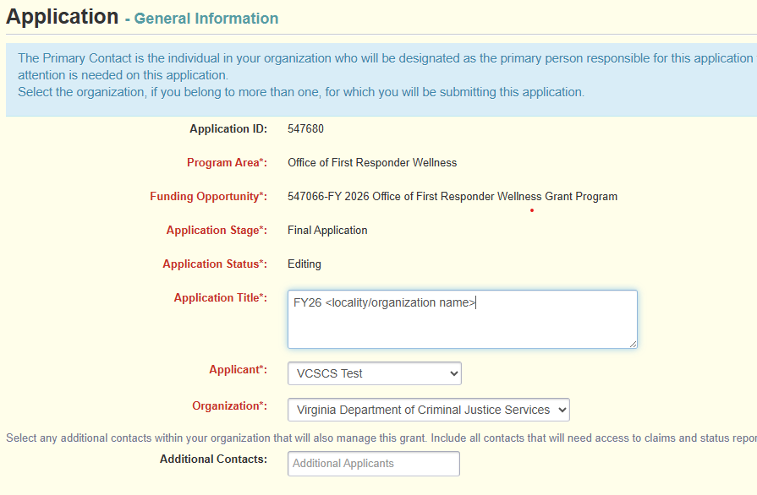
Application Creation Wizard
Application Title: Name your application with your agency or organization name
ex: FY26 <agency name>
Primary Contact: Name your Project Director
Organization: Select your organization
Notes:
After you click, "Start New Application" you will be taken to the Application Creation Wizard.​
​
The wizard will guide you through completing the "General Information" form. You must complete the next three steps before you can save the application.​
​
In the first step, you must enter an application title and a primary contact. The application title should include the fiscal year and localities or organization name.​
​
In the second step, you will select who will be the primary contact for the grant application. The primary contact is the person who has the day-to-day responsibility for managing the grant. It is recommended that the Project Director be listed as the primary contact. A definition for the Project Director can be found in the funding opportunity under the face sheet section).​
​
Once the information is complete, click "Save Form" to move to the next step.

Slide 23
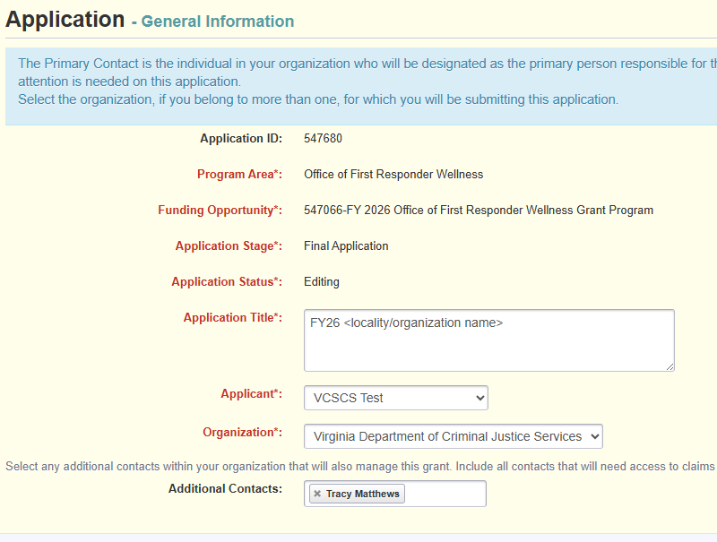
Application Creation Wizard
Additional Contacts: Add people in your organization who need access to the grant. If someone is not listed as an additional contact, they will not be able to see the application or the grant in OGMS.
Notes:
The third step is where you will have the chance to include additional applicants.​
​
At this step, you can select any additional individuals within your organization who will manage the grant and work on the application. This will include the Project Administrator and Finance Officer. You can add additional users after the grant is awarded or at any time while preparing the grant application. ​
​
Once you click "Save Form Information," you will have completed the General Information component of the application. You can now edit the application components in any order and save any sections to return to later. ​
​

Slide 24
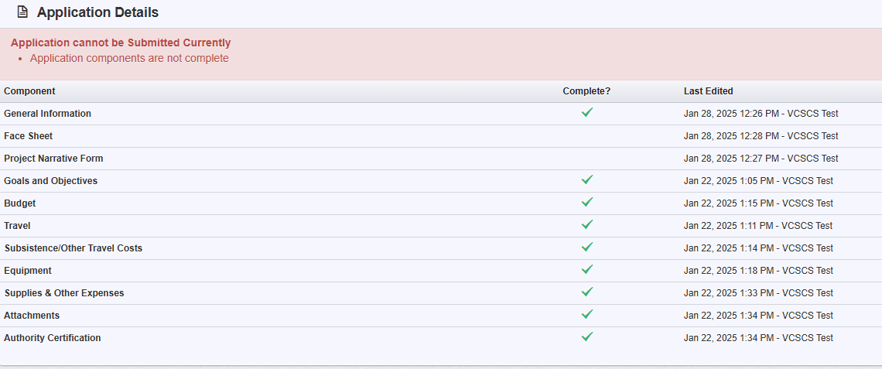
Application Details
A green checkmark in the “Complete” column means that the section is completed. If there is no green checkmark, you must return to the application section, complete the required components to mark the section as complete.
Notes:
After “General Information“ is completed, you will be taken to “Application Details“.
This screen lists all the application components and indicates if they’ve been marked as complete with a green checkmark. If there is not a green checkmark, you need to return to the application section, complete the required components, and mark the section as complete.
On this screen, you can also see who last edited an individual application component. This feature can be helpful if multiple people are working on the same application.
Before you can submit, all sections must be marked as complete. The system will tell you if the application is ready for submission.
Please note that the system cannot tell you if you’ve correctly completed the section, but only that you have completed all required fields.
Before submitting your application, it’s very important to review it and ensure that it meets all the requirements of the funding opportunity.

Slide 25
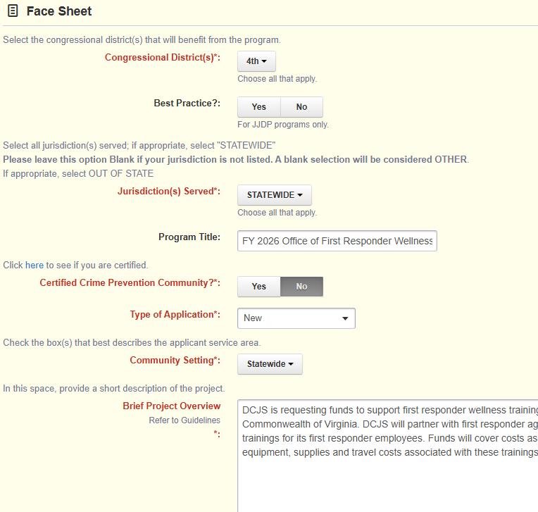
Face Sheet Example
Notes:
Now, that we have completed the general information portion of the application, I’m going to go through each of the application components in the order they appear in the application wizard. Remember you can complete sections in any order, but you will need to save each time, so you don’t lose your edits.​
​
Let's start by completing the “Face Sheet.” The first step of completing this section is choosing the congressional district where your locality or organization resides.​
​
You can skip the “Best Practice” question. This question does not apply to this program​
​
Next, you will indicate your jurisdiction. If your agency or organization serves the whole state, select statewide; otherwise, choose the jurisdiction your agency or organization serves. ​
​
The “Program Title” is not required under this grant program, but it is recommended you provide a Program Title.​
​
For “Certified Crime Prevention Community,” question you will click the hyperlink to see if your locality is certified. If your locality appears on this list, select yes to this question.​
​
For this program, your application will be “New”​
​
Next, indicate the setting of your community: rural, urban or suburban. You can choose more than one if appropriate for your agency or organization.​
​
The “Brief Project Overview” should briefly describe the grant-funded project. This should also include a summary of the activities the agency or organization plans to complete over the course of the grant year. The Brief Project Overview will be provided to the Criminal Justice Services Board as a summary of your proposed project and they will use this overview when making award decisions.​
​

Slide 26
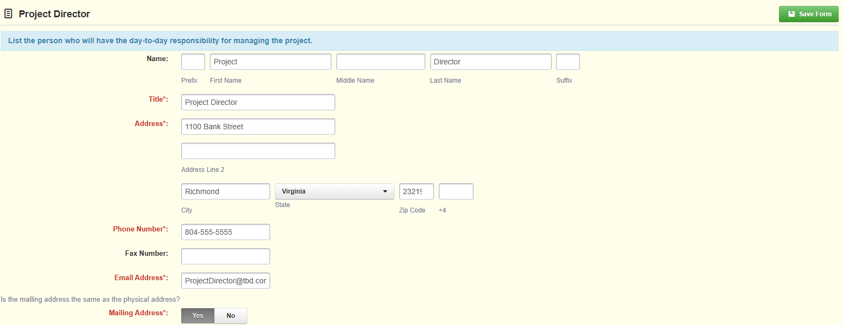
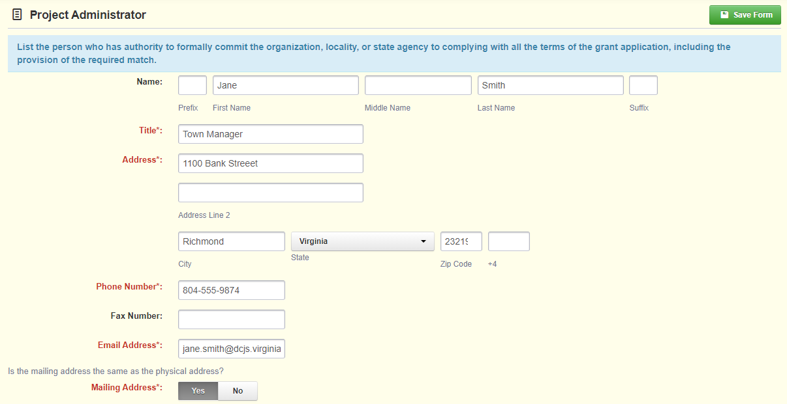
Face Sheet Example
Notes:
Next you will need to enter the Project Director, Project Administrator, and Finance Officer including their contact information. ​
​
The Project Director should be the person who will have the day-to-day responsibility for managing the project. I will contact this person if I have any questions about the grant, such as status reports or activities.​
​
The Project Administrator should be someone who has the authority to formally commit the agency or organization to comply with all terms of the grant applications. If someone has been delegated this authority, you must provide a memo from the Project Administrator giving authority for another individual to sign grant documentation, but that person must be listed as the Project Administrator. If signing authority is given, the memo should be uploaded under "Attachments.“​
​
Lastly, you will enter the Finance Officer’s information. The person listed should be responsible for the fiscal management of grant funds.

Slide 27
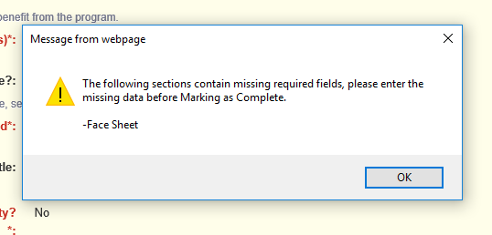
Face Sheet Example
After completing all fields, click the orange “Mark as Complete” button. If a field is not complete, you will receive an error message.
Notes:
Before the form can be marked as complete, all fields in red font must be completed.
If a field is missing, you will get an alert letting you know that a required field is missing, and you will need to go back to the form.
For this section, the separate forms are “Face Sheet“, “Project Director“, “Project Administrator“, and “Finance Officer“.
The alert will direct you to the form but not the missing field.
Now that we have completed the Face Sheet Component of the application we will be moving onto the Project Narrative From​
​

Slide 28
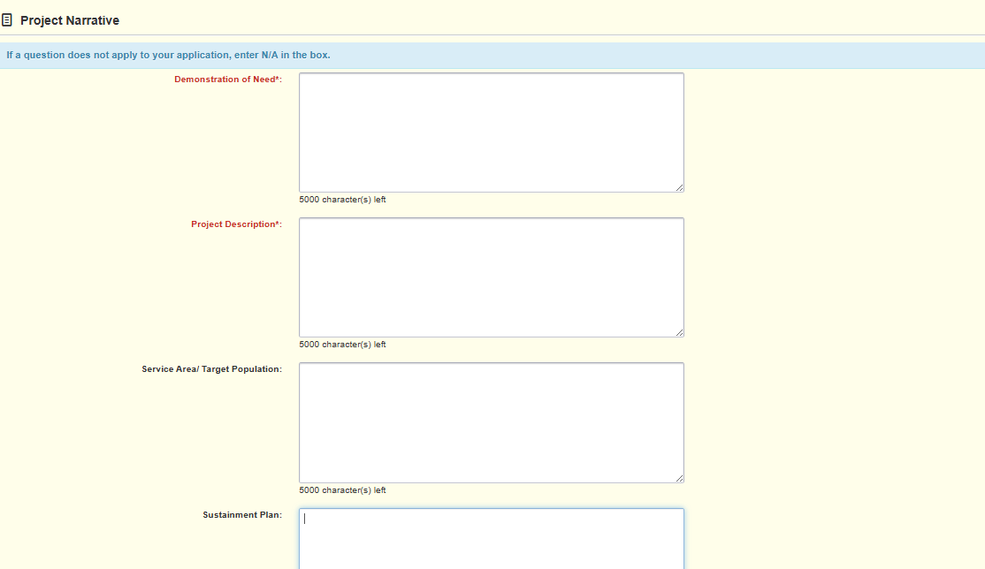
Project Narrative Form
Notes:
All questions in this section are required.
Demonstration of Need
Provide a clear and detailed explanation of the need for wellness-related support and resources within your agency or non-profit organization. Describe the challenges your first responders face with regard to their mental, emotional, and physical well-being and how these challenges impact their performance, safety, and overall wellness.
Describe your existing resources and services that are available to address first responder wellness, and state why those resources and services are not adequate to the needs of your first responders.
Project Description:
Provide a detailed description of the project design and planned implementation activities. Describe how the project will reach the stated goals of this funding opportunity and the capabilities of your organization to implement and manage this project. If you are requesting equipment and/or training expenses, explain how they will be used.
Service Area Demographic/Target Population:
Identify the target population, where the activities will occur, and any key community partners supporting the proposed project.
Sustainment Plan:
Provide a brief description of how your organization intends to support this program after grant funding ends.

Slide 29
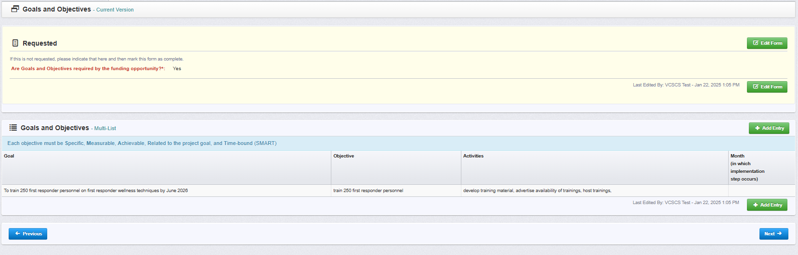
Goals and Objectives
Notes:
Next, we will review how to complete the Goals and Objectives section of the application.​
​
This section is required under this grant program. You should have a goal, activity, and outcome for each objective outlined in the grant application. Responses should be clear and concise, and the goals should be laid out in a SMART Goal format. A smart goal is Specific, Measurable, Achievable, Relevant, and Time-bound. For each goal, you will need to outline the activities that will be performed to accomplish the goal and explain the outcome you hope to achieve with this goal. To complete this section, you will click “Add Entry”, then complete each section component, and then click “Save Row” to add to the Goal to the grant application.

Slide 30
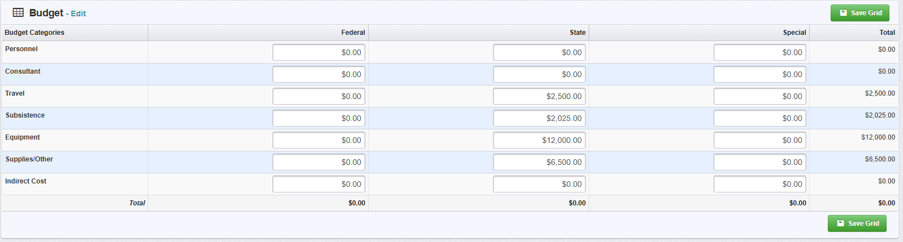
Budget
Enter the requested amount under the “State” column.
Do not enter anything under the “Federal” or “Special” columns.
Notes:
The next component of the application that I will be walking you through in the Budget Form. ​
The Budget form is required.​
​
To complete this form, click "Edit Grid" and enter your requested amount under the "State" column. Do not enter anything under the federal or special columns.​
​
When everything is complete, you click "Save Grid." ​
​
This form must match what you enter on the subsequent budget application forms. The total amounts on this form are given to the Criminal Justice Services Board and used to determine the grant award. Once it has been approved, you cannot request additional funds. I always recommend double-checking your math and making sure your requests throughout the application are accurate.

Slide 31
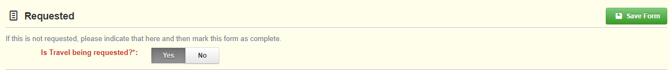
Budget Categories
If requesting funding answer “Yes” at the top of the form.
If not, answer “No”.
Click “Save Form”.
Note: Budget categories include; travel, subsistence/ other travel costs, equipment, supplies/other expenses.
Notes:
This funding opportunity has four budget categories. You can request funds for Travel, Subsistence, Equipment, or Supplies. Please note that personnel, consultant, and indirect cost categories will not be funded through this grant program.​
​
The top of each budget category form will ask you if you are requesting funding for that category. If you are requesting funds within that category, select “Yes.” ​
​
If you are not requesting funding within that category answer “No”. ​
​
You must answer the question before you can mark the form as complete and submit the application. ​
​
At the bottom of each budget form there will be totals based on what was entered in the form. This amount should match what entered on the previous “Budget“ form. If they do not match you will need to edit the previous “Budget” form.

Slide 32
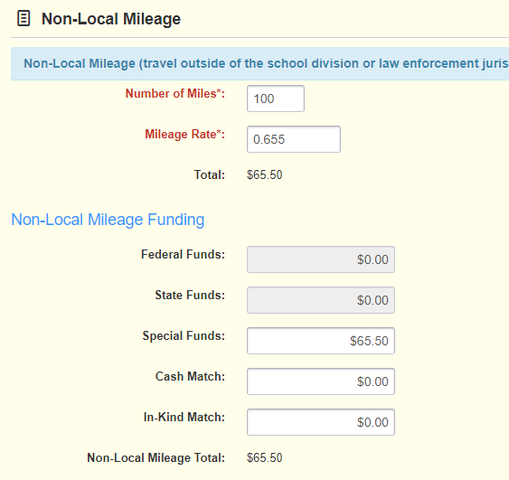
Travel
Follow local or state travel policy.
Travel = Mileage expenses
  Local = travel within the first responder agency's or non-profit organization's jurisdiction
  Non-Local = travel outside of the first responder agency's or non-profit organization’s jurisdiction
Notes:
​
The first budget category in this application is for Travel.​
​
The form is broken into Local Mileage and Non-Local Mileage. Local Mileage is travel within the first responder agencies or non-profit organizations’ jurisdiction, while Non-Local Mileage is travel outside of first responder agencies or non-profit organizations’ jurisdiction. ​
​
To request funding for travel you will need to enter the Number of Miles and the Mileage Rate.​
​
If you do not have an established local travel policy, then you must adhere to the state travel policy when entering the Mileage Rate data. If the local travel policy differs from the state policy, please provide or describe the policy in the justification section in the next section of the application. ​
​

Slide 33
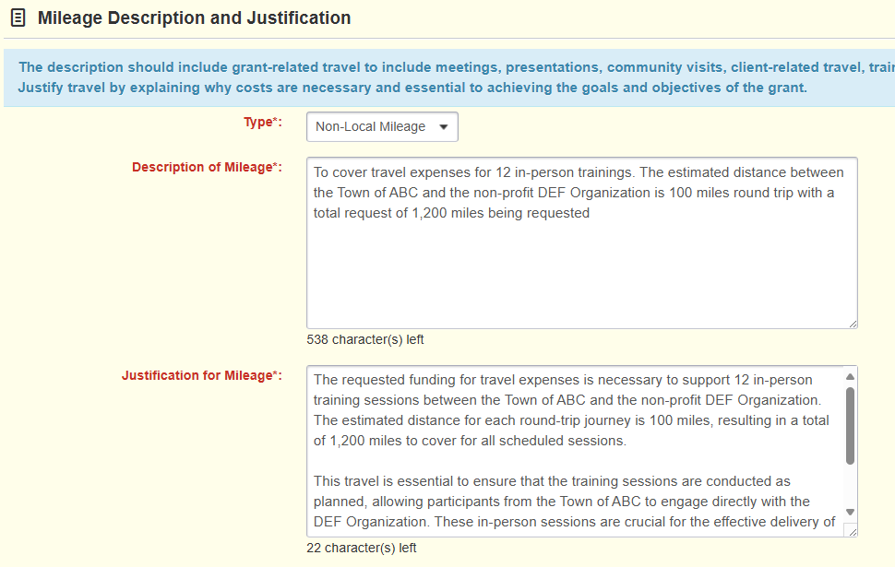
33
Travel
Description of Mileage
  Reason for travel
Justification of Mileage
  Why costs are necessary
  Explain why local travel policy is different from the state policy
Notes:
If you request funding in this category, you must provide a “Description of Mileage“ and “Justification of Mileage.” You should describe the mileage being requested, provide the justification, and explain why the costs are necessary and essential to achieving the grant's goals and objectives. ​
​
You will also describe the local travel policy if it differs from the state travel policy. ​
​

Slide 34
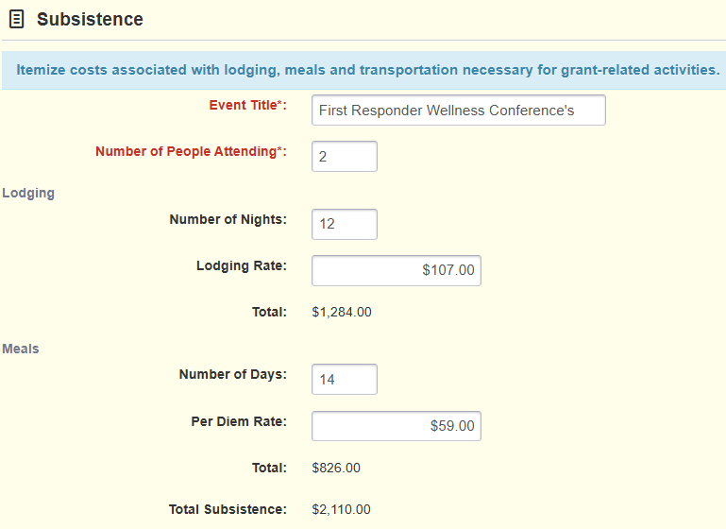
34
34
34
Subsistence = lodging and per diem
  Number of People Attending
  Number of Nights (sum of all people attending)
  Lodging Rate per night
  Number of Days (sum of all people attending)
  Per Diem Rate per day
Other Travel Costs = parking, tolls, etc.
  Airfare is unallowable
Subsistence/
Other Travel Costs
Notes:
The second budget category is where you can request Subsistence and Other Travel Costs ​
​
Lodging, per diem, and other travel costs should be itemized under “Subsistence/Other Travel Costs”. ​
​
When completing this section, you will enter the event’s title and indicate how many staff will be attending. ​
​
For “Number of Nights”, provide the sum of nights for the number of people attending. As an example, if you have two first responders attending a first responder wellness conference that requires 6 nights in a hotel room, when you enter the number of nights, you should type 12 (6 nights x 2 people = 12 nights). Next, enter the lodging rate. Please use local or state travel policies to determine the appropriate lodging rate.​
​
The “Number of Days” is like when you entered the number of nights. You will enter the sum of days for the people attending. Using the same example as above, if the 2 first responders will be traveling for 7 days each, then you will enter 14 days (7 days x 2 people = 14 days). ​
​
All travel expenses, including lodging and per diem rates, should follow the state travel policy unless the locality has its own policy. In that case, explain the local policy under justification.​
​
Moving on to “Other Travel Costs,” this is where you request funding for other travel-related expenses, such as parking and tolls.​
​

Slide 35
35
Subsistence Description and Justification
Description of Costs
Describe the event for which travel is required. Provide location and dates if known.
Justification of Costs
Explain why the event and costs are necessary and essential. If location and dates are unknown, explain how costs were determined.
Notes:
Under the “Description of Costs” you will need to describe the event and provide the location and dates. When completing the “Justification of Costs” you will want to explain why the event and costs are necessary. If the event’s location and dates are unknown, explain how the costs you entered on the form were determined.

Slide 36
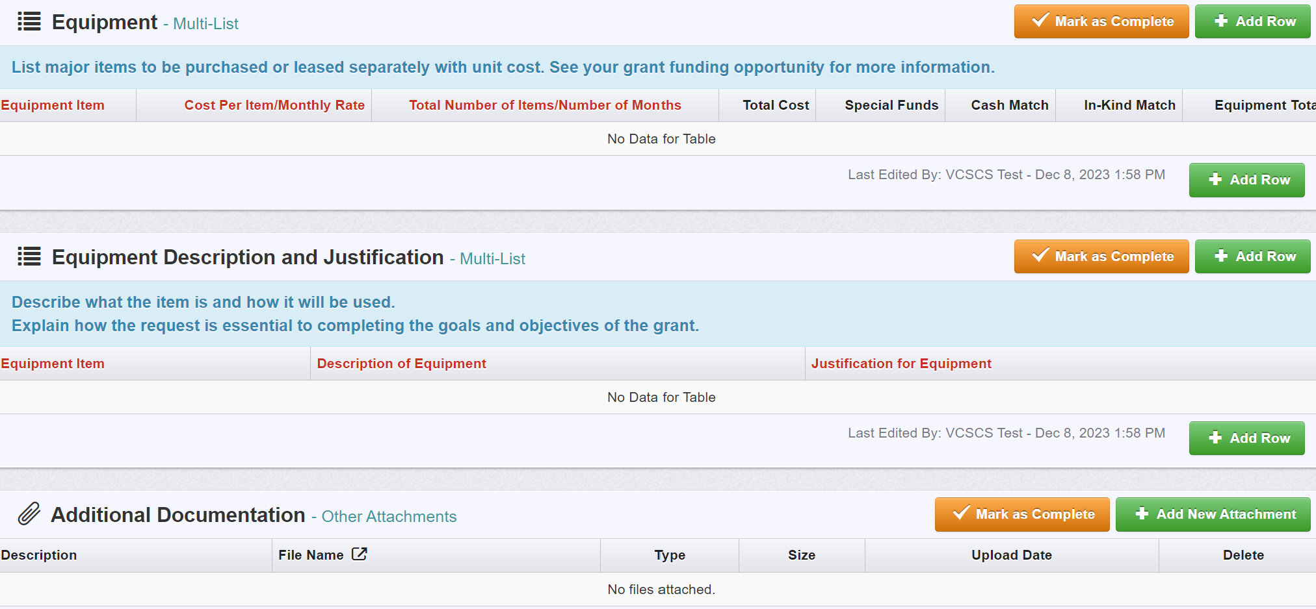
Equipment
Equipment = property with a useful life of more than one year and a per-unit cost of $10,000 or greater.
Track, manage, and dispose of equipment consistent with locality policies.
Notes:
The third budget category is where you can request Equipment​
​
If you are requesting funding under Equipment, you should answer, "Yes" when asked, "Is Equipment being requested?"​
​
There are three sections in this application section to complete; Equipment, Equipment Description and Justification, and Additional Documentation.​
​
Under this funding opportunity, equipment is defined as tangible property with a useful life of more than 1 year and a per-unit cost of $10,000 or greater.​
​
Grant funds cannot support the entire cost of an item not used exclusively for grant project-related activities; however, grant funds can support a pro-rated share of such an item. ​
​
Please note that grant-funded equipment should be tracked, managed, and disposed of in a manner consistent with the locality’s policies. ​
​

Slide 37
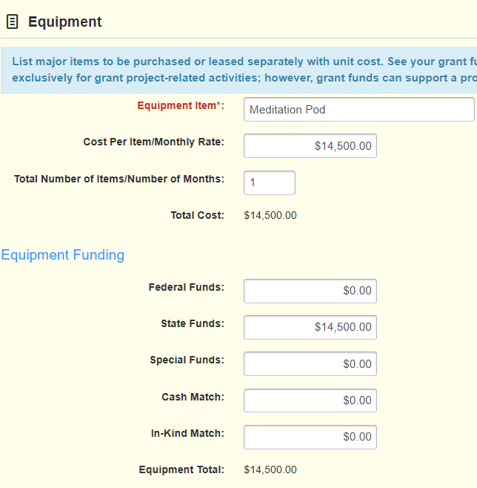
37
37
37
Equipment
Enter equipment item
Cost Per Item
Total Number of Items
Total cost will auto-calculate
Notes:
When completing this section you will First, list the equipment item​
​
Next, provide the "Cost Per Item/Monthly Rate". Enter the unit cost or the monthly rate for the item listed above and then the number of items to be purchased or number of months fund are being requested for. ​
​
The totals will auto-calculate when you save the row.

Slide 38
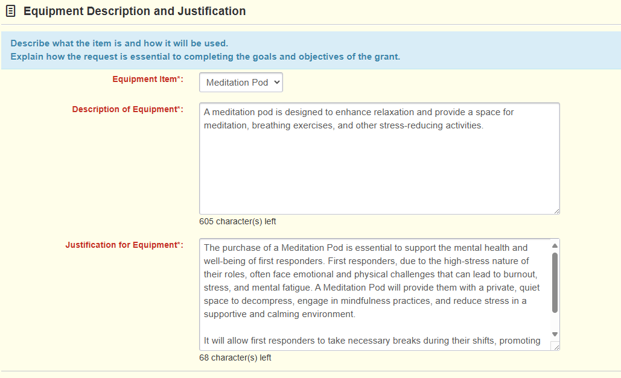
38
38
38
Equipment
Required:
Description: Describe the item and how it will be used.
Justification: Explain why it's necessary and how costs were determined.
Notes:
If you are requesting funding under any category, you must complete the description and justification sections. ​
​
On the equipment form, select the item from the drop-down box and describe the equipment and how it will be used in the grant project. ​
​
The justification should explain why the costs are necessary and essential to the project. Also, describe how costs were determined, especially if an item is being pro-rated. ​
​
The third section within this application component will allow you to attach additional documentation supporting your equipment request.

Slide 39
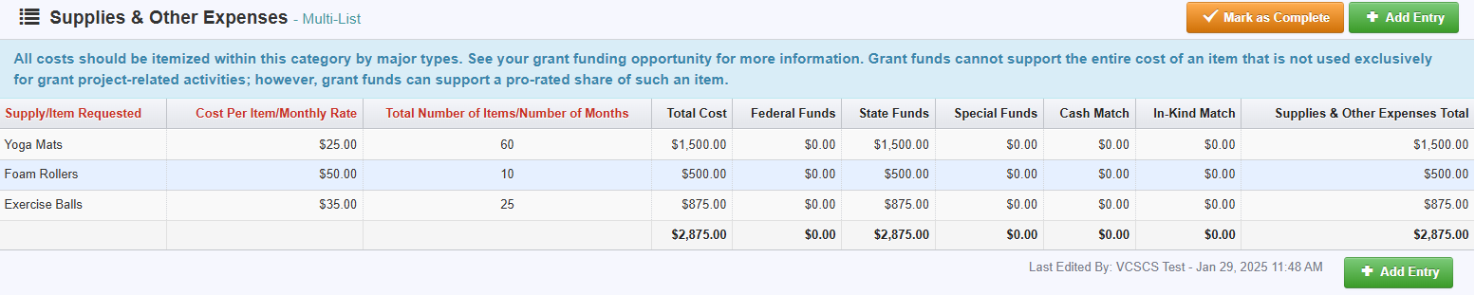
Supplies and Other Expenses
Supplies can include:
  Exercise balls
  Foam rollers
  Yoga mats
  Materials to support first responder wellness trainings
Notes:
The final budget component is where you will request funding for supplies and other expenses.​
​
Supplies can include but are not limited to Exercise Balls, Foam Rollers, Yoga Mats and Materials to support first responder wellness trainings, and any items that do not meet the grant’s equipment definition. ​
​
This form is set up like the equipment form where you enter the item, the cost per item or monthly rate, and the number of items. Also, as with equipment, grant funds cannot support the entire cost of an item not used exclusively for grant project-related activities; however, grant funds can support a pro-rated share of such an item. ​
​

Slide 40
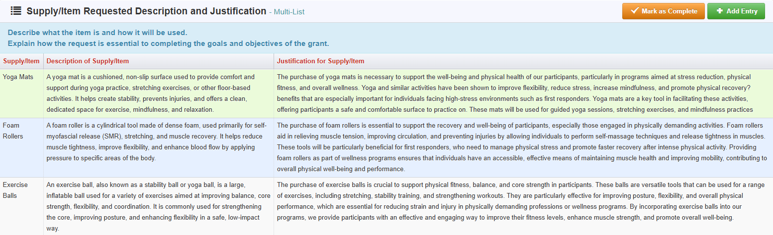
Supplies and Other Expenses
Notes:
Like the Equipment form, you will need to provide a description and justification for all items requested under Supplies & Other Expenses.​
​
The description should clarify what the item is and how it will be used. The justification should explain why the item is essential and how the costs were determined, especially if the item is pro-rated.​
​
Do not assume that the person reviewing the application knows the item. Applications should be written as if the person reviewing the application doesn’t know anything about your field of work.

Slide 41
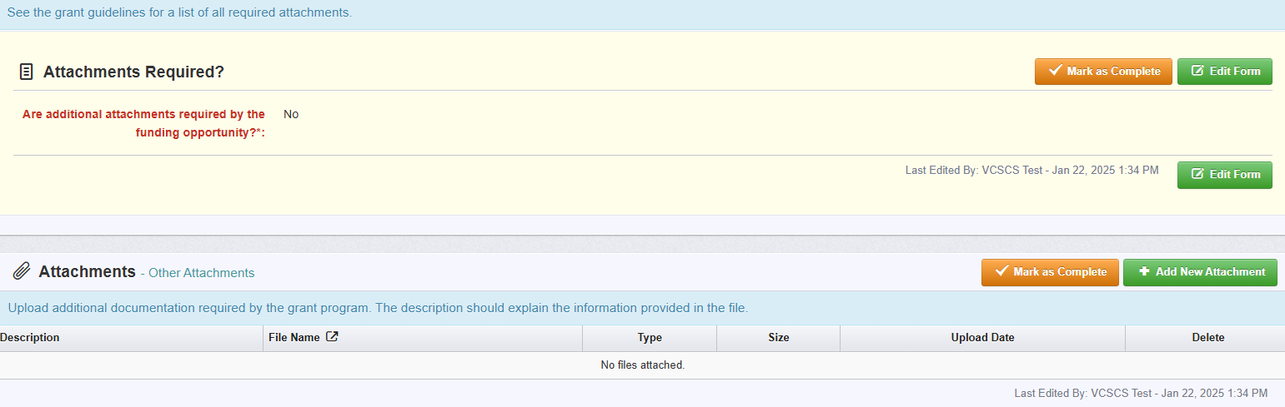
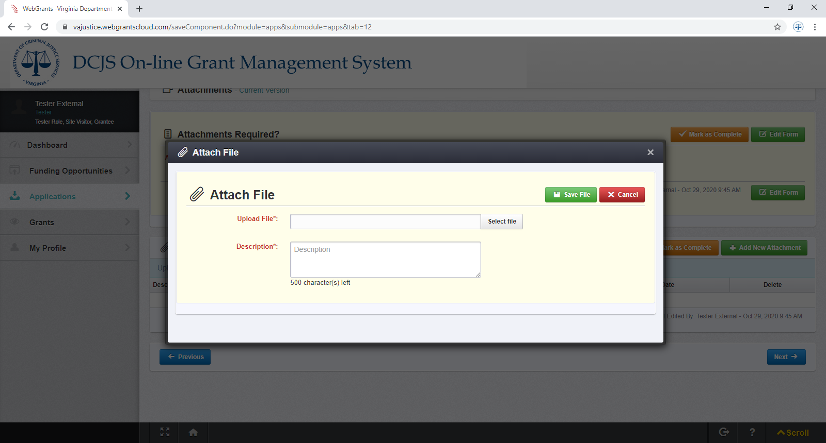
Attachments
Notes:
Next we will discuss the Attachment component of the application​
​
The “Attachments” form is after all the budget itemization forms.​
​
You should answer, "No" when asked, "Are attachments required by the funding opportunity? "unless you are submitting a signing authority letter or non-profit organization documentation.​
​
When adding an attachment, first select "Add New Attachment."​
​
Then, select the file from your computer and indicate what the attachment is in the description.​
​
Then Click "Save File," and when all documents have been uploaded, click "Mark as Complete."​
​

Slide 42
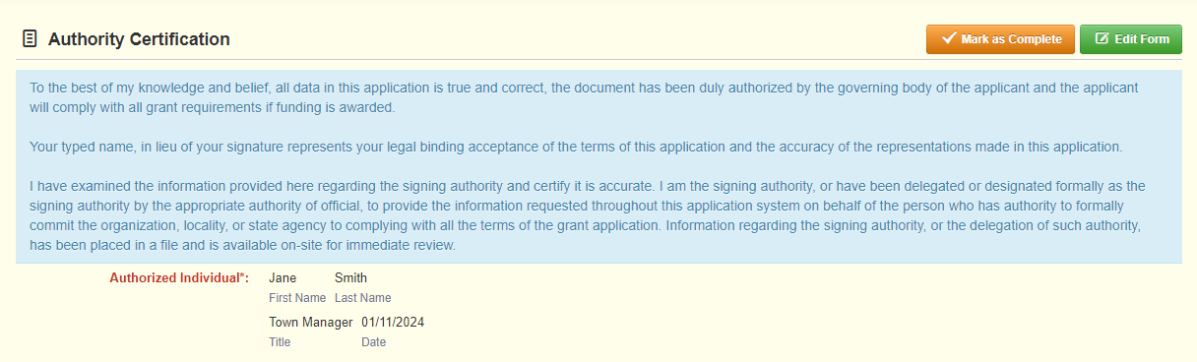
Authority Certification
Signing authority documentation should be uploaded under “Attachments”.
Notes:
The final component of the application is the “Authority Certification”.​
​
This is a required section and says, if the person completing the application is not the Project Administrator, as we defined earlier, information regarding the signing authority, or the delegation of such authority, should be submitted under “Attachments”. ​
​
Any signing authority documentation should be included in the application's attachments section. Just make sure to label it appropriately. ​
​
As stated on the previous slide, if the Project Administrator is not registered in OGMS and a signing authority has not been designated, a signed copy of the authority certification form can be uploaded under “Attachments”.​

Slide 43
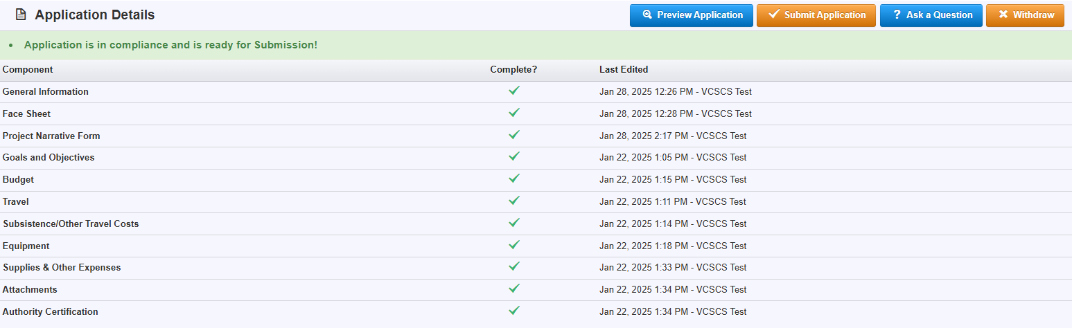
Submitting the Application
Notes:
After you have completed all the application components you will be able to submit the application.​
​
To submit the application, every form must be marked as complete. If you do not see a green check mark in the "Complete?" column, then you need to return to the form and mark it as complete. ​
Once you submit the application, you will not be able to make changes. So, please review the entire application and ensure budgets match, information is correct, and you’ve provided all required items. It’s possible to have more than one person working on an application at one time, so again, make sure everything is accurate. You can review the entire application by clicking "Preview Application."​
When you are ready, click the orange "Submit Application" box.

Slide 44
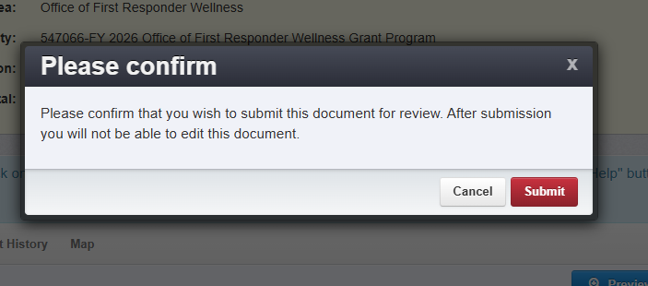
44
44
44
44
Submitting the Application
*Review the entire application*
Ensure budgets match, information is correct, and all required items are provided.
Notes:
After clicking "Submit Application", the system will give you the chance to confirm.
You will receive a pop-up confirmation informing you that once you click, "Submit" the system will no longer let you edit the application.
You can then click on the red "Submit" button, or "Cancel" to return to editing.

Slide 45
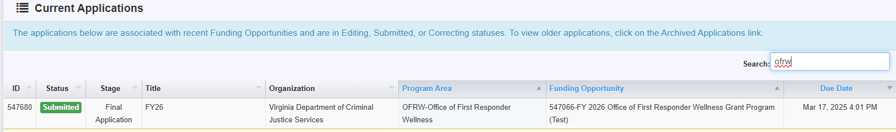
Submitting the Application
Current Applications listing:
Notes:
After clicking "Submit" the system will take you back to your current applications listing and will display your submitted application.
The list will show you the status of the application, which in this case is "submitted."
It will also display the stage, application title, organization name, the program area, and the title of the funding opportunity you applied under.

Slide 46

46
46
46
46
46
Application Review
Grant awards are contingent on the availability of funding
as appropriated by
Executive Order 38.
Grants may be funded in whole or in part, depending on the number of qualifying applications, funding availability, and geographical representation.
Notes:
So, what happens after applications have been submitted?
After the application due date, DCJS staff will review all submitted applications.
Grant awards are contingent on the availability of funding as appropriated by Executive Order 38
Grants may be funded in whole or in part, based on the number of qualifying applications, funding availability, and geographical representation.

Slide 47
Criminal Justice Services Board (CJSB)
Grants Committee reviews:
• Brief project overview
• Staff evaluation summaries
• Grant application scores for competitive applications
Grants Committee makes funding recommendations to the full CJSB
Full CJSB makes final grant award decisions
• Meeting in
May 2025
Notes:
After all applications are reviewed, the Grants Committee of the Criminal Justice Services Board, will review the brief project overviews, summaries of staff evaluations of applications, and grant application scores for competitive applications.
The Grants Committee will then make funding recommendations to the full Criminal Justice Services Board, who will make the final grant award decisions at its meeting in May 2025. Funding decisions made by the CJSB are final and may not be appealed.

Slide 48
Summary
Applications are due
by 5:00 p.m. on
March 17, 2025.
The application must be submitted in OGMS.
Anyone in the organization working
on the grant should register in OGMS.
Grant requirements and instructions under “Funding Opportunity”
in OGMS and on the DCJS website.
Applicants can request up to $30,000 per application.
Notes:
So, to briefly recap, applications are due by 5:00 p.m. on March 17th, 2025. The system will not let you submit after the deadline and, therefore it will not be considered.​
​
All applicants must submit their application using the Online Grants Management System (OGMS).​
​
Anyone in your organization that will be working on the grant application should register in the system. This includes Project Directors, Project Administrators, and Finance Officers. ​
​
Grant requirements and instructions can be found under Funding Opportunities in OGMS and on our DCJS website. Please read them carefully to avoid errors when completing the application.​
​
Funding requests may not exceed $30,000.

Slide 49
Technical Assistance
Contact the following DCJS staff for questions regarding your grant application:
  Phyllis Vaughan: Phyllis.Vaughan@dcjs.virginia.gov or (804) 340-9754
  Tracy Matthews: Tracy.Matthews@dcjs.virginia.gov or (804) 371-0635
For specific questions regarding first responder wellness training, equipment, supplies or programming, and/or first responder wellness roles and responsibilities, please contact:
  Ronald Coombs: Ronald.Coombs@dcjs.virginia.gov or (804) 845-0505
For assistance with the OGMS system, email:
OGMSsupport@dcjs.virginia.gov
(This should not include grant application-specific questions.)
For additional resources, refer to “Attachments” and “Website Links” under the Funding Opportunity in OGMS.
Notes:
For technical assistance, please contact me or Mr. Tracy Matthews with any questions about the grant requirements and instructions. ​
​
However, for specific questions regarding first responder wellness training, equipment, supplies, or programming, and/or first responder wellness roles and responsibilities, please contact Ronald Combs.​
​
If you have issues with the system, and it’s not specific to the grant application, email the OGMS Support mailbox at ogmssupport@dcjs.virginia.gov. Please include the grant program in the subject line. ​
​
You can also refer to the funding opportunity which is located on our website as well as on OGMS and there are additional resources in the Website Links under the funding opportunity in the system.

